Slide 1

A Super Christmas
A Super Christmas
A Super Christmas

Slide 2


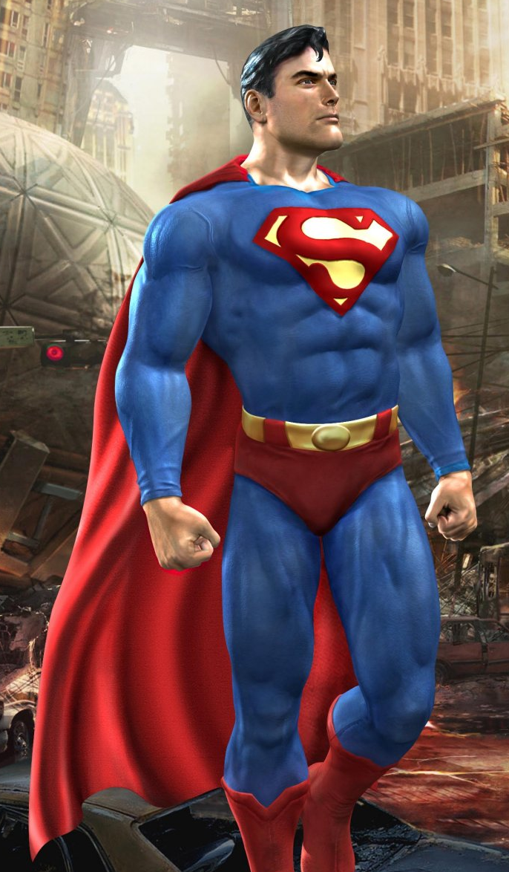
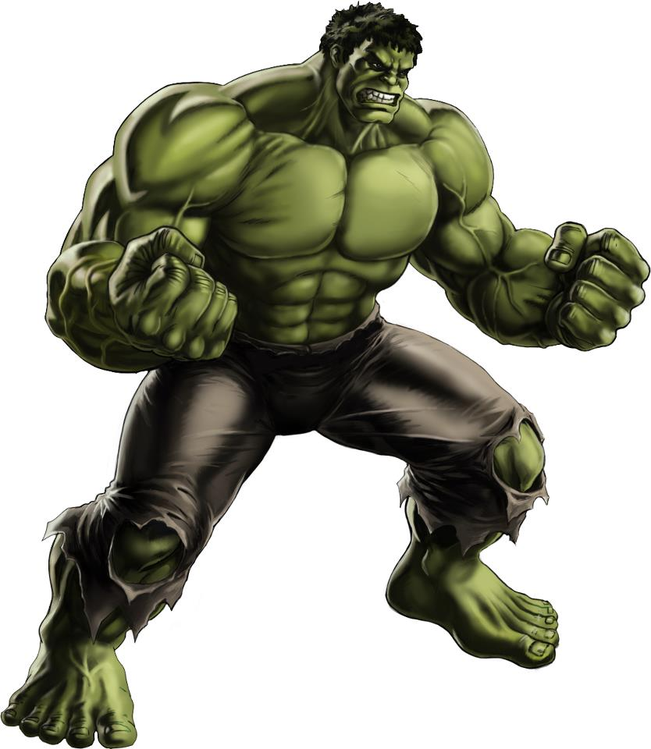
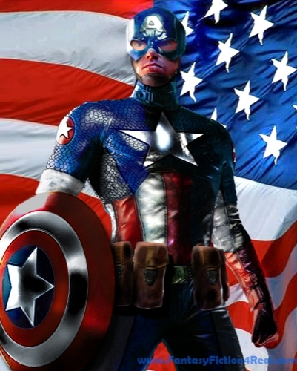

Slide 3
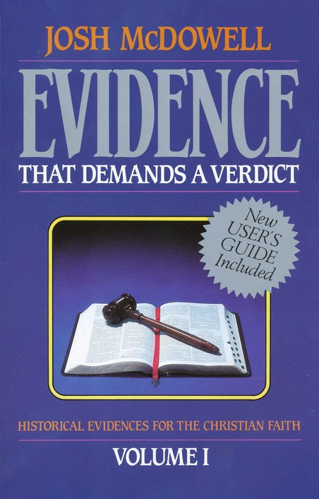

Slide 4
Born of a Virgin
"Therefore the Lord Himself will give you a sign: Behold, a virgin will be with child and bear a son, and she will call His name Immanuel." Isaiah 7:14
  700 years BC

Slide 5
Location of Birth
"But as for you, Bethlehem Ephrathah, Too little to be among the clans of Judah, From you One will go forth for Me to be ruler in Israel. His goings forth are from long ago, From the days of eternity." Micah 5:2
  735 – 700 BC

Slide 6
Ancestry
Tribe of Judah
  "The scepter shall not depart from Judah, Nor the ruler's staff from between his feet, Until Shiloh comes, And to him shall be the obedience of the peoples."
  Genesis 49:10
Line of Jesse
  "Then a shoot will spring from the stem of Jesse, And a branch from his roots will bear fruit."
  Isaiah 11:1
House of David
  'Behold, the days are coming,' declares the Lord, 'When I shall raise up for David a righteous Branch; And He will reign as king and act wisely And do justice and righteousness in the land.'" Jeremiah 23:5

Slide 7
Gifts
"Let the kings of Tarshish and of the islands bring presents; The kings of Sheba and Seba offer gifts." Psalms 72:10
  1000 years BC

Slide 8
Born of a Virgin
" . . . She was found to be with child by the Holy Spirit and Joseph . . . kept her a virgin until she gave birth to a Son; and he called His name Jesus." Matthew 1:18,24,25

Slide 9
Location of Birth
Jesus was born in Bethlehem of Judea " Matthew 2:1

Slide 10
Ancestry
The book of the genealogy of Jesus Christ, the Son of David, the Son of Abraham: ² Abraham begot Isaac, Isaac begot Jacob, and Jacob begot Judah and his brothers. ³ Judah begot Perez and Zerah by Tamar, Perez begot Hezron, and Hezron begot Ram. ⁴ Ram begot Amminadab, Amminadab begot Nahshon, and Nahshon begot Salmon. ⁵ Salmon begot Boaz by Rahab, Boaz begot Obed by Ruth, Obed begot Jesse, ⁶ and Jesse begot David the king. David the king begot Solomon by her who had been the wife of Uriah. ⁷ Solomon begot Rehoboam, Rehoboam begot Abijah, and Abijah begot Asa. ⁸ Asa begot Jehoshaphat, Jehoshaphat begot Joram, and Joram begot Uzziah. ⁹ Uzziah begot Jotham, Jotham begot Ahaz, and Ahaz begot Hezekiah. ¹⁰ Hezekiah begot Manasseh, Manasseh begot Amon, and Amon begot Josiah. ¹¹ Josiah begot Jeconiah and his brothers about the time they were carried away to Babylon. ¹² And after they were brought to Babylon, Jeconiah begot Shealtiel, and Shealtiel begot Zerubbabel. ¹³ Zerubbabel begot Abiud, Abiud begot Eliakim, and Eliakim begot Azor. ¹⁴ Azor begot Zadok, Zadok begot Achim, and Achim begot Eliud. ¹⁵ Eliud begot Eleazar, Eleazar begot Matthan, and Matthan begot Jacob. ¹⁶ And Jacob begot Joseph the husband of Mary, of whom was born Jesus who is called Christ. ¹⁷ So all the generations from Abraham to David are fourteen generations, from David until the captivity in Babylon are fourteen generations, and from the captivity in Babylon until the Christ are fourteen generations.

Slide 11
Gifts
Magi from the east arrived in Jerusalem... and they fell down and worshiped Him; and opening their treasures they presented to Him gifts... ." Matthew 2:1,11

Slide 12

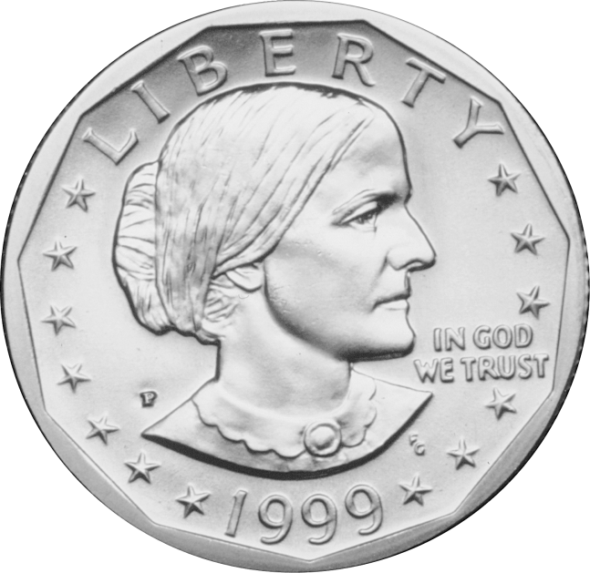
Coincidence?
8 Prophecies
  1 in 10¹⁷
  1 in 100,000,000,000,000,000

Slide 13
Coincidence?
48 Prophecies
  1 in 10¹⁵⁷
  = 1 in 10,000,000,000,000,000,000,000,000,000,000,000,000,000,000,000,000,000,000,000,000,000,000,000,000,000,000,000,000,000,000,000,000,000,000,000,000,000,000,000,000,000,000,000,000,000,000,000,000,000,000,000,000

Slide 14
Coincidence?
456 Prophecies?

Slide 15
Arranged?
456 Prophecies?

Slide 16
The Mission
10 For the Son of Man came to seek and to save the lost.
Luke 19:10 ESV
  23 for all have sinned and fall short of the glory of God
  Romans 3:23 ESV
  ²³ For the wages of sin is death…
  Romans 6:23a
  8 but God shows his love for us in that while we were still sinners, Christ died for us.
  Romans 5:8 ESV
  ¹⁶ For God so loved the world that he gave his only Son, that whoever believes in him should not perish but have eternal life. John 3:16 ESV

Slide 17
The Gift
  ²³ For the wages of sin is death, but the gift of God is eternal life in Christ Jesus our Lord.
  Romans 6:23
¹⁸ Therefore, as through one man’s offense judgment came to all men, resulting in condemnation, even so through one Man’s righteous act the free gift came to all men, resulting in justification of life. ¹⁹ For as by one man’s disobedience many were made sinners, so also by one Man’s obedience many will be made righteous.
Romans 5:18-19

