Slide 1


Slide 2
So as your fellow elder and a witness of Christ’s sufferings and as one who shares in the glory that will be revealed, I urge the elders among you: ² Give a shepherd’s care to God’s flock among you, exercising oversight not merely as a duty but willingly under God’s direction, not for shameful profit but eagerly. ³ And do not lord it over those entrusted to you, but be examples to the flock.⁴ Then when the Chief Shepherd appears, you will receive the crown of glory that never fades away.
1 Peter 5:1-4 NET

Slide 3
  ¹⁶ Every scripture is inspired by God and useful for teaching, for reproof, for correction, and for training in righteousness, ¹⁷ that the person dedicated to God may be capable and equipped for every good work.
  2 Timothy 3:16-17 NET

Slide 4
¹⁵ When they had finished breakfast, Jesus said to Simon Peter, “Simon, son of John, do you love me more than these?” He said to him, “Yes, Lord; you know that I love you.” He said to him, “Feed my lambs.” ¹⁶ He said to him a second time, “Simon, son of John, do you love me?” He said to him, “Yes, Lord; you know that I love you.” He said to him, “Tend my sheep.” ¹⁷ He said to him the third time, “Simon, son of John, do you love me?” Peter was grieved because he said to him the third time, “Do you love me?” and he said to him, “Lord, you know everything; you know that I love you.” Jesus said to him, “Feed my sheep.
John 21:15-17 ESV

Slide 5
²⁸ Watch out for yourselves and for all the flock of which the Holy Spirit has made you overseers, to shepherd the church of God that he obtained with the blood of his own Son.
Acts 20:28 ESV

Slide 6
So as your fellow elder and a witness of Christ’s sufferings and as one who shares in the glory that will be revealed, I urge the elders among you: ² Give a shepherd’s care to God’s flock among you, exercising oversight not merely as a duty but willingly under God’s direction, not for shameful profit but eagerly. ³ And do not lord it over those entrusted to you, but be examples to the flock.⁴ Then when the Chief Shepherd appears, you will receive the crown of glory that never fades away.
1 Peter 5:1-4 NET

Slide 7
²¹ For you have been called for this purpose, since Christ also suffered for you, leaving you an example for you to follow in His steps
1 Peter 2:21 NASB

Slide 8
¹⁵ For we do not have a high priest who is unable to sympathize with our weaknesses, but one who in every respect has been tempted as we are, yet without sin.
Hebrews 4:15 ESV

Slide 9
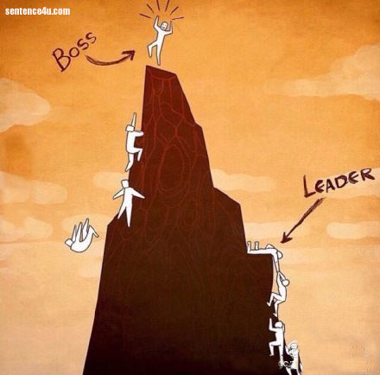
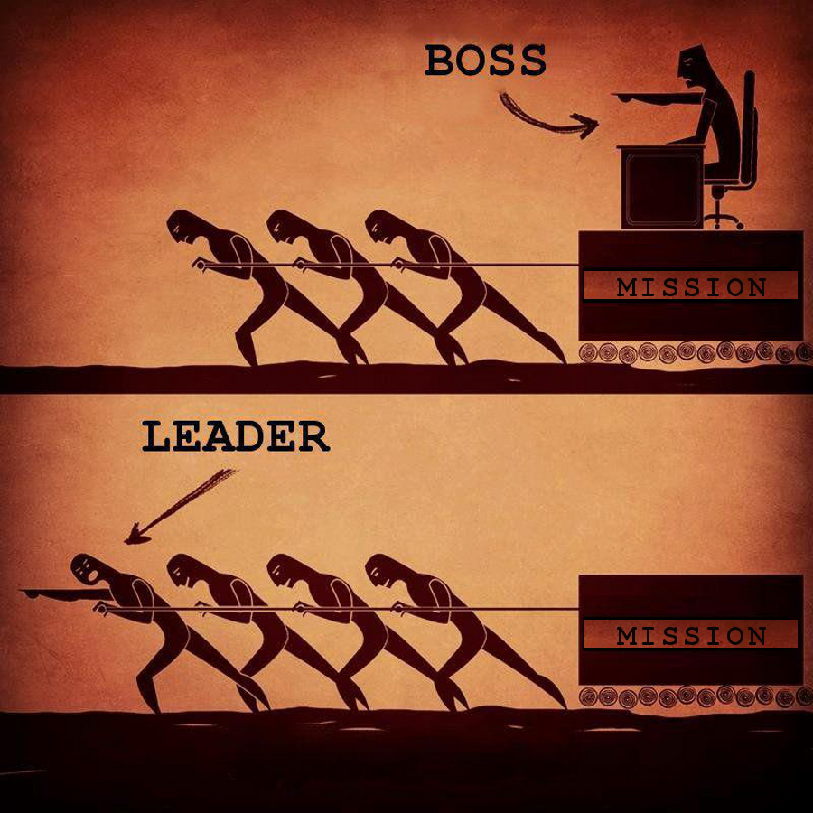

Slide 10
So as your fellow elder and a witness of Christ’s sufferings and as one who shares in the glory that will be revealed, I urge the elders among you: ² Give a shepherd’s care to God’s flock among you, exercising oversight not merely as a duty but willingly under God’s direction, not for shameful profit but eagerly. ³ And do not lord it over those entrusted to you, but be examples to the flock.⁴ Then when the Chief Shepherd appears, you will receive the crown of glory that never fades away.
1 Peter 5:1-4 NET

Slide 11
So as your fellow elder and a witness of Christ’s sufferings and as one who shares in the glory that will be revealed, I urge the elders among you: ² Give a shepherd’s care to God’s flock among you, exercising oversight not merely as a duty but willingly under God’s direction, not for shameful profit but eagerly. ³ And do not lord it over those entrusted to you, but be examples to the flock.⁴ Then when the Chief Shepherd appears, you will receive the crown of glory that never fades away.
1 Peter 5:1-4 NET

Slide 12
¹⁵ Then the seventh angel blew his trumpet, and there were loud voices in heaven, saying, “The kingdom of the world has become the kingdom of our Lord and of his Christ, and he shall reign forever and ever.”
Revelation 11:15 ESV

Slide 13
²⁵ For you were continually straying like sheep, but now you have returned to the Shepherd and Guardian of your souls.
1 Peter 2:25 NASB

