Slide 1


Slide 2
¹⁰ And after you have suffered a little while, the God of all grace, who has called you to his eternal glory in Christ, will himself restore, confirm, strengthen, and establish you. ¹¹ To him be the dominion forever and ever. Amen. ¹² By Silvanus, a faithful brother as I regard him, I have written briefly to you, exhorting and declaring that this is the true grace of God. Stand firm in it. ¹³ She who is at Babylon, who is likewise chosen, sends you greetings, and so does Mark, my son. ¹⁴ Greet one another with the kiss of love. Peace to all of you who are in Christ.
1 Peter 5:10 – 14 ESV

Slide 3
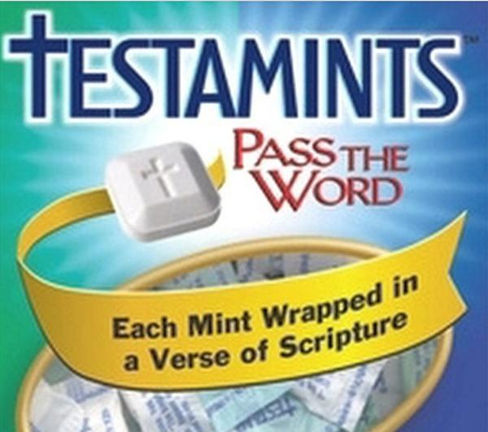

Slide 4
¹⁰ And after you have suffered a little while, the God of all grace, who has called you to his eternal glory in Christ, will himself restore, confirm, strengthen, and establish you. ¹¹ To him be the dominion forever and ever. Amen. ¹² By Silvanus, a faithful brother as I regard him, I have written briefly to you, exhorting and declaring that this is the true grace of God. Stand firm in it. ¹³ She who is at Babylon, who is likewise chosen, sends you greetings, and so does Mark, my son. ¹⁴ Greet one another with the kiss of love. Peace to all of you who are in Christ.
1 Peter 5:10 – 14 ESV

Slide 5
  May grace and peace be multiplied to you.
  1 Peter 1:2b ESV

Slide 6
¹⁰ And after you have suffered a little while, the God of all grace, who has called you to his eternal glory in Christ, will himself restore, confirm, strengthen, and establish you. ¹¹ To him be the dominion forever and ever. Amen. ¹² By Silvanus, a faithful brother as I regard him, I have written briefly to you, exhorting and declaring that this is the true grace of God. Stand firm in it. ¹³ She who is at Babylon, who is likewise chosen, sends you greetings, and so does Mark, my son. ¹⁴ Greet one another with the kiss of love. Peace to all of you who are in Christ.
1 Peter 5:10 – 14 ESV

Slide 7
¹⁰ And after you have suffered a little while, the God of all grace, who has called you to his eternal glory in Christ, will himself restore, confirm, strengthen, and establish you. ¹¹ To him be the dominion forever and ever. Amen. ¹² By Silvanus, a faithful brother as I regard him, I have written briefly to you, exhorting and declaring that this is the true grace of God. Stand firm in it. ¹³ She who is at Babylon, who is likewise chosen, sends you greetings, and so does Mark, my son. ¹⁴ Greet one another with the kiss of love. Peace to all of you who are in Christ.
1 Peter 5:10 – 14 ESV

Slide 8
¹⁰ And after you have suffered a little while, the God of all grace, who has called you to his eternal glory in Christ, will himself restore, confirm, strengthen, and establish you. ¹¹ To him be the dominion forever and ever. Amen. ¹² By Silvanus, a faithful brother as I regard him, I have written briefly to you, exhorting and declaring that this is the true grace of God. Stand firm in it. ¹³ She who is at Babylon, who is likewise chosen, sends you greetings, and so does Mark, my son. ¹⁴ Greet one another with the kiss of love. Peace to all of you who are in Christ.
1 Peter 5:10 – 14 ESV

Slide 9
Acts 9:16 ESV - ¹⁶ For I will show him how much he must suffer for the sake of my name.
John 16:33 ESV - ³³ I have said these things to you, that in me you may have peace. In the world you will have tribulation. But take heart; I have overcome the world.”
1 Peter 2:20b – 21 ESV - But if when you do good and suffer for it you endure, this is a gracious thing in the sight of God. ²¹ For to this you have been called, because Christ also suffered for you, leaving you an example, so that you might follow in his steps.

Slide 10
¹⁰ And after you have suffered a little while, the God of all grace, who has called you to his eternal glory in Christ, will himself restore, confirm, strengthen, and establish you. ¹¹ To him be the dominion forever and ever. Amen. ¹² By Silvanus, a faithful brother as I regard him, I have written briefly to you, exhorting and declaring that this is the true grace of God. Stand firm in it. ¹³ She who is at Babylon, who is likewise chosen, sends you greetings, and so does Mark, my son. ¹⁴ Greet one another with the kiss of love. Peace to all of you who are in Christ.
1 Peter 5:10 – 14 ESV

Slide 11
⁹ But he said to me, “My grace is sufficient for you, for my power is made perfect in weakness.” Therefore I will boast all the more gladly of my weaknesses, so that the power of Christ may rest upon me. ¹⁰ For the sake of Christ, then, I am content with weaknesses, insults, hardships, persecutions, and calamities. For when I am weak, then I am strong.
2 Corinthians 12:9-11 ESV

Slide 12
  The heart is deceitful above all things, and desperately sick; who can understand it?
  Jeremiah 17:9 ESV

