Slide 1


Slide 2
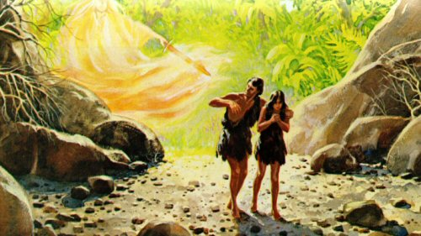

Slide 3
³ Blessed be the God and Father of our Lord Jesus Christ! According to his great mercy, he has caused us to be born again to a living hope through the resurrection of Jesus Christ from the dead, ⁴ to an inheritance that is imperishable, undefiled, and unfading, kept in heaven for you, ⁵ who by God's power are being guarded through faith for a salvation ready to be revealed in the last time. ⁶ In this you rejoice, though now for a little while, if necessary, you have been grieved by various trials, ⁷ so that the tested genuineness of your faith—more precious than gold that perishes though it is tested by fire—may be found to result in praise and glory and honor at the revelation of Jesus Christ. ⁸ Though you have not seen him, you love him. Though you do not now see him, you believe in him and rejoice with joy that is inexpressible and filled with glory, ⁹ obtaining the outcome of your faith, the salvation of your souls.
1 Peter 1:3-9 ESV

Slide 4
¹ Peter, an apostle of Jesus Christ, To those who are elect exiles of the Dispersion in Pontus, Galatia, Cappadocia, Asia, and Bithynia, ² according to the foreknowledge of God the Father, in the sanctification of the Spirit, for obedience to Jesus Christ and for sprinkling with his blood: May grace and peace be multiplied to you.
1 Peter 1:1-2 ESV

Slide 5
³ Blessed be the God and Father of our Lord Jesus Christ!
may be found to result in praise and glory and honor at the revelation of Jesus Christ.
and rejoice with joy that is inexpressible and filled with glory

Slide 6
³ Blessed be the God and Father of our Lord Jesus Christ! According to his great mercy, he has caused us to be born again to a living hope through the resurrection of Jesus Christ from the dead, ⁴ to an inheritance that is imperishable, undefiled, and unfading, kept in heaven for you, ⁵ who by God's power are being guarded through faith for a salvation ready to be revealed in the last time. ⁶ In this you rejoice, though now for a little while, if necessary, you have been grieved by various trials, ⁷ so that the tested genuineness of your faith—more precious than gold that perishes though it is tested by fire—may be found to result in praise and glory and honor at the revelation of Jesus Christ. ⁸ Though you have not seen him, you love him. Though you do not now see him, you believe in him and rejoice with joy that is inexpressible and filled with glory, ⁹ obtaining the outcome of your faith, the salvation of your souls.
1 Peter 1:3-9 ESV

Slide 7
³ Blessed be the God and Father of our Lord Jesus Christ! According to his great mercy, he has caused us to be born again to a living hope through the resurrection of Jesus Christ from the dead, ⁴ to an inheritance that is imperishable, undefiled, and unfading
1 Peter 1:3-4 ESV

Slide 8
⁸ Though you have not seen him, you love him. Though you do not now see him, you believe in him and rejoice with joy that is inexpressible and filled with glory, ⁹ obtaining the outcome of your faith, the salvation of your souls.
1 Peter 1:8-9 ESV

Slide 9
Now faith is confidence in what we hope for and assurance about what we do not see.
Hebrews 11:1 NIV

Slide 10
⁴ to an inheritance that is imperishable, undefiled, and unfading, kept in heaven for you, ⁵ who by God's power are being guarded through faith for a salvation ready to be revealed in the last time.
1 Peter 1:4-5 ESV

Slide 11
⁶ In this you rejoice, though now for a little while, if necessary, you have been grieved by various trials, ⁷ so that the tested genuineness of your faith—more precious than gold that perishes though it is tested by fire—may be found to result in praise and glory and honor at the revelation of Jesus Christ.
1 Peter 1:6-7 ESV

Slide 12
