Slide 1


Slide 2
¹³ Therefore, preparing your minds for action, and being sober-minded, set your hope fully on the grace that will be brought to you at the revelation of Jesus Christ.
1 Peter 1:13 ESV

Slide 3
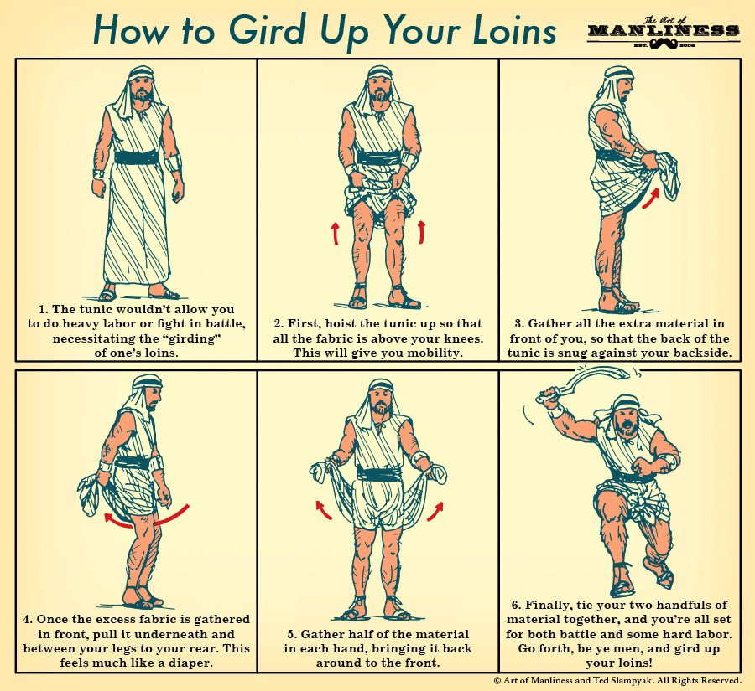

Slide 4
¹³ Therefore, preparing your minds for action, and being sober-minded, set your hope fully on the grace that will be brought to you at the revelation of Jesus Christ.
1 Peter 1:13 ESV

Slide 5
¹⁷ So when God desired to show more convincingly to the heirs of the promise the unchangeable character of his purpose, he guaranteed it with an oath, ¹⁸ so that by two unchangeable things, in which it is impossible for God to lie, we who have fled for refuge might have strong encouragement to hold fast to the hope set before us. ¹⁹ We have this as a sure and steadfast anchor of the soul, a hope that enters into the inner place behind the curtain
Hebrews 6:17-19 ESV

