Slide 1


Slide 2
“We do not study the Bible just to get to know the Bible. We study the Bible that we might get to know God better. Too many earnest Bible students are content with outlines and explanations, and do not really get to know God. It is good to know the Word of God, but this should help us better know the God of the Word.”
Warren Wiersbe

Slide 3
  ¹⁷ And if you call on him as Father who judges impartially according to each one's deeds, conduct yourselves with fear throughout the time of your exile,¹⁸ knowing that you were ransomed from the futile ways inherited from your forefathers, not with perishable things such as silver or gold, ¹⁹ but with the precious blood of Christ, like that of a lamb without blemish or spot. ²⁰ He was foreknown before the foundation of the world but was made manifest in the last times for the sake of you ²¹ who through him are believers in God, who raised him from the dead and gave him glory, so that your faith and hope are in God.
  1 Peter 1:17-21 ESV

Slide 4
  ¹⁷ And if you call on him as Father who judges impartially according to each one's deeds, conduct yourselves with fear throughout the time of your exile,¹⁸ knowing that you were ransomed from the futile ways inherited from your forefathers, not with perishable things such as silver or gold, ¹⁹ but with the precious blood of Christ, like that of a lamb without blemish or spot. ²⁰ He was foreknown before the foundation of the world but was made manifest in the last times for the sake of you ²¹ who through him are believers in God, who raised him from the dead and gave him glory, so that your faith and hope are in God.
  1 Peter 1:17-21 ESV

Slide 5
  The fear of the Lord is the beginning of wisdom; all those who practice it have a good understanding
  Psalms 111:10 ESV

Slide 6
  ¹⁷ And if you call on him as Father who judges impartially according to each one's deeds, conduct yourselves with fear throughout the time of your exile,¹⁸ knowing that you were ransomed from the futile ways inherited from your forefathers, not with perishable things such as silver or gold, ¹⁹ but with the precious blood of Christ, like that of a lamb without blemish or spot. ²⁰ He was foreknown before the foundation of the world but was made manifest in the last times for the sake of you ²¹ who through him are believers in God, who raised him from the dead and gave him glory, so that your faith and hope are in God.
  1 Peter 1:17-21 ESV

Slide 7
  ⁵ And have you forgotten the exhortation that addresses you as sons? “My son, do not regard lightly the discipline of the Lord, nor be weary when reproved by him. ⁶ For the Lord disciplines the one he loves, and chastises every son whom he receives.” ⁷ It is for discipline that you have to endure. God is treating you as sons. For what son is there whom his father does not discipline? ⁸ If you are left without discipline, in which all have participated, then you are illegitimate children and not sons.
  Hebrews 12:5-8 ESV

Slide 8


Slide 9
  ¹⁷ And if you call on him as Father who judges impartially according to each one's deeds, conduct yourselves with fear throughout the time of your exile,¹⁸ knowing that you were ransomed from the futile ways inherited from your forefathers, not with perishable things such as silver or gold, ¹⁹ but with the precious blood of Christ, like that of a lamb without blemish or spot. ²⁰ He was foreknown before the foundation of the world but was made manifest in the last times for the sake of you ²¹ who through him are believers in God, who raised him from the dead and gave him glory, so that your faith and hope are in God.
  1 Peter 1:17-21 ESV

Slide 10
  There is therefore now no condemnation for those who are in Christ Jesus
  Romans 8:1 ESV

Slide 11
  ⁶ For while we were still weak, at the right time Christ died for the ungodly.⁷ For one will scarcely die for a righteous person—though perhaps for a good person one would dare even to die— ⁸ but God shows his love for us in that while we were still sinners, Christ died for us. ⁹ Since, therefore, we have now been justified by his blood, much more shall we be saved by him from the wrath of God. ¹⁰ For if while we were enemies we were reconciled to God by the death of his Son, much more, now that we are reconciled, shall we be saved by his life. ¹¹ More than that, we also rejoice in God through our Lord Jesus Christ, through whom we have now received reconciliation.
  Romans 5:6-11 ESV

Slide 12
  Since we have these promises, beloved, let us cleanse ourselves from every defilement of body and spirit, bringing holiness to completion in the fear of God.
  2 Corinthians 7:1 ESV

Slide 13
  ¹⁷ And if you call on him as Father who judges impartially according to each one's deeds, conduct yourselves with fear throughout the time of your exile,¹⁸ knowing that you were ransomed from the futile ways inherited from your forefathers, not with perishable things such as silver or gold, ¹⁹ but with the precious blood of Christ, like that of a lamb without blemish or spot. ²⁰ He was foreknown before the foundation of the world but was made manifest in the last times for the sake of you ²¹ who through him are believers in God, who raised him from the dead and gave him glory, so that your faith and hope are in God.
  1 Peter 1:17-21 ESV

Slide 14
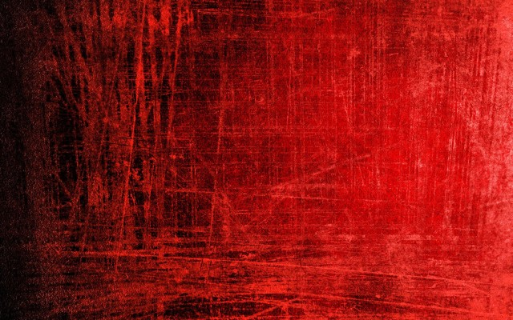

Love Ran Red
Chris Tomlin

