Slide 1


Slide 2
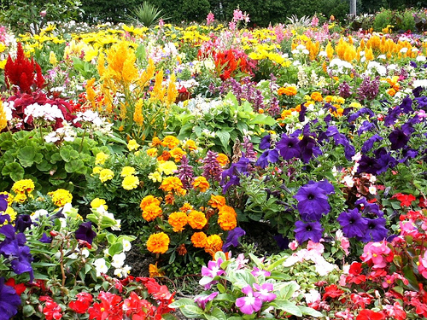

Slide 3
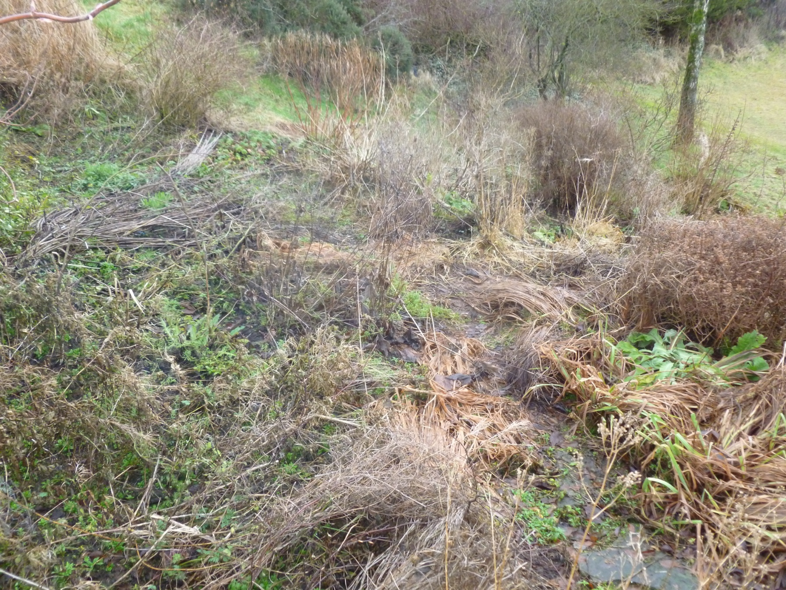

Slide 4
  ²² Having purified your souls by your obedience to the truth for a sincere brotherly love, love one another earnestly from a pure heart, ²³ since you have been born again, not of perishable seed but of imperishable, through the living and abiding word of God; ²⁴ for “All flesh is like grass and all its glory like the flower of grass. The grass withers, and the flower falls, ²⁵ but the word of the Lord remains forever.” And this word is the good news that was preached to you.
  1 Peter 1:22-25 ESV

Slide 5
  ²² Having purified your souls by your obedience to the truth for a sincere brotherly love, love one another earnestly from a pure heart, ²³ since you have been born again, not of perishable seed but of imperishable, through the living and abiding word of God; ²⁴ for “All flesh is like grass and all its glory like the flower of grass. The grass withers, and the flower falls, ²⁵ but the word of the Lord remains forever.” And this word is the good news that was preached to you.
  1 Peter 1:22-25 ESV

Slide 6
  ²² Having purified your souls by your obedience to the truth for a sincere brotherly love, love one another earnestly from a pure heart, ²³ since you have been born again, not of perishable seed but of imperishable, through the living and abiding word of God; ²⁴ for “All flesh is like grass and all its glory like the flower of grass. The grass withers, and the flower falls, ²⁵ but the word of the Lord remains forever.” And this word is the good news that was preached to you.
  1 Peter 1:22-25 ESV

Slide 7
  ²² Having purified your souls by your obedience to the truth for a sincere brotherly love, love one another earnestly from a pure heart, ²³ since you have been born again, not of perishable seed but of imperishable, through the living and abiding word of God; ²⁴ for “All flesh is like grass and all its glory like the flower of grass. The grass withers, and the flower falls, ²⁵ but the word of the Lord remains forever.” And this word is the good news that was preached to you.
  1 Peter 1:22-25 ESV

Slide 8
  ¹⁹ We love because he first loved us.
  1 John 4:19 ESV

Slide 9
  ²² Having purified your souls by your obedience to the truth for a sincere brotherly love, love one another earnestly from a pure heart, ²³ since you have been born again, not of perishable seed but of imperishable, through the living and abiding word of God; ²⁴ for “All flesh is like grass and all its glory like the flower of grass. The grass withers, and the flower falls, ²⁵ but the word of the Lord remains forever.” And this word is the good news that was preached to you.
  1 Peter 1:22-25 ESV

Slide 10
  ²² Having purified your souls by your obedience to the truth for a sincere brotherly love, love one another earnestly from a pure heart, ²³ since you have been born again, not of perishable seed but of imperishable, through the living and abiding word of God; ²⁴ for “All flesh is like grass and all its glory like the flower of grass. The grass withers, and the flower falls, ²⁵ but the word of the Lord remains forever.” And this word is the good news that was preached to you.
  1 Peter 1:22-25 ESV

Slide 11
  ²² Having purified your souls by your obedience to the truth for a sincere brotherly love, love one another earnestly from a pure heart, ²³ since you have been born again, not of perishable seed but of imperishable, through the living and abiding word of God; ²⁴ for “All flesh is like grass and all its glory like the flower of grass. The grass withers, and the flower falls, ²⁵ but the word of the Lord remains forever.” And this word is the good news that was preached to you.
  1 Peter 1:22-25 ESV

