Slide 1


Slide 2
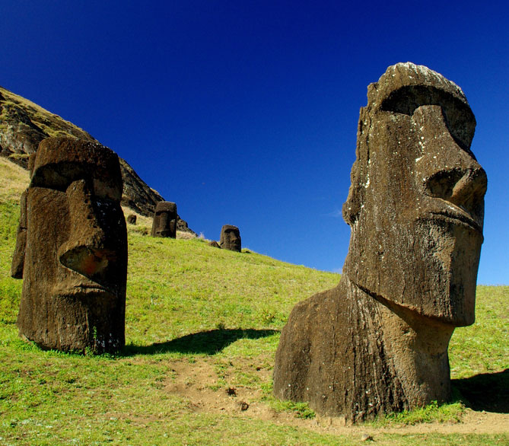
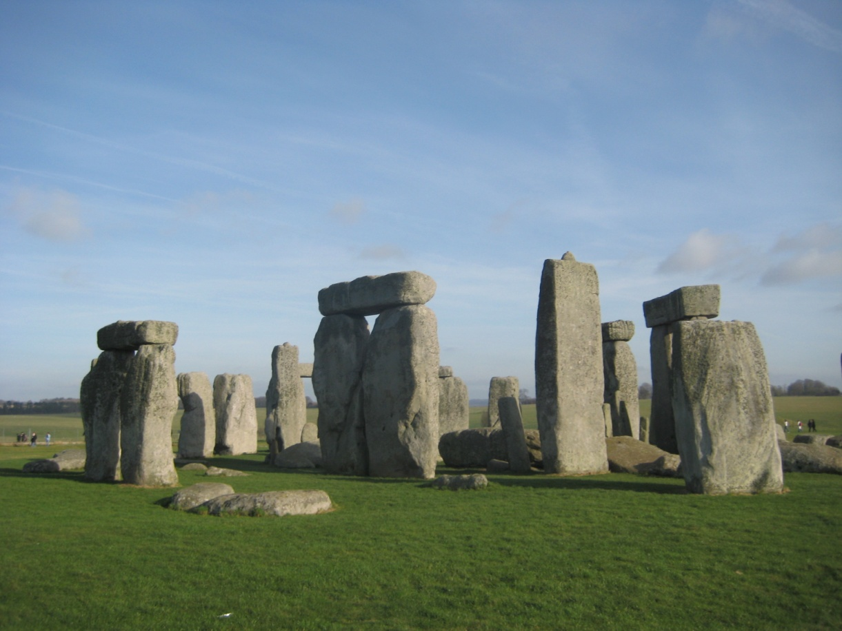

Slide 3
  ⁴ So as you come to him, a living stone rejected by men but chosen and precious in God’s sight, ⁵ you yourselves, as living stones, are built up as a spiritual house to be a holy priesthood and to offer spiritual sacrifices that are acceptable to God through Jesus Christ. ⁶ For it says in scripture, “Look, I lay in Zion a stone, a chosen and precious cornerstone, and whoever believes in him will never be put to shame.” ⁷ So you who believe see his value, but for those who do not believe, the stone that the builders rejected has become the cornerstone, ⁸ and a stumbling-stone and a rock to trip over. They stumble because they disobey the word, as they were destined to do.⁹ But you are a chosen race, a royal priesthood, a holy nation, a people of his own, so that you may proclaim the virtues of the one who called you out of darkness into his marvelous light. ¹⁰ You once were not a people, but now you are God’s people. You were shown no mercy, but now you have received mercy.
  1 Peter 2:4-10 NET

Slide 4
  ¹⁹ Therefore, brothers, since we have confidence to enter the holy places by the blood of Jesus, ²⁰ by the new and living way that he opened for us through the curtain, that is, through his flesh, ²¹ and since we have a great priest over the house of God, ²² let us draw near with a true heart in full assurance of faith, with our hearts sprinkled clean from an evil conscience and our bodies washed with pure water. ²³ Let us hold fast the confession of our hope without wavering, for he who promised is faithful
  Hebrews 10:19-23 ESV

Slide 5
…the stone that the builders rejected has become the cornerstone…
1 Corinthians 3:11 ESV - ¹¹ For no one can lay a foundation other than that which is laid, which is Jesus Christ.
Ephesians 2:19-22 ESV - ¹⁹ So then you are no longer strangers and aliens, but you are fellow citizens with the saints and members of the household of God, ²⁰ built on the foundation of the apostles and prophets, Christ Jesus himself being the cornerstone, ²¹ in whom the whole structure, being joined together, grows into a holy temple in the Lord. ²² In him you also are being built together into a dwelling place for God by the Spirit.

Slide 6
  ⁴ So as you come to him, a living stone rejected by men but chosen and precious in God’s sight, ⁵ you yourselves, as living stones, are built up as a spiritual house to be a holy priesthood and to offer spiritual sacrifices that are acceptable to God through Jesus Christ. ⁶ For it says in scripture, “Look, I lay in Zion a stone, a chosen and precious cornerstone, and whoever believes in him will never be put to shame.” ⁷ So you who believe see his value, but for those who do not believe, the stone that the builders rejected has become the cornerstone, ⁸ and a stumbling-stone and a rock to trip over. They stumble because they disobey the word, as they were destined to do.⁹ But you are a chosen race, a royal priesthood, a holy nation, a people of his own, so that you may proclaim the virtues of the one who called you out of darkness into his marvelous light. ¹⁰ You once were not a people, but now you are God’s people. You were shown no mercy, but now you have received mercy.
  1 Peter 2:4-10 NET

Slide 7
Temple of the Holy Spirit
1 Corinthian 6:19 - Or do you not know that your body is a temple of the Holy Spirit within you, whom you have from God? You are not your own
1 Corinthians 3:16 ESV - ¹⁶ Do you not know that you are God's temple and that God's Spirit dwells in you?

Slide 8
Temple of the Holy Spirit
1 Corinthian 6:19 - Or do you not know that your body is a temple of the Holy Spirit within you, whom you have from God? You are not your own
1 Corinthians 3:16 ESV - ¹⁶ Do you not know that you are God's temple and that God's Spirit dwells in you?
SINGULAR
PLURAL

Slide 9
  ⁴ So as you come to him, a living stone rejected by men but chosen and precious in God’s sight, ⁵ you yourselves, as living stones, are built up as a spiritual house to be a holy priesthood and to offer spiritual sacrifices that are acceptable to God through Jesus Christ. ⁶ For it says in scripture, “Look, I lay in Zion a stone, a chosen and precious cornerstone, and whoever believes in him will never be put to shame.” ⁷ So you who believe see his value, but for those who do not believe, the stone that the builders rejected has become the cornerstone, ⁸ and a stumbling-stone and a rock to trip over. They stumble because they disobey the word, as they were destined to do.⁹ But you are a chosen race, a royal priesthood, a holy nation, a people of his own, so that you may proclaim the virtues of the one who called you out of darkness into his marvelous light. ¹⁰ You once were not a people, but now you are God’s people. You were shown no mercy, but now you have received mercy.
  1 Peter 2:4-10 NET

Slide 10
  ⁴ So as you come to him, a living stone rejected by men but chosen and precious in God’s sight, ⁵ you yourselves, as living stones, are built up as a spiritual house to be a holy priesthood and to offer spiritual sacrifices that are acceptable to God through Jesus Christ. ⁶ For it says in scripture, “Look, I lay in Zion a stone, a chosen and precious cornerstone, and whoever believes in him will never be put to shame.” ⁷ So you who believe see his value, but for those who do not believe, the stone that the builders rejected has become the cornerstone, ⁸ and a stumbling-stone and a rock to trip over. They stumble because they disobey the word, as they were destined to do. ⁹ But you are a chosen race, a royal priesthood, a holy nation, a people of his own, so that you may proclaim the virtues of the one who called you out of darkness into his marvelous light. ¹⁰ You once were not a people, but now you are God’s people. You were shown no mercy, but now you have received mercy.
  1 Peter 2:4-10 NET

Slide 11
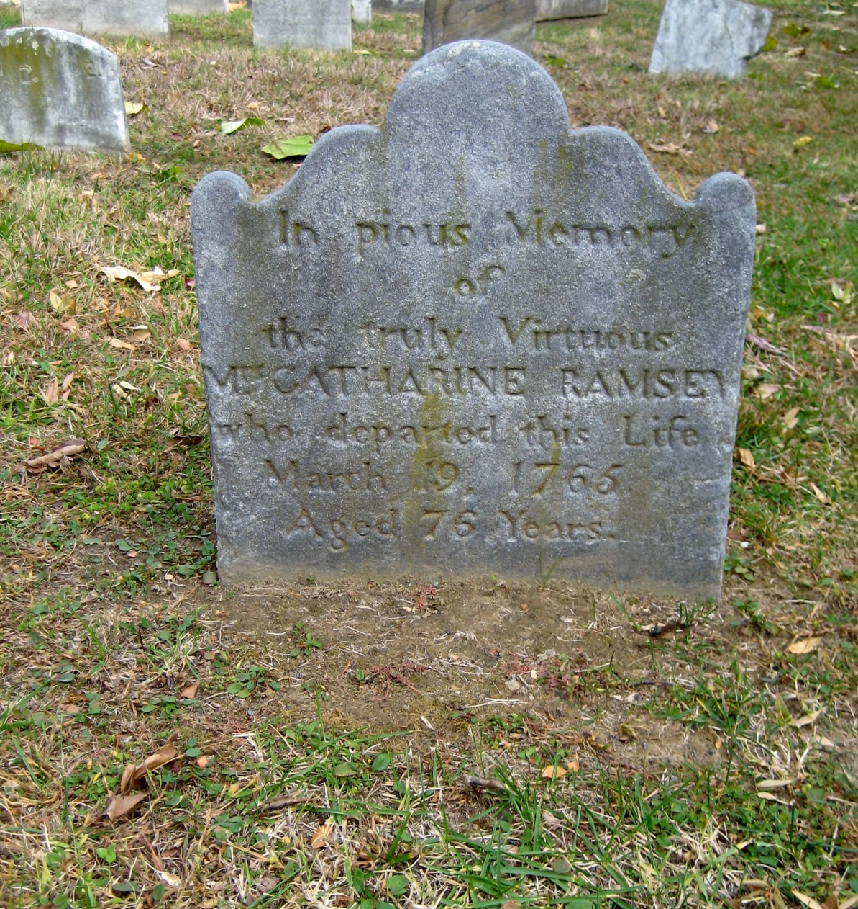

Slide 12
  ²⁸ Come to me, all who labor and are heavy laden, and I will give you rest.²⁹ Take my yoke upon you, and learn from me, for I am gentle and lowly in heart, and you will find rest for your souls. ³⁰ For my yoke is easy, and my burden is light.”
  Matthew 11:28-30 ESV

