Slide 1


Slide 2
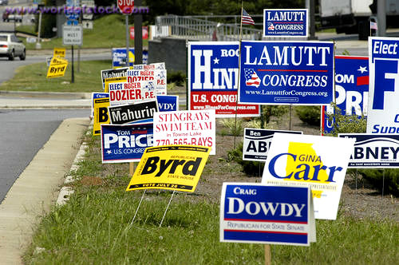
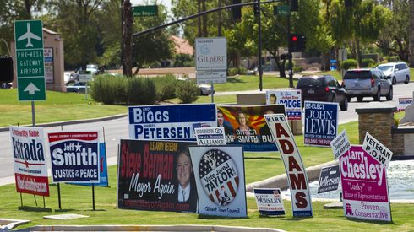

Slide 3
  ¹³ Be subject for the Lord's sake to every human institution, whether it be to the emperor as supreme, ¹⁴ or to governors as sent by him to punish those who do evil and to praise those who do good. ¹⁵ For this is the will of God, that by doing good you should put to silence the ignorance of foolish people. ¹⁶ Live as people who are free, not using your freedom as a cover-up for evil, but living as servants of God. ¹⁷ Honor everyone. Love the brotherhood. Fear God. Honor the emperor.
  1 Peter 2:13-17 ESV

Slide 4
  ⁹ But you are a chosen race, a royal priesthood, a holy nation, a people for his own possession, that you may proclaim the excellencies of him who called you out of darkness into his marvelous light.
  1 Peter 2:9 ESV

Slide 5
  ¹³ Be subject for the Lord's sake to every human institution, whether it be to the emperor as supreme, ¹⁴ or to governors as sent by him to punish those who do evil and to praise those who do good. ¹⁵ For this is the will of God, that by doing good you should put to silence the ignorance of foolish people. ¹⁶ Live as people who are free, not using your freedom as a cover-up for evil, but living as servants of God. ¹⁷ Honor everyone. Love the brotherhood. Fear God. Honor the emperor.
  1 Peter 2:13-17 ESV

Slide 6
  ⁸ Now we know that the law is good, if one uses it lawfully, ⁹ understanding this, that the law is not laid down for the just but for the lawless and disobedient, for the ungodly and sinners, for the unholy and profane, for those who strike their fathers and mothers, for murderers, ¹⁰ the sexually immoral, men who practice homosexuality, enslavers, liars, perjurers, and whatever else is contrary to sound doctrine
  1 Timothy 1:8-10 ESV

Slide 7
  ¹³ Be subject for the Lord's sake to every human institution, whether it be to the emperor as supreme, ¹⁴ or to governors as sent by him to punish those who do evil and to praise those who do good. ¹⁵ For this is the will of God, that by doing good you should put to silence the ignorance of foolish people. ¹⁶ Live as people who are free, not using your freedom as a cover-up for evil, but living as servants of God. ¹⁷ Honor everyone. Love the brotherhood. Fear God. Honor the emperor.
  1 Peter 2:13-17 ESV

Slide 8
  For there is no authority except from God, and those that exist have been instituted by God.
  Romans 13:1b ESV

Slide 9
  ¹³ Be subject for the Lord's sake to every human institution, whether it be to the emperor as supreme, ¹⁴ or to governors as sent by him to punish those who do evil and to praise those who do good. ¹⁵ For this is the will of God, that by doing good you should put to silence the ignorance of foolish people. ¹⁶ Live as people who are free, not using your freedom as a cover-up for evil, but living as servants of God. ¹⁷ Honor everyone. Love the brotherhood. Fear God. Honor the emperor.
  1 Peter 2:13-17 ESV

Slide 10
  ¹³ Be subject for the Lord's sake to every human institution, whether it be to the emperor as supreme, ¹⁴ or to governors as sent by him to punish those who do evil and to praise those who do good. ¹⁵ For this is the will of God, that by doing good you should put to silence the ignorance of foolish people. ¹⁶ Live as people who are free, not using your freedom as a cover-up for evil, but living as servants of God. ¹⁷ Honor everyone. Love the brotherhood. Fear God. Honor the emperor.
  1 Peter 2:13-17 ESV

Slide 11
  ¹⁸ Servants, be subject to your masters with all respect, not only to the good and gentle but also to the unjust.
  1 Peter 2:18 ESV

Slide 12
  ²³ When he was reviled, he did not revile in return; when he suffered, he did not threaten, but continued entrusting himself to him who judges justly.
  1 Peter 1:23 ESV

Slide 13
  ¹³ Be subject for the Lord's sake to every human institution, whether it be to the emperor as supreme, ¹⁴ or to governors as sent by him to punish those who do evil and to praise those who do good. ¹⁵ For this is the will of God, that by doing good you should put to silence the ignorance of foolish people. ¹⁶ Live as people who are free, not using your freedom as a cover-up for evil, but living as servants of God. ¹⁷ Honor everyone. Love the brotherhood. Fear God. Honor the emperor.
  1 Peter 2:13-17 ESV

Slide 14
  ¹⁹ But Peter and John answered them, “Whether it is right in the sight of God to listen to you rather than to God, you must judge, ²⁰ for we cannot but speak of what we have seen and heard.”
  Acts 4:19-20 ESV

Slide 15
  ¹³ Be subject for the Lord's sake to every human institution, whether it be to the emperor as supreme, ¹⁴ or to governors as sent by him to punish those who do evil and to praise those who do good. ¹⁵ For this is the will of God, that by doing good you should put to silence the ignorance of foolish people. ¹⁶ Live as people who are free, not using your freedom as a cover-up for evil, but living as servants of God. ¹⁷ Honor everyone. Love the brotherhood. Fear God. Honor the emperor.
  1 Peter 2:13-17 ESV

