Slide 1


Slide 2
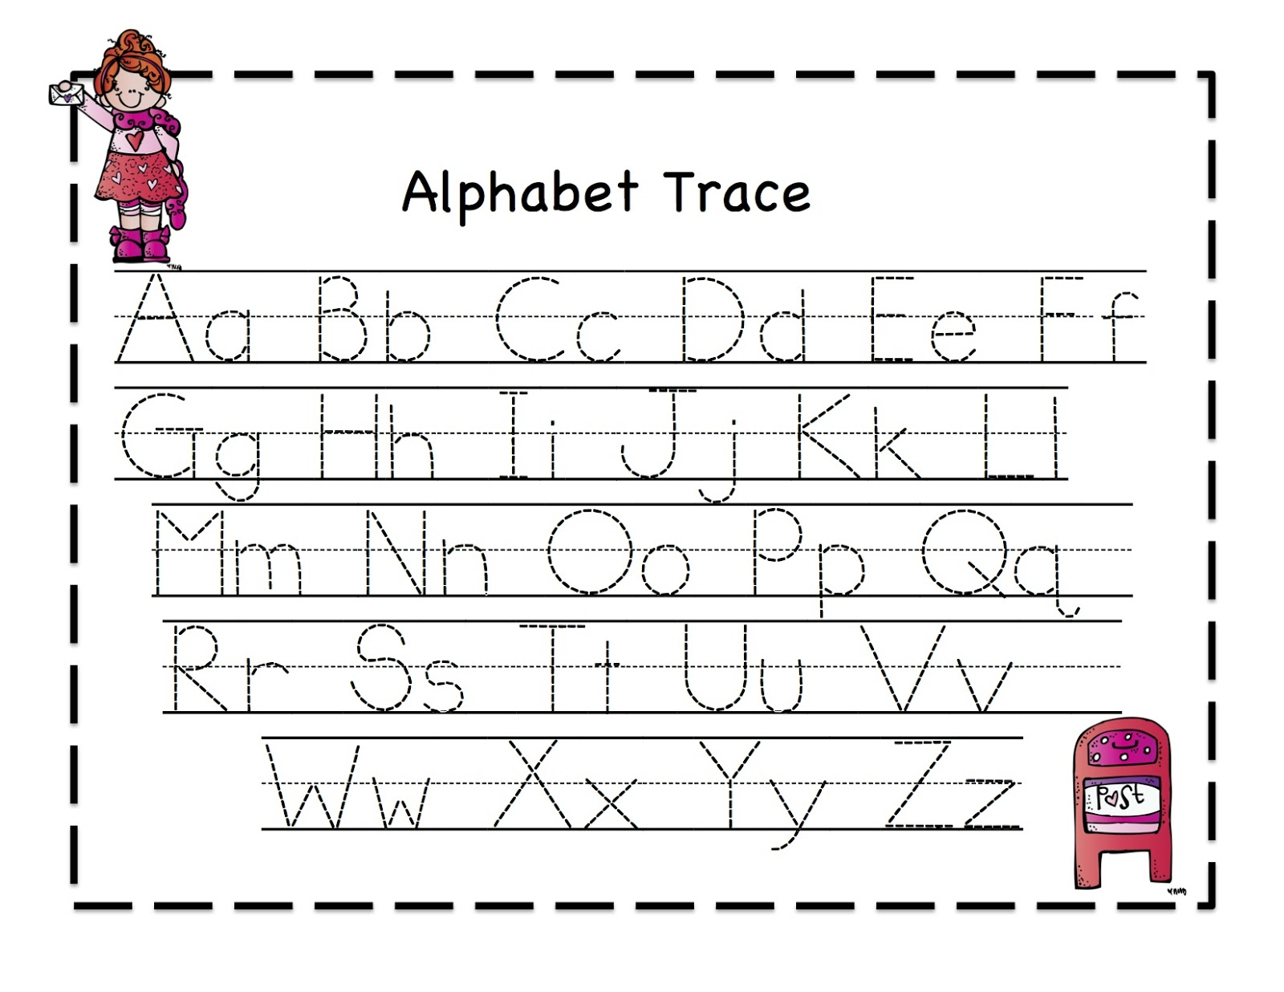

Slide 3
  ¹⁸ Servants, be subject to your masters with all respect, not only to the good and gentle but also to the unjust. ¹⁹ For this is a gracious thing, when, mindful of God, one endures sorrows while suffering unjustly. ²⁰ For what credit is it if, when you sin and are beaten for it, you endure? But if when you do good and suffer for it you endure, this is a gracious thing in the sight of God. ²¹ For to this you have been called, because Christ also suffered for you, leaving you an example, so that you might follow in his steps. ²² He committed no sin, neither was deceit found in his mouth. ²³ When he was reviled, he did not revile in return; when he suffered, he did not threaten, but continued entrusting himself to him who judges justly. ²⁴ He himself bore our sins in his body on the tree, that we might die to sin and live to righteousness. By his wounds you have been healed. ²⁵ For you were straying like sheep, but have now returned to the Shepherd and Overseer of your souls.
  1 Peter 2:18-25 ESV

Slide 4
  ¹⁸ Servants, be subject to your masters with all respect, not only to the good and gentle but also to the unjust. ¹⁹ For this is a gracious thing, when, mindful of God, one endures sorrows while suffering unjustly. ²⁰ For what credit is it if, when you sin and are beaten for it, you endure? But if when you do good and suffer for it you endure, this is a gracious thing in the sight of God. ²¹ For to this you have been called, because Christ also suffered for you, leaving you an example, so that you might follow in his steps. ²² He committed no sin, neither was deceit found in his mouth. ²³ When he was reviled, he did not revile in return; when he suffered, he did not threaten, but continued entrusting himself to him who judges justly. ²⁴ He himself bore our sins in his body on the tree, that we might die to sin and live to righteousness. By his wounds you have been healed. ²⁵ For you were straying like sheep, but have now returned to the Shepherd and Overseer of your souls.
  1 Peter 2:18-25 ESV

Slide 5
¹⁶ Live as people who are free, not using your freedom as a cover-up for evil, but living as servants of God.
1 Peter 2:16 ESV

Slide 6
  ¹⁸ Servants, be subject to your masters with all respect, not only to the good and gentle but also to the unjust. ¹⁹ For this is a gracious thing, when, mindful of God, one endures sorrows while suffering unjustly. ²⁰ For what credit is it if, when you sin and are beaten for it, you endure? But if when you do good and suffer for it you endure, this is a gracious thing in the sight of God. ²¹ For to this you have been called, because Christ also suffered for you, leaving you an example, so that you might follow in his steps. ²² He committed no sin, neither was deceit found in his mouth. ²³ When he was reviled, he did not revile in return; when he suffered, he did not threaten, but continued entrusting himself to him who judges justly. ²⁴ He himself bore our sins in his body on the tree, that we might die to sin and live to righteousness. By his wounds you have been healed. ²⁵ For you were straying like sheep, but have now returned to the Shepherd and Overseer of your souls.
  1 Peter 2:18-25 ESV

Slide 7
  ¹⁸ Servants, be subject to your masters with all respect, not only to the good and gentle but also to the unjust. ¹⁹ For this is a gracious thing, when, mindful of God, one endures sorrows while suffering unjustly. ²⁰ For what credit is it if, when you sin and are beaten for it, you endure? But if when you do good and suffer for it you endure, this is a gracious thing in the sight of God. ²¹ For to this you have been called, because Christ also suffered for you, leaving you an example, so that you might follow in his steps. ²² He committed no sin, neither was deceit found in his mouth. ²³ When he was reviled, he did not revile in return; when he suffered, he did not threaten, but continued entrusting himself to him who judges justly. ²⁴ He himself bore our sins in his body on the tree, that we might die to sin and live to righteousness. By his wounds you have been healed. ²⁵ For you were straying like sheep, but have now returned to the Shepherd and Overseer of your souls.
  1 Peter 2:18-25 ESV

Slide 8
  ¹⁸ Servants, be subject to your masters with all respect, not only to the good and gentle but also to the unjust. ¹⁹ For this is a gracious thing, when, mindful of God, one endures sorrows while suffering unjustly. ²⁰ For what credit is it if, when you sin and are beaten for it, you endure? But if when you do good and suffer for it you endure, this is a gracious thing in the sight of God. ²¹ For to this you have been called, because Christ also suffered for you, leaving you an example, so that you might follow in his steps. ²² He committed no sin, neither was deceit found in his mouth. ²³ When he was reviled, he did not revile in return; when he suffered, he did not threaten, but continued entrusting himself to him who judges justly. ²⁴ He himself bore our sins in his body on the tree, that we might die to sin and live to righteousness. By his wounds you have been healed. ²⁵ For you were straying like sheep, but have now returned to the Shepherd and Overseer of your souls.
  1 Peter 2:18-25 ESV

Slide 9
God does not look to the smallness of the work, but to the heart that serves him in such little things.
-Martin Luther

Slide 10
Hypogrammos

Slide 11
In your struggle against sin you have not yet resisted to the point of shedding your blood.
Hebrews 12:4 ESV

Slide 12
Christ Our Example
John 6:38 ESV - ³⁸ For I have come down from heaven, not to do my own will but the will of him who sent me.
John 12:49 ESV - ⁴⁹ For I have not spoken on my own authority, but the Father who sent me has himself given me a commandment—what to say and what to speak.
Luke 22:42 ESV - “Father, if you are willing, remove this cup from me. Nevertheless, not my will, but yours, be done.”
Philippians 2:8 ESV - And being found in human form, he humbled himself by becoming obedient to the point of death, even death on a cross.

Slide 13
  ¹⁸ Servants, be subject to your masters with all respect, not only to the good and gentle but also to the unjust. ¹⁹ For this is a gracious thing, when, mindful of God, one endures sorrows while suffering unjustly. ²⁰ For what credit is it if, when you sin and are beaten for it, you endure? But if when you do good and suffer for it you endure, this is a gracious thing in the sight of God. ²¹ For to this you have been called, because Christ also suffered for you, leaving you an example, so that you might follow in his steps. ²² He committed no sin, neither was deceit found in his mouth. ²³ When he was reviled, he did not revile in return; when he suffered, he did not threaten, but continued entrusting himself to him who judges justly. ²⁴ He himself bore our sins in his body on the tree, that we might die to sin and live to righteousness. By his wounds you have been healed. ²⁵ For you were straying like sheep, but have now returned to the Shepherd and Overseer of your souls.
  1 Peter 2:18-25 ESV

Slide 14
Mindful of God
Ephesians 6:5-8 ESV - ⁵ Bondservants, obey your earthly masters with fear and trembling, with a sincere heart, as you would Christ, ⁶ not by the way of eye-service, as people-pleasers, but as bondservants of Christ, doing the will of God from the heart,⁷ rendering service with a good will as to the Lord and not to man, ⁸ knowing that whatever good anyone does, this he will receive back from the Lord, whether he is a bondservant or is free.
Colossians 3:22-24 ESV - ²² Bondservants, obey in everything those who are your earthly masters, not by way of eye-service, as people-pleasers, but with sincerity of heart, fearing the Lord. ²³ Whatever you do, work heartily, as for the Lord and not for men, ²⁴ knowing that from the Lord you will receive the inheritance as your reward. You are serving the Lord Christ.

Slide 15
⁴¹ So they left the council rejoicing because they had been considered worthy to suffer dishonor for the sake of the name.
Acts 5:41 NET

Slide 16
