Slide 1


Slide 2
Likewise, wives, be subject to your own husbands, so that even if some do not obey the word, they may be won without a word by the conduct of their wives, ² when they see your respectful and pure conduct. ³ Do not let your adorning be external—the braiding of hair and the putting on of gold jewelry, or the clothing you wear— ⁴ but let your adorning be the hidden person of the heart with the imperishable beauty of a gentle and quiet spirit, which in God's sight is very precious. ⁵ For this is how the holy women who hoped in God used to adorn themselves, by submitting to their own husbands, ⁶ as Sarah obeyed Abraham, calling him lord. And you are her children, if you do good and do not fear anything that is frightening. ⁷ Likewise, husbands, live with your wives in an understanding way, showing honor to the woman as the weaker vessel, since they are heirs with you of the grace of life, so that your prayers may not be hindered.”
1 Peter 3:1-7 ESV

Slide 3
Likewise, wives, be subject to your own husbands, so that even if some do not obey the word, they may be won without a word by the conduct of their wives, ² when they see your respectful and pure conduct. ³ Do not let your adorning be external—the braiding of hair and the putting on of gold jewelry, or the clothing you wear— ⁴ but let your adorning be the hidden person of the heart with the imperishable beauty of a gentle and quiet spirit, which in God's sight is very precious. ⁵ For this is how the holy women who hoped in God used to adorn themselves, by submitting to their own husbands, ⁶ as Sarah obeyed Abraham, calling him lord. And you are her children, if you do good and do not fear anything that is frightening. ⁷ Likewise, husbands, live with your wives in an understanding way, showing honor to the woman as the weaker vessel, since they are heirs with you of the grace of life, so that your prayers may not be hindered.”
1 Peter 3:1-7 ESV

Slide 4
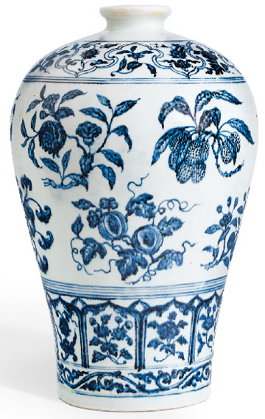
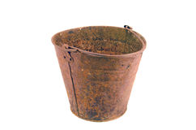

Slide 5
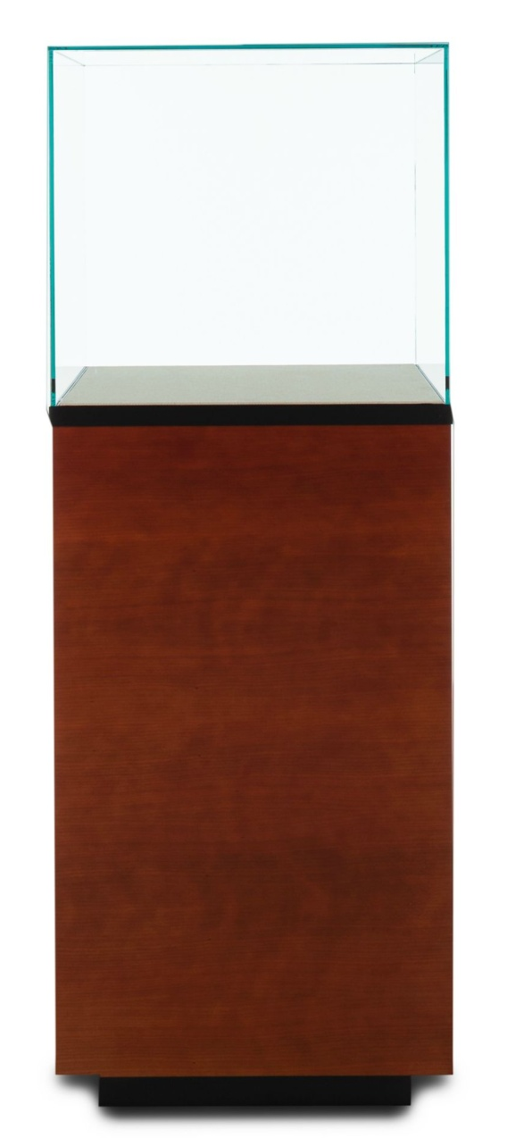


Slide 6
Likewise, wives, be subject to your own husbands, so that even if some do not obey the word, they may be won without a word by the conduct of their wives, ² when they see your respectful and pure conduct. ³ Do not let your adorning be external—the braiding of hair and the putting on of gold jewelry, or the clothing you wear— ⁴ but let your adorning be the hidden person of the heart with the imperishable beauty of a gentle and quiet spirit, which in God's sight is very precious. ⁵ For this is how the holy women who hoped in God used to adorn themselves, by submitting to their own husbands, ⁶ as Sarah obeyed Abraham, calling him lord. And you are her children, if you do good and do not fear anything that is frightening. ⁷ Likewise, husbands, live with your wives in an understanding way, showing honor to the woman as the weaker vessel, since they are heirs with you of the grace of life, so that your prayers may not be hindered.”
1 Peter 3:1-7 ESV

Slide 7
Likewise, wives, be subject to your own husbands, so that even if some do not obey the word, they may be won without a word by the conduct of their wives, ² when they see your respectful and pure conduct. ³ Do not let your adorning be external—the braiding of hair and the putting on of gold jewelry, or the clothing you wear— ⁴ but let your adorning be the hidden person of the heart with the imperishable beauty of a gentle and quiet spirit, which in God's sight is very precious. ⁵ For this is how the holy women who hoped in God used to adorn themselves, by submitting to their own husbands, ⁶ as Sarah obeyed Abraham, calling him lord. And you are her children, if you do good and do not fear anything that is frightening. ⁷ Likewise, husbands, live with your wives in an understanding way, showing honor to the woman as the weaker vessel, since they are heirs with you of the grace of life, so that your prayers may not be hindered.”
1 Peter 3:1-7 ESV

Slide 8
Likewise, wives, be subject to your own husbands, so that even if some do not obey the word, they may be won without a word by the conduct of their wives, ² when they see your respectful and pure conduct. ³ Do not let your adorning be external—the braiding of hair and the putting on of gold jewelry, or the clothing you wear— ⁴ but let your adorning be the hidden person of the heart with the imperishable beauty of a gentle and quiet spirit, which in God's sight is very precious. ⁵ For this is how the holy women who hoped in God used to adorn themselves, by submitting to their own husbands, ⁶ as Sarah obeyed Abraham, calling him lord. And you are her children, if you do good and do not fear anything that is frightening. ⁷ Likewise, husbands, live with your wives in an understanding way, showing honor to the woman as the weaker vessel, since they are heirs with you of the grace of life, so that your prayers may not be hindered.”
1 Peter 3:1-7 ESV

Slide 9
Likewise, wives, be subject to your own husbands, so that even if some do not obey the word, they may be won without a word by the conduct of their wives, ² when they see your respectful and pure conduct. ³ Do not let your adorning be external—the braiding of hair and the putting on of gold jewelry, or the clothing you wear— ⁴ but let your adorning be the hidden person of the heart with the imperishable beauty of a gentle and quiet spirit, which in God's sight is very precious. ⁵ For this is how the holy women who hoped in God used to adorn themselves, by submitting to their own husbands, ⁶ as Sarah obeyed Abraham, calling him lord. And you are her children, if you do good and do not fear anything that is frightening. ⁷ Likewise, husbands, live with your wives in an understanding way, showing honor to the woman as the weaker vessel, since they are heirs with you of the grace of life, so that your prayers may not be hindered.”
1 Peter 3:1-7 ESV

Slide 10
Likewise, wives, be subject to your own husbands, so that even if some do not obey the word, they may be won without a word by the conduct of their wives, ² when they see your respectful and pure conduct. ³ Do not let your adorning be external—the braiding of hair and the putting on of gold jewelry, or the clothing you wear— ⁴ but let your adorning be the hidden person of the heart with the imperishable beauty of a gentle and quiet spirit, which in God's sight is very precious. ⁵ For this is how the holy women who hoped in God used to adorn themselves, by submitting to their own husbands, ⁶ as Sarah obeyed Abraham, calling him lord. And you are her children, if you do good and do not fear anything that is frightening. ⁷ Likewise, husbands, live with your wives in an understanding way, showing honor to the woman as the weaker vessel, since they are heirs with you of the grace of life, so that your prayers may not be hindered.”
1 Peter 3:1-7 ESV

Slide 11
⁹ likewise also that women should adorn themselves in respectable apparel, with modesty and self-control, not with braided hair and gold or pearls or costly attire, ¹⁰ but with what is proper for women who profess godliness—with good works.
1 Timothy 2:9-10 ESV

Slide 12
Likewise, wives, be subject to your own husbands, so that even if some do not obey the word, they may be won without a word by the conduct of their wives, ² when they see your respectful and pure conduct. ³ Do not let your adorning be external—the braiding of hair and the putting on of gold jewelry, or the clothing you wear— ⁴ but let your adorning be the hidden person of the heart with the imperishable beauty of a gentle and quiet spirit, which in God's sight is very precious. ⁵ For this is how the holy women who hoped in God used to adorn themselves, by submitting to their own husbands, ⁶ as Sarah obeyed Abraham, calling him lord. And you are her children, if you do good and do not fear anything that is frightening. ⁷ Likewise, husbands, live with your wives in an understanding way, showing honor to the woman as the weaker vessel, since they are heirs with you of the grace of life, so that your prayers may not be hindered.”
1 Peter 3:1-7 ESV

