Slide 1


Slide 2
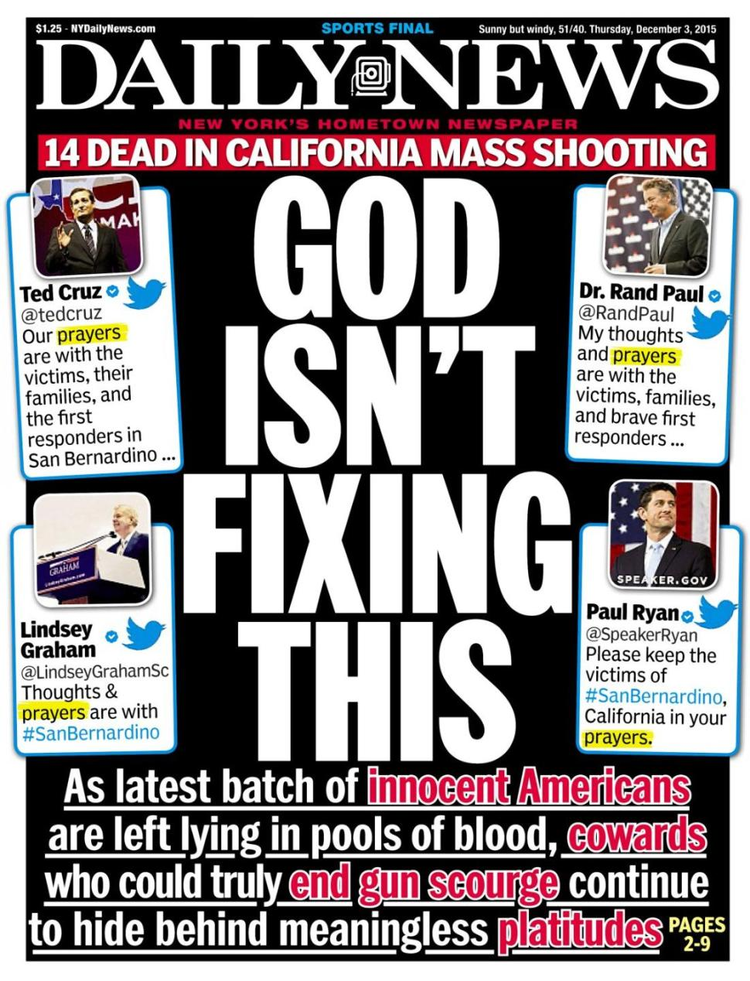

Slide 3
¹⁸ For the word of the cross is folly to those who are perishing, but to us who are being saved it is the power of God. ¹⁹ For it is written, “I will destroy the wisdom of the wise, and the discernment of the discerning I will thwart.” ²⁰ Where is the one who is wise? Where is the scribe? Where is the debater of this age? Has not God made foolish the wisdom of the world?
1 Corinthians 1:18-20 ESV

Slide 4
¹⁸ For the wrath of God is revealed from heaven against all ungodliness and unrighteousness of men, who by their unrighteousness suppress the truth. ¹⁹ For what can be known about God is plain to them, because God has shown it to them. ²⁰ For his invisible attributes, namely, his eternal power and divine nature, have been clearly perceived, ever since the creation of the world, in the things that have been made. So they are without excuse. ²¹ For although they knew God, they did not honor him as God or give thanks to him, but they became futile in their thinking, and their foolish hearts were darkened. ²² Claiming to be wise, they became fools, ²³ and exchanged the glory of the immortal God for images resembling mortal man and birds and animals and creeping things.
Romans 1:18-23 ESV

Slide 5
…for the anger of man does not produce the righteousness of God.
James 1:20 ESV

Slide 6
¹³ Now who is there to harm you if you are zealous for what is good? ¹⁴ But even if you should suffer for righteousness' sake, you will be blessed. Have no fear of them, nor be troubled, ¹⁵ but in your hearts honor Christ the Lord as holy, always being prepared to make a defense to anyone who asks you for a reason for the hope that is in you; yet do it with gentleness and respect,¹⁶ having a good conscience, so that, when you are slandered, those who revile your good behavior in Christ may be put to shame.
1 Peter 3:13-16 ESV

Slide 7
¹⁰ But the Lord is the true God; he is the living God and the everlasting King. At his wrath the earth quakes, and the nations cannot endure his indignation. ¹² It is he who made the earth by his power, who established the world by his wisdom, and by his understanding stretched out the heavens. ¹³ When he utters his voice, there is a tumult of waters in the heavens, and he makes the mist rise from the ends of the earth. He makes lightning for the rain, and he brings forth the wind from his storehouses. ¹⁴ Every man is stupid and without knowledge; every goldsmith is put to shame by his idols, for his images are false, and there is no breath in them. ¹⁵ They are worthless, a work of delusion; at the time of their punishment they shall perish. ¹⁶ Not like these is he who is the portion of Jacob, for he is the one who formed all things, and Israel is the tribe of his inheritance; the Lord of hosts is his name.
Jeremiah 10:10, 12-16 ESV

Slide 8
² I will come upon him while he is weary and discouraged and throw him into a panic, and all the people who are with him will flee. I will strike down only the king
2 Samuel 17:2 ESV

Slide 9
O Lord, how many are my foes! Many are rising against me; ² many are saying of my soul, there is no salvation for him in God. Selah ³ But you, O Lord, are a shield about me, my glory, and the lifter of my head. ⁴ I cried aloud to the Lord, and he answered me from his holy hill. Selah ⁵ I lay down and slept; I woke again, for the Lord sustained me. ⁶ I will not be afraid of many thousands of people who have set themselves against me all around. ⁷ Arise, O Lord! Save me, O my God! For you strike all my enemies on the cheek; you break the teeth of the wicked. ⁸ Salvation belongs to the Lord; your blessing be on your people! Selah
Psalm 3 ESV

Slide 10
¹³ Now who is there to harm you if you are zealous for what is good? ¹⁴ But even if you should suffer for righteousness' sake, you will be blessed. Have no fear of them, nor be troubled, ¹⁵ but in your hearts honor Christ the Lord as holy, always being prepared to make a defense to anyone who asks you for a reason for the hope that is in you; yet do it with gentleness and respect,¹⁶ having a good conscience, so that, when you are slandered, those who revile your good behavior in Christ may be put to shame.
1 Peter 3:13-16 ESV

Slide 11
¹⁴ And above all these put on love, which binds everything together in perfect harmony. ¹⁵ And let the peace of Christ rule in your hearts, to which indeed you were called in one body. And be thankful.
Colossians 3:14-15 ESV

Slide 12
Peace
Therefore, since we have been justified by faith, we have peace with God through our Lord Jesus Christ. ² Through him we have also obtained access by faith into this grace in which we stand, and we rejoice in hope of the glory of God. Romans 5:1-2 ESV
¹⁴ For he himself is our peace, who has made us both one and has broken down in his flesh the dividing wall of hostility Ephesians 2:14 ESV

