Slide 1


Slide 2
Since therefore Christ suffered in the flesh, arm yourselves with the same way of thinking, for whoever has suffered in the flesh has ceased from sin, ² so as to live for the rest of the time in the flesh no longer for human passions but for the will of God. ³ For the time that is past suffices for doing what the Gentiles want to do, living in sensuality, passions, drunkenness, orgies, drinking parties, and lawless idolatry. ⁴ With respect to this they are surprised when you do not join them in the same flood of debauchery, and they malign you; ⁵ but they will give account to him who is ready to judge the living and the dead. ⁶ For this is why the gospel was preached even to those who are dead, that though judged in the flesh the way people are, they might live in the spirit the way God does.
1 Peter 4:1-6 ESV

Slide 3
And we all, with unveiled face, beholding the glory of the Lord, are being transformed into the same image from one degree of glory to another.
1 Corinthians 3:18a ESV

Slide 4
with this goal in mind, I strive toward the prize of the upward call of God in Christ Jesus.
Philippians 3:14 NET

Slide 5
  And we all, with unveiled face, beholding the glory of the Lord, are being transformed into the same image from one degree of glory to another. For this comes from the Lord who is the Spirit.
  1 Corinthians 3:18 ESV

Slide 6
² And do not be conformed to this world, but be transformed by the renewing of your mind
Romans 12:2 ESV

Slide 7
Since therefore Christ suffered in the flesh, arm yourselves with the same way of thinking, for whoever has suffered in the flesh has ceased from sin, ² so as to live for the rest of the time in the flesh no longer for human passions but for the will of God. ³ For the time that is past suffices for doing what the Gentiles want to do, living in sensuality, passions, drunkenness, orgies, drinking parties, and lawless idolatry. ⁴ With respect to this they are surprised when you do not join them in the same flood of debauchery, and they malign you; ⁵ but they will give account to him who is ready to judge the living and the dead. ⁶ For this is why the gospel was preached even to those who are dead, that though judged in the flesh the way people are, they might live in the spirit the way God does.
1 Peter 4:1-6 ESV

Slide 8
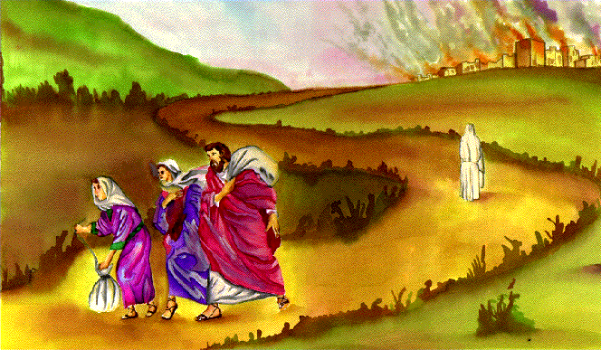

Slide 9
¹³ Brothers, I do not consider that I have made it my own. But one thing I do: forgetting what lies behind and straining forward to what lies ahead
Philippians 3:13 ESV

Slide 10
Wretched man that I am! Who will deliver me from this body of death?
Romans 7:24 ESV

Slide 11
¹³ for it is God who works in you, both to will and to work for his good pleasure.
Philippians 2:13 ESV

Slide 12
Since therefore Christ suffered in the flesh, arm yourselves with the same way of thinking, for whoever has suffered in the flesh has ceased from sin, ² so as to live for the rest of the time in the flesh no longer for human passions but for the will of God. ³ For the time that is past suffices for doing what the Gentiles want to do, living in sensuality, passions, drunkenness, orgies, drinking parties, and lawless idolatry. ⁴ With respect to this they are surprised when you do not join them in the same flood of debauchery, and they malign you; ⁵ but they will give account to him who is ready to judge the living and the dead. ⁶ For this is why the gospel was preached even to those who are dead, that though judged in the flesh the way people are, they might live in the spirit the way God does.
1 Peter 4:1-6 ESV

Slide 13
…just as people are appointed to die once, and then to face judgment…
Hebrews 9:27 NET

Slide 14
Since therefore Christ suffered in the flesh, arm yourselves with the same way of thinking, for whoever has suffered in the flesh has ceased from sin, ² so as to live for the rest of the time in the flesh no longer for human passions but for the will of God. ³ For the time that is past suffices for doing what the Gentiles want to do, living in sensuality, passions, drunkenness, orgies, drinking parties, and lawless idolatry. ⁴ With respect to this they are surprised when you do not join them in the same flood of debauchery, and they malign you; ⁵ but they will give account to him who is ready to judge the living and the dead. ⁶ For this is why the gospel was preached even to those who are dead, that though judged in the flesh the way people are, they might live in the spirit the way God does.
1 Peter 4:1-6 ESV

Slide 15
¹⁹ And this is the judgment: the light has come into the world, and people loved the darkness rather than the light because their works were evil. ²⁰ For everyone who does wicked things hates the light and does not come to the light, lest his works should be exposed.
John 3:19-20 ESV

Slide 16
¹⁵ Do not love the world or the things in the world. If anyone loves the world, the love of the Father is not in him. ¹⁶ For all that is in the world-the desires of the flesh and the desires of the eyes and pride of life - is not from the Father but is from the world. ¹⁷ And the world is passing away along with its desires, but whoever does the will of God abides forever.
John 3:19-20 ESV

