Slide 1


Slide 2
When Jesus had spoken these words, he lifted up his eyes to heaven, and said, “Father, the hour has come; glorify your Son that the Son may glorify you, ² since you have given him authority over all flesh, to give eternal life to all whom you have given him. ³ And this is eternal life, that they know you, the only true God, and Jesus Christ whom you have sent.
John 17:1-3 ESV

Slide 3
¹³ I write these things to you who believe in the name of the Son of God, that you may know that you have eternal life
1 John 5:13 ESV

Slide 4
¹⁰ Whoever believes in the Son of God has the testimony in
¹² Whoever has the Son has life
1 John 5:10, 12a ESV

Slide 5
¹¹ And this is the testimony, that God gave us eternal life, and this life is in his Son.
1 John 5:11 ESV

Slide 6
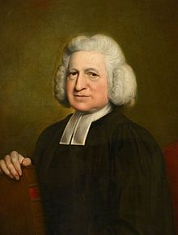

Slide 7
Testimony
³ And this is eternal life, that they know you, the only true God, and Jesus Christ whom you have sent.
¹¹ And this is the testimony, that God gave us eternal life, and this life is in his Son.
¹⁰ Whoever believes in the Son of God has the testimony in himself
¹² Whoever has the Son has life

Slide 8
⁸ Therefore do not be ashamed of the testimony about our Lord, nor of me his prisoner, but share in suffering for the gospel by the power of God, ⁹ who saved us and called us to a holy calling, not because of our works but because of his own purpose and grace, which he gave us in Christ Jesus before the ages began, ¹⁰ and which now has been manifested through the appearing of our Savior Christ Jesus, who abolished death and brought life and immortality to light through the gospel, ¹¹ for which I was appointed a preacher and apostle and teacher, ¹² which is why I suffer as I do. But I am not ashamed, for I know whom I have believed, and I am convinced that he is able to guard until that day what has been entrusted to me.
2 Timothy 1:8-12 ESV

Slide 9
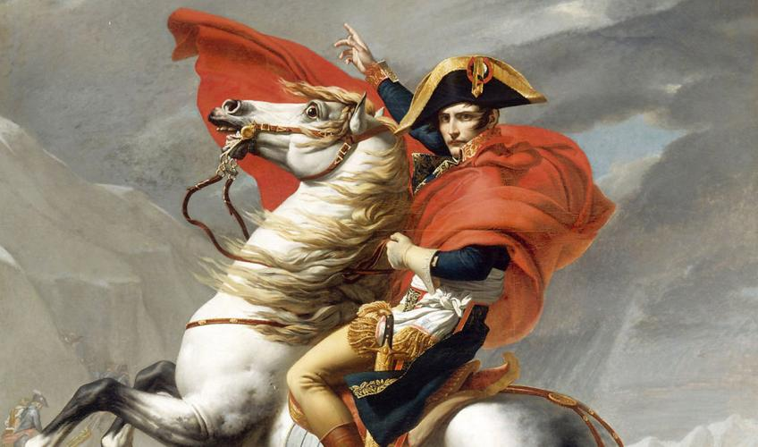

Slide 10
What wondrous blessings overflow,
When we can truly say, "I know"
I know in whom I have believed,
I know the One I have received,
I know His Blood avails for me,
I know that I was blind, but see,
I know that my Redeemer lives,
I know the gift He freely gives,
I know He'll keep me to the end,
I know He's my unfailing Friend,
I know He's coming in the sky,
I know the time is drawing nigh.
R.E. Neighbour

Slide 11
³ And this is eternal life, that they know you, the only true God, and Jesus Christ whom you have sent.
John 17:3 ESV

Slide 12
¹² Whoever has the Son has life; whoever does not have the Son of God does not have life.
1 John 5:12 ESV

