Slide 1
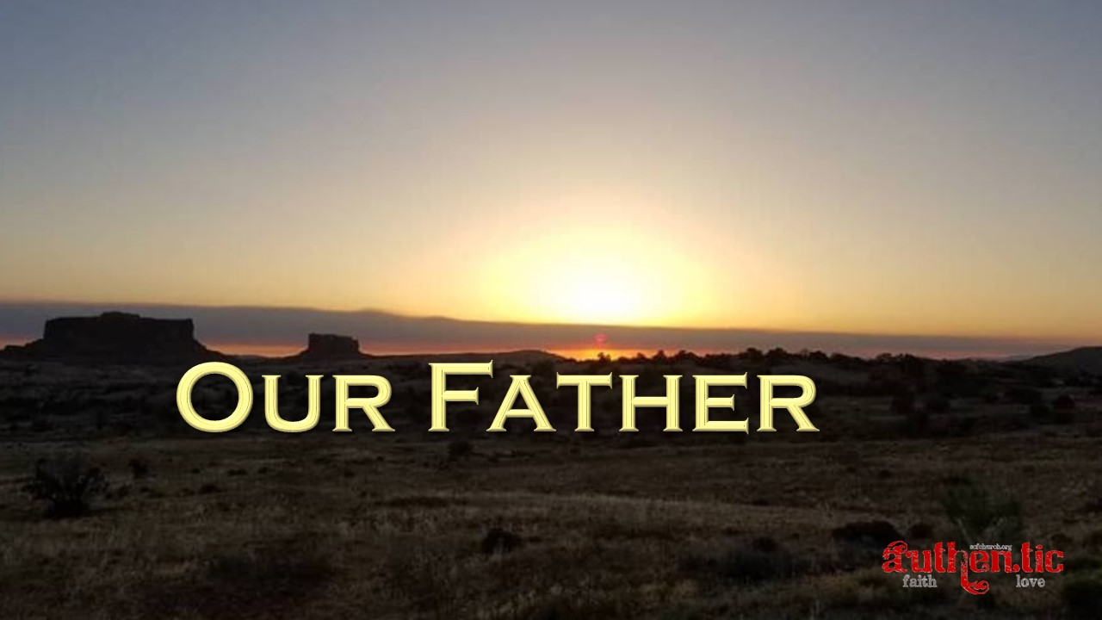

Slide 2
See what kind of love the Father has given to us, that we should be called children of God; and so we are.
1 John 1:3a ESV

Slide 3
³ And one called to another and said: “Holy, holy, holy is the Lord of hosts; the whole earth is full of his glory!”
Isaiah 6:3 ESV

Slide 4
²⁰ For his invisible attributes, namely, his eternal power and divine nature, have been clearly perceived, ever since the creation of the world, in the things that have been made. So they are without excuse.
Romans 1:20 ESV

Slide 5
²³ Let us hold fast the confession of our hope without wavering, for he who promised is faithful. ²⁴ And let us consider how to stir up one another to love and good works, ²⁵ not neglecting to meet together, as is the habit of some, but encouraging one another, and all the more as you see the Day drawing near.
Hebrews 10:23-25 ESV

Slide 6
For you, O Lord, have made me glad by your work; at the works of your hands I sing for joy.
Psalm 92:4 ESV

