Slide 1


Slide 2
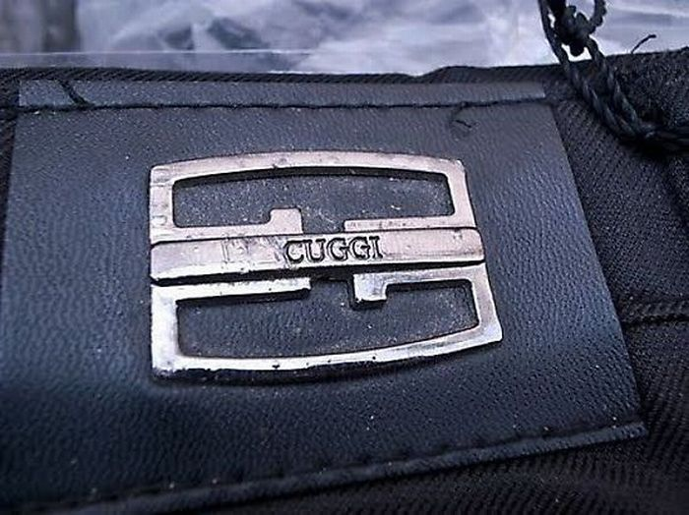
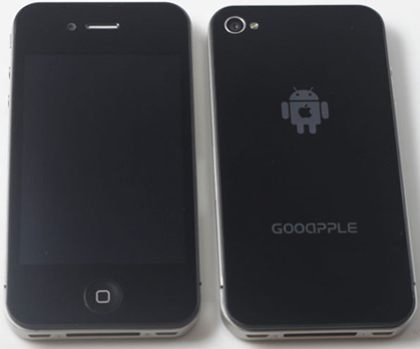

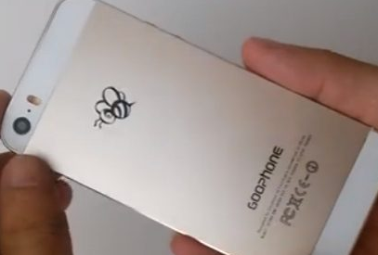

Slide 3
¹³ I write these things to you who believe in the name of the Son of God, that you may know that you have eternal life.
1 John 5:13 ESV

Slide 4
²¹ “Not everyone who says to me, ‘Lord, Lord,’ will enter the kingdom of heaven, but the one who does the will of my Father who is in heaven. ²² On that day many will say to me, ‘Lord, Lord, did we not prophesy in your name, and cast out demons in your name, and do many mighty works in your name?’ ²³ And then will I declare to them, ‘I never knew you; depart from me, you workers of lawlessness.’
Matthew 7:21-23 ESV

Slide 5

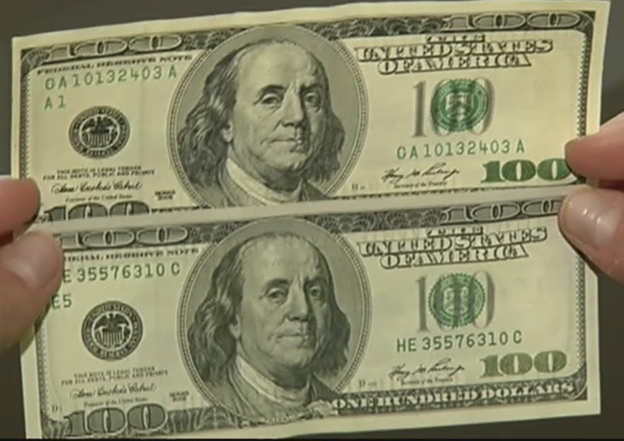

Slide 6
¹ This is what we proclaim to you: what was from the beginning, what we have heard, what we have seen with our eyes, what we have looked at and our hands have touched (concerning the word of life— ² and the life was revealed, and we have seen and testify and announce to you the eternal life that was with the Father and was revealed to us). ³ What we have seen and heard we announce to you too, so that you may have fellowship with us (and indeed our fellowship is with the Father and with his Son Jesus Christ). ⁴ Thus we are writing these things so that our joy may be complete.
1 John 1:1-4 NET

Slide 7
¹ In the beginning was the Word, and the Word was with God, and the Word was God. ² He was in the beginning with God. ³ All things were made through him, and without him was not any thing made that was made.
John 1:1-2 ESV

Slide 8
¹ This is what we proclaim to you: what was from the beginning, what we have heard, what we have seen with our eyes, what we have looked at and our hands have touched (concerning the word of life— ² and the life was revealed, and we have seen and testify and announce to you the eternal life that was with the Father and was revealed to us). ³ What we have seen and heard we announce to you too, so that you may have fellowship with us (and indeed our fellowship is with the Father and with his Son Jesus Christ). ⁴ Thus we are writing these things so that our joy may be complete.
1 John 1:1-4 NET

Slide 9
¹ This is what we proclaim to you: what was from the beginning, what we have heard, what we have seen with our eyes, what we have looked at and our hands have touched (concerning the word of life— ² and the life was revealed, and we have seen and testify and announce to you the eternal life that was with the Father and was revealed to us). ³ What we have seen and heard we announce to you too, so that you may have fellowship with us (and indeed our fellowship is with the Father and with his Son Jesus Christ). ⁴ Thus we are writing these things so that our joy may be complete.
1 John 1:1-4 NET

Slide 10
Fellowship
2 Corinthians 5:21 ESV - ²¹ For our sake he made him to be sin who knew no sin, so that in him we might become the righteousness of God.
1 Peter 3:18a ESV - For Christ also suffered once for sins, the righteous for the unrighteous, that he might bring us to God…

