Slide 1
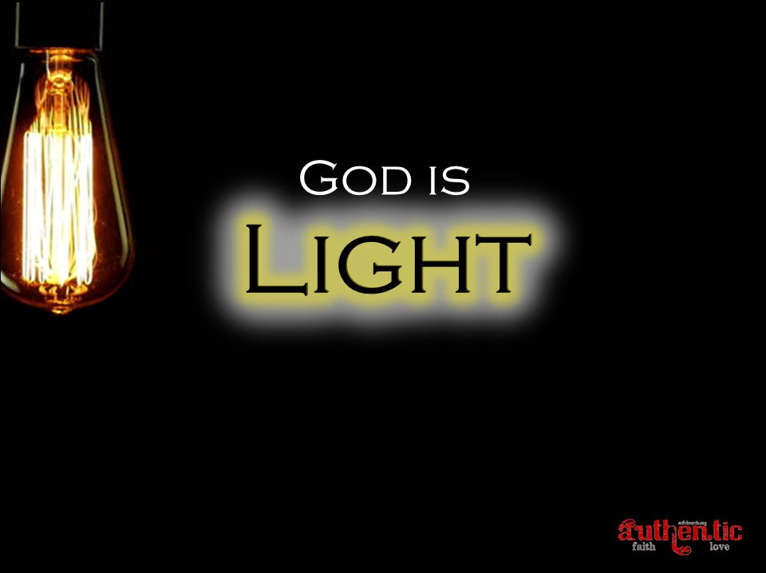

Slide 2
⁵ This is the message we have heard from him and proclaim to you, that God is light, and in him is no darkness at all. ⁶ If we say we have fellowship with him while we walk in darkness, we lie and do not practice the truth.⁷ But if we walk in the light, as he is in the light, we have fellowship with one another, and the blood of Jesus his Son cleanses us from all sin. ⁸ If we say we have no sin, we deceive ourselves, and the truth is not in us.⁹ If we confess our sins, he is faithful and just to forgive us our sins and to cleanse us from all unrighteousness.¹⁰ If we say we have not sinned, we make him a liar, and his word is not in us. ¹ My little children, I am writing these things to you so that you may not sin. But if anyone does sin, we have an advocate with the Father, Jesus Christ the righteous. ² He is the propitiation for our sins, and not for ours only but also for the sins of the whole world.
1 John 1:5-2:2 ESV

Slide 3


Slide 4
Light Revealed
Proverbs 6:23 ESV - ²³ For the commandment is a lamp and the teaching a light, and the reproofs of discipline are the way of life
Psalm 119:105 ESV - ¹⁰⁵ Your word is a lamp to my feet and a light to my path.
Psalm 119:130 ESV - ¹³⁰ The unfolding of your words gives light; it imparts understanding to the simple.
2 Peter 1:19 ESV - ¹⁹ And we have the prophetic word more fully confirmed, to which you will do well to pay attention as to a lamp shining in a dark place, until the day dawns and the morning star rises in your hearts

Slide 5
For what partnership has righteousness with lawlessness? Or what fellowship has light with darkness?
2 Corinthians 6:14b ESV

Slide 6
⁵ This is the message we have heard from him and proclaim to you, that God is light, and in him is no darkness at all. ⁶ If we say we have fellowship with him while we walk in darkness, we lie and do not practice the truth.⁷ But if we walk in the light, as he is in the light, we have fellowship with one another, and the blood of Jesus his Son cleanses us from all sin. ⁸ If we say we have no sin, we deceive ourselves, and the truth is not in us.⁹ If we confess our sins, he is faithful and just to forgive us our sins and to cleanse us from all unrighteousness.¹⁰ If we say we have not sinned, we make him a liar, and his word is not in us. ¹ My little children, I am writing these things to you so that you may not sin. But if anyone does sin, we have an advocate with the Father, Jesus Christ the righteous. ² He is the propitiation for our sins, and not for ours only but also for the sins of the whole world.
1 John 1:5-2:2 ESV

Slide 7
⁵ This is the message we have heard from him and proclaim to you, that God is light, and in him is no darkness at all. ⁶ If we say we have fellowship with him while we walk in darkness, we lie and do not practice the truth.⁷ But if we walk in the light, as he is in the light, we have fellowship with one another, and the blood of Jesus his Son cleanses us from all sin. ⁸ If we say we have no sin, we deceive ourselves, and the truth is not in us.⁹ If we confess our sins, he is faithful and just to forgive us our sins and to cleanse us from all unrighteousness.¹⁰ If we say we have not sinned, we make him a liar, and his word is not in us. ¹ My little children, I am writing these things to you so that you may not sin. But if anyone does sin, we have an advocate with the Father, Jesus Christ the righteous. ² He is the propitiation for our sins, and not for ours only but also for the sins of the whole world.
1 John 1:5-2:2 ESV

Slide 8
²¹ So I find it to be a law that when I want to do right, evil lies close at hand. ²² For I delight in the law of God, in my inner being, ²³ but I see in my members another law waging war against the law of my mind and making me captive to the law of sin that dwells in my members. ²⁴ Wretched man that I am! Who will deliver me from this body of death?
Romans 7:21-24 ESV

Slide 9
⁵ This is the message we have heard from him and proclaim to you, that God is light, and in him is no darkness at all. ⁶ If we say we have fellowship with him while we walk in darkness, we lie and do not practice the truth.⁷ But if we walk in the light, as he is in the light, we have fellowship with one another, and the blood of Jesus his Son cleanses us from all sin. ⁸ If we say we have no sin, we deceive ourselves, and the truth is not in us.⁹ If we confess our sins, he is faithful and just to forgive us our sins and to cleanse us from all unrighteousness.¹⁰ If we say we have not sinned, we make him a liar, and his word is not in us. ¹ My little children, I am writing these things to you so that you may not sin. But if anyone does sin, we have an advocate with the Father, Jesus Christ the righteous. ² He is the propitiation for our sins, and not for ours only but also for the sins of the whole world.
1 John 1:5-2:2 ESV

Slide 10
Universal Problem
1 Kings 8:46a ESV - ⁴⁶ …for there is no one who does not sin
Psalm 14:3 ESV - ³ They have all turned aside; together they have become corrupt; there is none who does good, not even one.
Ecclesiastes 7:20 ESV - ²⁰ Surely there is not a righteous man on earth who does good and never sins.
Isaiah 53:6a ESV - ⁶ All we like sheep have gone astray; we have turned—every one—to his own way;
Isaiah 64:6 ESV - ⁶ We have all become like one who is unclean, and all our righteous deeds are like a polluted garment. We all fade like a leaf, and our iniquities, like the wind, take us away

Slide 11
⁵ This is the message we have heard from him and proclaim to you, that God is light, and in him is no darkness at all. ⁶ If we say we have fellowship with him while we walk in darkness, we lie and do not practice the truth.⁷ But if we walk in the light, as he is in the light, we have fellowship with one another, and the blood of Jesus his Son cleanses us from all sin. ⁸ If we say we have no sin, we deceive ourselves, and the truth is not in us.⁹ If we confess our sins, he is faithful and just to forgive us our sins and to cleanse us from all unrighteousness.¹⁰ If we say we have not sinned, we make him a liar, and his word is not in us. ¹ My little children, I am writing these things to you so that you may not sin. But if anyone does sin, we have an advocate with the Father, Jesus Christ the righteous. ² He is the propitiation for our sins, and not for ours only but also for the sins of the whole world.
1 John 1:5-2:2 ESV

Slide 12
⁵ This is the message we have heard from him and proclaim to you, that God is light, and in him is no darkness at all. ⁶ If we say we have fellowship with him while we walk in darkness, we lie and do not practice the truth.⁷ But if we walk in the light, as he is in the light, we have fellowship with one another, and the blood of Jesus his Son cleanses us from all sin. ⁸ If we say we have no sin, we deceive ourselves, and the truth is not in us.⁹ If we confess our sins, he is faithful and just to forgive us our sins and to cleanse us from all unrighteousness.¹⁰ If we say we have not sinned, we make him a liar, and his word is not in us. ¹ My little children, I am writing these things to you so that you may not sin. But if anyone does sin, we have an advocate with the Father, Jesus Christ the righteous. ² He is the propitiation for our sins, and not for ours only but also for the sins of the whole world.
1 John 1:5-2:2 ESV

Slide 13
⁵ This is the message we have heard from him and proclaim to you, that God is light, and in him is no darkness at all. ⁶ If we say we have fellowship with him while we walk in darkness, we lie and do not practice the truth.⁷ But if we walk in the light, as he is in the light, we have fellowship with one another, and the blood of Jesus his Son cleanses us from all sin. ⁸ If we say we have no sin, we deceive ourselves, and the truth is not in us.⁹ If we confess our sins, he is faithful and just to forgive us our sins and to cleanse us from all unrighteousness.¹⁰ If we say we have not sinned, we make him a liar, and his word is not in us. ¹ My little children, I am writing these things to you so that you may not sin. But if anyone does sin, we have an advocate with the Father, Jesus Christ the righteous. ² He is the propitiation for our sins, and not for ours only but also for the sins of the whole world.
1 John 1:5-2:2 ESV

Slide 14
Christ Our Advocate
‘Our advocate does not plead that we are innocent, or adduce extenuating circumstances. He acknowledges our guilt and presents His vicarious work as the ground of our acquittal’
‘Christ’s intercession is the continual application of His death to our salvation’

