Slide 1


Slide 2
Oh give thanks to the Lord, for he is good; for his steadfast love endures forever!
Psalm 118:1 ESV

Slide 3
¹⁶ Rejoice always, ¹⁷ pray without ceasing, ¹⁸ give thanks in all circumstances; for this is the will of God in Christ Jesus for you.
1 Thessalonians 5:16-18 ESV

Slide 4
²² Are they Hebrews? So am I. Are they Israelites? So am I. Are they offspring of Abraham? So am I. ²³ Are they servants of Christ? I am a better one—I am talking like a madman—with far greater labors, far more imprisonments, with countless beatings, and often near death. ²⁴ Five times I received at the hands of the Jews the forty lashes less one. ²⁵ Three times I was beaten with rods. Once I was stoned. Three times I was shipwrecked; a night and a day I was adrift at sea; ²⁶ on frequent journeys, in danger from rivers, danger from robbers, danger from my own people, danger from Gentiles, danger in the city, danger in the wilderness, danger at sea, danger from false brothers; ²⁷ in toil and hardship, through many a sleepless night, in hunger and thirst, often without food, in cold and exposure. ²⁸ And, apart from other things, there is the daily pressure on me of my anxiety for all the churches. ²⁹ Who is weak, and I am not weak? Who is made to fall, and I am not indignant? ³⁰ If I must boast, I will boast of the things that show my weakness.
2 Corinthians 11:22-30 ESV

Slide 5
²⁰ And when they had brought them to the magistrates, they said, “These men are Jews, and they are disturbing our city. ²¹ They advocate customs that are not lawful for us as Romans to accept or practice.” ²² The crowd joined in attacking them, and the magistrates tore the garments off them and gave orders to beat them with rods. ²³ And when they had inflicted many blows upon them, they threw them into prison, ordering the jailer to keep them safely. ²⁴ Having received this order, he put them into the inner prison and fastened their feet in the stocks.
Acts 16:20-24 ESV

Slide 6
²⁵ About midnight Paul and Silas were praying and singing hymns to God, and the prisoners were listening to them
Acts 16:25 ESV

Slide 7
⁴ Rejoice in the Lord always; again I will say, rejoice. ⁵ Let your reasonableness be known to everyone. The Lord is at hand; ⁶ do not be anxious about anything, but in everything by prayer and supplication with thanksgiving let your requests be made known to God. ⁷ And the peace of God, which surpasses all understanding, will guard your hearts and your minds in Christ Jesus.
Philippians 4:4-7 ESV

Slide 8
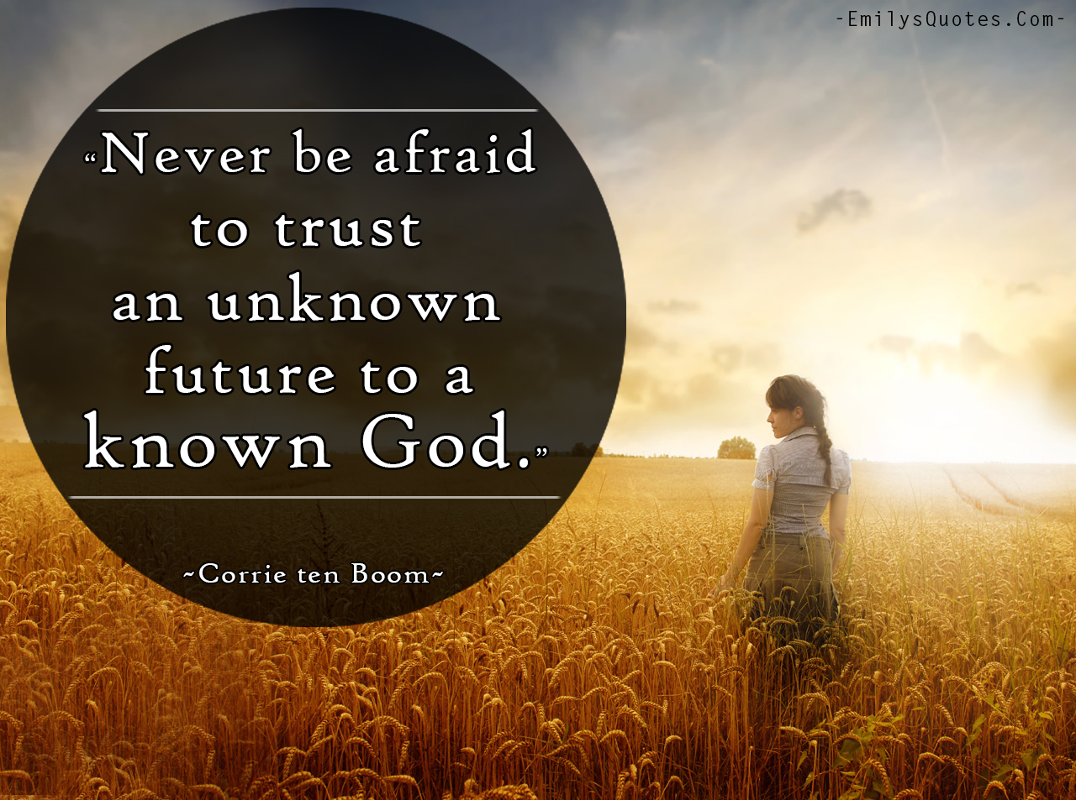

Slide 9
Now faith is being sure of what we hope for, being convinced of what we do not see.
Hebrews 11:1 NET

