Slide 1
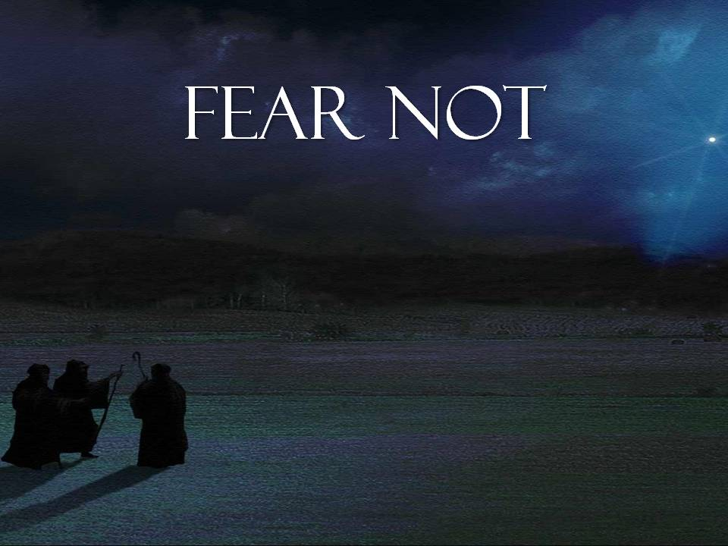

Slide 2
⁸ And in the same region there were shepherds out in the field, keeping watch over their flock by night. ⁹ And an angel of the Lord appeared to them, and the glory of the Lord shone around them, and they were filled with great fear.¹⁰ And the angel said to them, “Fear not, for behold, I bring you good news of great joy that will be for all the people. ¹¹ For unto you is born this day in the city of David a Savior, who is Christ the Lord. ¹² And this will be a sign for you: you will find a baby wrapped in swaddling cloths and lying in a manger.” ¹³ And suddenly there was with the angel a multitude of the heavenly host praising God and saying, ¹⁴ “Glory to God in the highest, and on earth peace among those with whom he is pleased!”
Luke 2:8-14 ESV

Slide 3
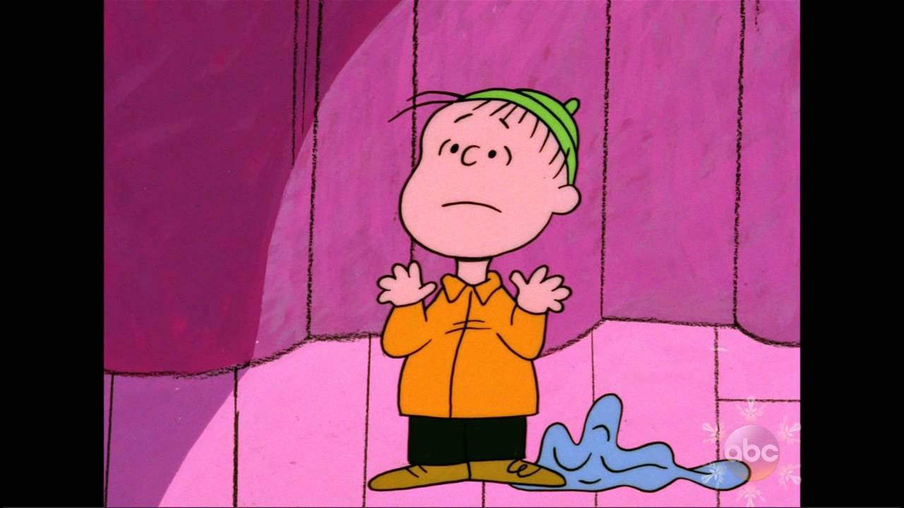
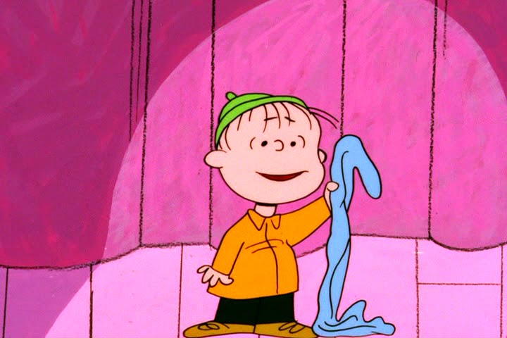

Slide 4
¹¹ For unto you is born this day in the city of David a Savior, who is Christ the Lord.
Luke 2:11 ESV

Slide 5
¹⁶ “For God so loved the world, that he gave his only Son, that whoever believes in him should not perish but have eternal life.
John 3:16 ESV

Slide 6
⁸ But God demonstrates his own love for us, in that while we were still sinners, Christ died for us.
Romans 5:8ESV

Slide 7
¹³ Greater love has no one than this, that someone lay down his life for his friends.
John 15:13 ESV

Slide 8
⁸ Anyone who does not love does not know God, because God is love. ⁹ In this the love of God was made manifest among us, that God sent his only Son into the world, so that we might live through him. ¹⁰ In this is love, not that we have loved God but that he loved us and sent his Son to be the propitiation for our sins.
1 John 4:8-10 ESV

Slide 9
And the life I now live in the flesh I live by faith in the Son of God, who loved me and gave himself for me.
Galatians 2:20b ESV

Slide 10
¹⁵ Whoever confesses that Jesus is the Son of God, God abides in him, and he in God. ¹⁶ So we have come to know and to believe the love that God has for us. God is love, and whoever abides in love abides in God, and God abides in him. ¹⁷ By this is love perfected with us, so that we may have confidence for the day of judgment, because as he is so also are we in this world. ¹⁸ There is no fear in love, but perfect love casts out fear.
1 John 4:15-18 ESV

Slide 12
God rest ye merry gentlemen, let nothing you dismay
Remember Christ our Savior was born on Christmas Day
To save us all from Satan's power when we were gone astray
O tidings of comfort and joy, comfort and joy
O tidings of comfort and joy

Slide 13
From God our Heavenly Father a blessed angel came
And unto certain shepherds brought tidings of the same
How that in Bethlehem was born the Son of God by name
O tidings of comfort and joy, comfort and joy
O tidings of comfort and joy

Slide 14
Joy to the world
For Christ our Lord has finally come
Let every heart receive the newborn King
O come all of heaven and nature sing!
O tidings of comfort and joy
O tidings of comfort and joy
O tidings of comfort and joy, comfort and joy
O tidings of comfort and joy

