Slide 1
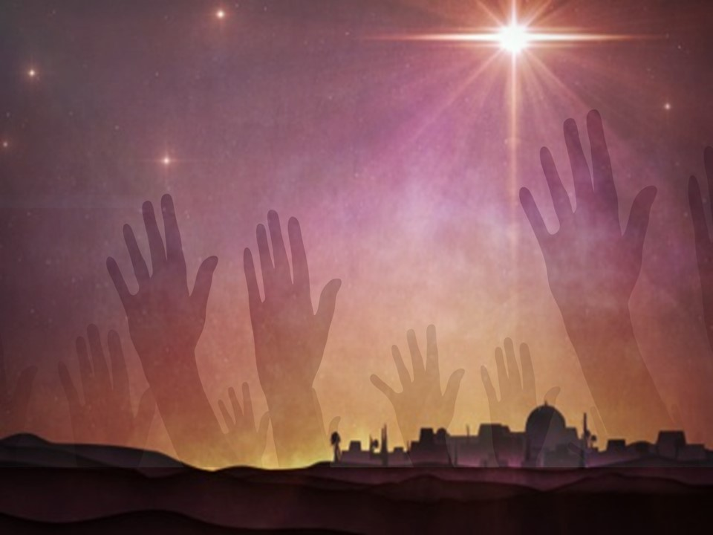
Come Let Us Adore Him

Slide 2
    ¹⁷ The Spirit and the Bride say, “Come.” And let the one who hears say, “Come.”
    And let the one who is thirsty come; let the one who desires take the water of life without price.
    Revelation 22:17 ESV

Slide 3
    ¹⁹ Therefore, brothers, since we have confidence to enter the holy places by the blood of Jesus, ²⁰ by the new and living way that he opened for us through the curtain, that is, through his flesh, ²¹ and since we have a great priest over the house of God, ²² let us draw near with a true heart in full assurance of faith, with our hearts sprinkled clean from an evil conscience and our bodies washed with pure water.
    Hebrews 10:19-22 ESV

Slide 4
Revelation 5:2 ESV - ² And I saw a mighty angel proclaiming with a loud voice, “Who is worthy to open the scroll and break its seals?”
Revelation 5:5 ESV - ⁵ And one of the elders said to me, “Weep no more; behold, the Lion of the tribe of Judah, the Root of David, has conquered, so that he can open the scroll and its seven seals.”
Revelation 5:9 ESV - ⁹ And they sang a new song, saying, “Worthy are you to take the scroll and to open its seals, for you were slain, and by your blood you ransomed people for God from every tribe and language and people and nation
Revelation 5:12a - “Worthy is the Lamb who was slain…

Slide 5
    For where your treasure is, there will your heart be also.
    Luke 12:34 ESV

Slide 6
    ¹⁷ Therefore he had to be made like his brothers in every respect, so that he might become a merciful and faithful high priest in the service of God, to make propitiation for the sins of the people.
    Hebrews 2:17 ESV

Slide 7
    ⁶⁸ “Blessed be the Lord God of Israel, for he has visited and redeemed his people ⁶⁹ and has raised up a horn of salvation for us in the house of his servant David, ⁷⁰ as he spoke by the mouth of his holy prophets from of old, ⁷¹ that we should be saved from our enemies and from the hand of all who hate us; ⁷² to show the mercy promised to our fathers and to remember his holy covenant, ⁷³ the oath that he swore to our father Abraham, to grant us ⁷⁴ that we, being delivered from the hand of our enemies, might serve him without fear, ⁷⁵ in holiness and righteousness before him all our days.
    Luke 1:68-75 ESV

