Slide 1
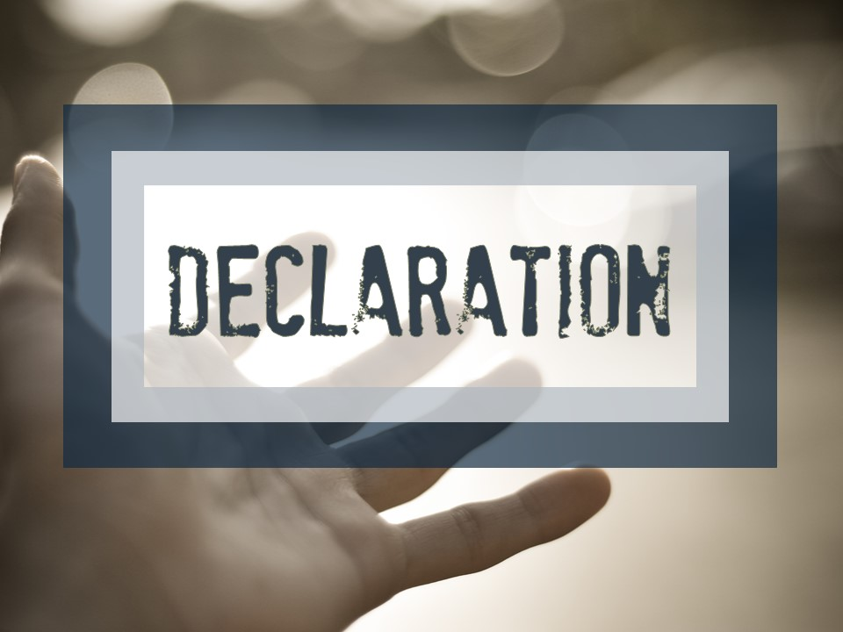

Slide 2
  ³³ For this is the covenant that I will make with the house of Israel after those days, declares the Lord: I will put my law within them, and I will write it on their hearts. And I will be their God, and they shall be my people. ³⁴ And no longer shall each one teach his neighbor and each his brother, saying, ‘Know the Lord,’ for they shall all know me, from the least of them to the greatest, declares the Lord. For I will forgive their iniquity, and I will remember their sin no more.”
  Jeremiah 31:33-34 ESV

Slide 3
  Children, obey your parents in the Lord, for this is right. ² “Honor your father and mother” (this is the first commandment with a promise),³ “that it may go well with you and that you may live long in the land.” ⁴ Fathers, do not provoke your children to anger, but bring them up in the discipline and instruction of the Lord.
  Ephesians 6:1-4 ESV

Slide 4
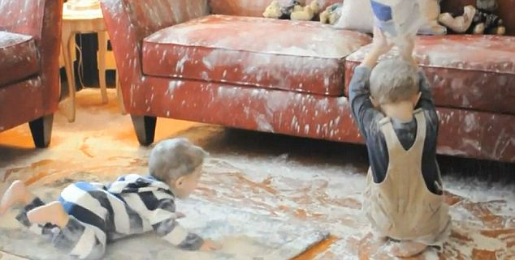
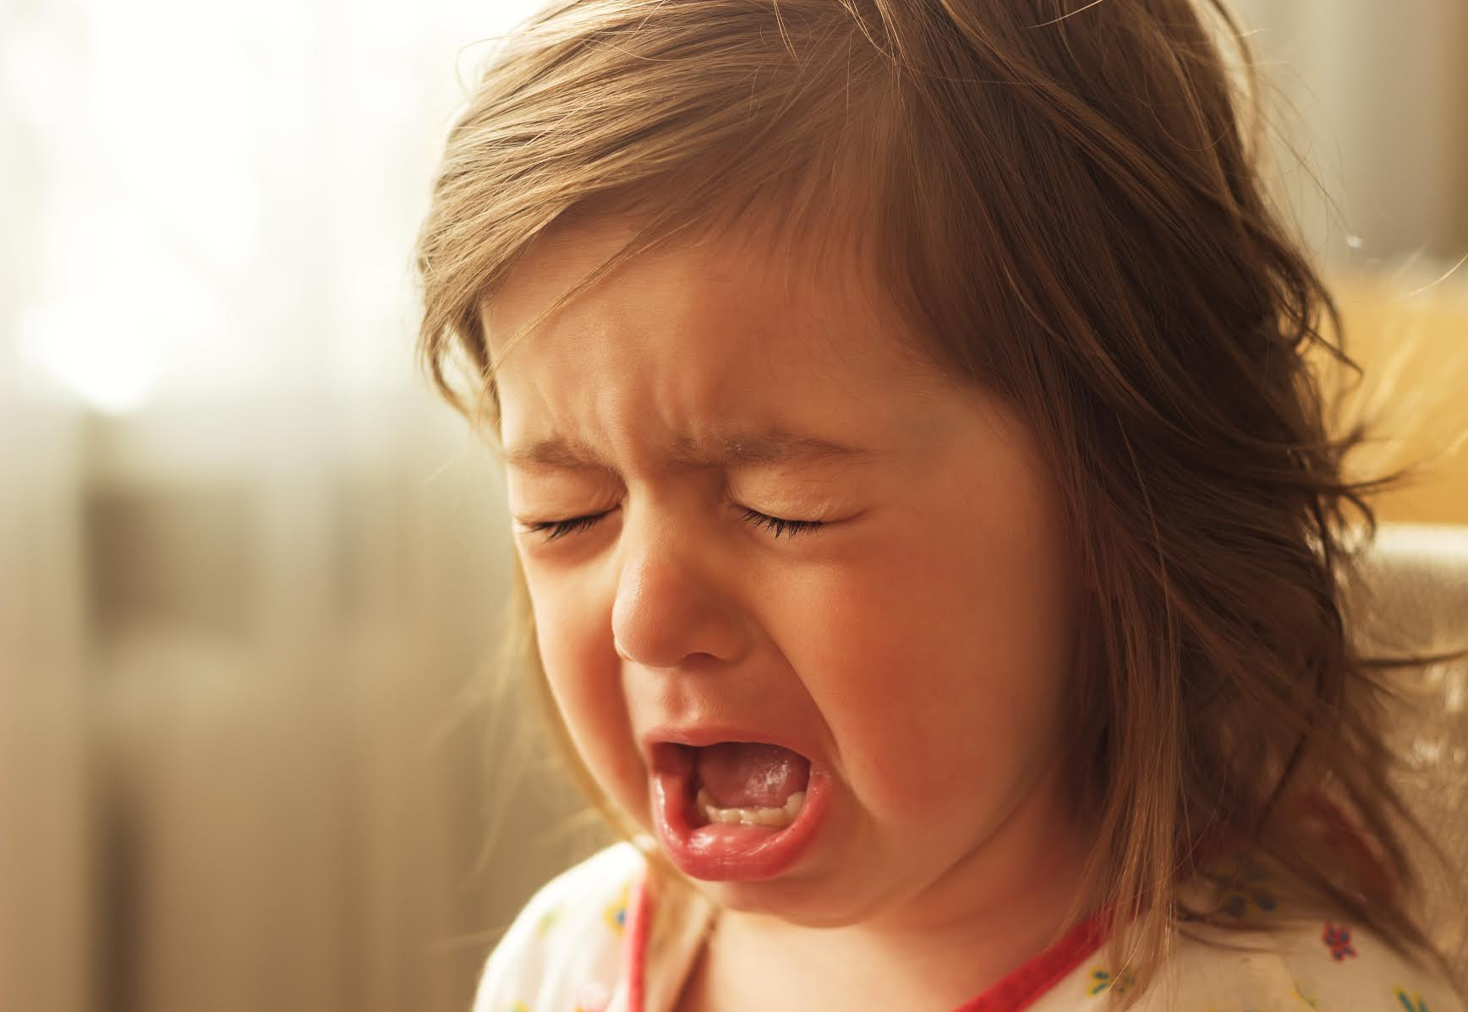
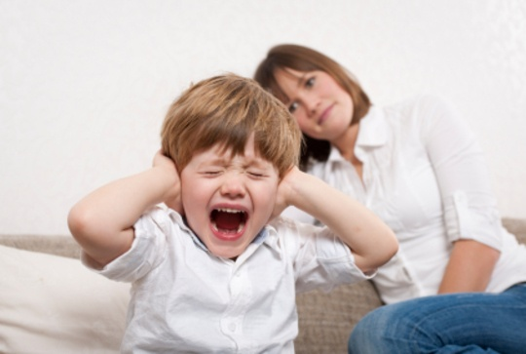

Slide 5
  ⁴ “Hear, O Israel: The Lord our God, the Lord is one. ⁵ You shall love the Lord your God with all your heart and with all your soul and with all your might. ⁶ And these words that I command you today shall be on your heart. ⁷ You shall teach them diligently to your children, and shall talk of them when you sit in your house, and when you walk by the way, and when you lie down, and when you rise. ⁸ You shall bind them as a sign on your hand, and they shall be as frontlets between your eyes. ⁹ You shall write them on the doorposts of your house and on your gates.
  Deuteronomy 6:4-9 ESV

Slide 6
  “Repent and be baptized every one of you in the name of Jesus Christ for the forgiveness of your sins, and you will receive the gift of the Holy Spirit. ³⁹ For the promise is for you and for your children and for all who are far off, everyone whom the Lord our God calls to himself.”
  Acts 2:38-40 ESV

Slide 7
  ⁴¹ So those who received his word were baptized
  Acts 2:41a ESV
¹² But when they believed Philip as he preached good news about the kingdom of God and the name of Jesus Christ, they were baptized, both men and women. ¹³ Even Simon himself believed, and after being baptized he continued with Philip.
Acts 8:12-13 ESV

Slide 8
  ¹³ For “everyone who calls on the name of the Lord will be saved.” ¹⁴ How then will they call on him in whom they have not believed? And how are they to believe in him of whom they have never heard? And how are they to hear without someone preaching?
  Romans 10:13-14 ESV

Slide 9
  I have been crucified with Christ. It is no longer I who live, but Christ who lives in me. And the life I now live in the flesh I live by faith in the Son of God, who loved me and gave himself for me.
  Galatians 2:20 ESV

Slide 10
  ¹² Having been buried with him in baptism, you also have been raised with him through your faith in the power of God who raised him from the dead. ¹³ And even though you were dead in your transgressions and in the uncircumcision of your flesh, he nevertheless made you alive with him, having forgiven all your transgressions.
  Colossians 2:12-13 NET

Slide 12
Alone in my sorrow and dead in my sin
Lost without hope with no place to begin
Your love made a way to let mercy come in
When death was arrested and my life began

Slide 13
Ash was redeemed only beauty remains
My orphan heart was given a name
My mourning grew quiet my feet rose to dance
When death was arrested and my life began

Slide 14
Oh Your grace so free washes over me
You have made me new now life begins with You
It's Your endless love pouring down on us
You have made us new now life begins with You

Slide 15
Released from my chains I'm a pris'ner no more
My shame was a ransom He faithfully bore
He cancelled my debt and He called me His friend
When death was arrested and my life began

Slide 16
Oh Your grace so free washes over me
You have made me new now life begins with You
It's Your endless love pouring down on us
You have made us new now life begins with You

Slide 17
Our Savior displayed on a criminal's cross
Darkness rejoiced as though Heaven had lost
But then Jesus arose with our freedom in hand
That's when death was arrested and my life began

Slide 18
Oh Your grace so free washes over me
You have made me new now life begins with You
It's Your endless love pouring down on us
You have made us new now life begins with You

Slide 19
Oh we're free free forever we're free
Come join the song of all the redeemed
Yes we're free free forever amen
When death was arrested and my life began

Slide 20
Oh Your grace so free washes over me
You have made me new now life begins with You
It's Your endless love pouring down on us
You have made us new now life begins with You

