Slide 1
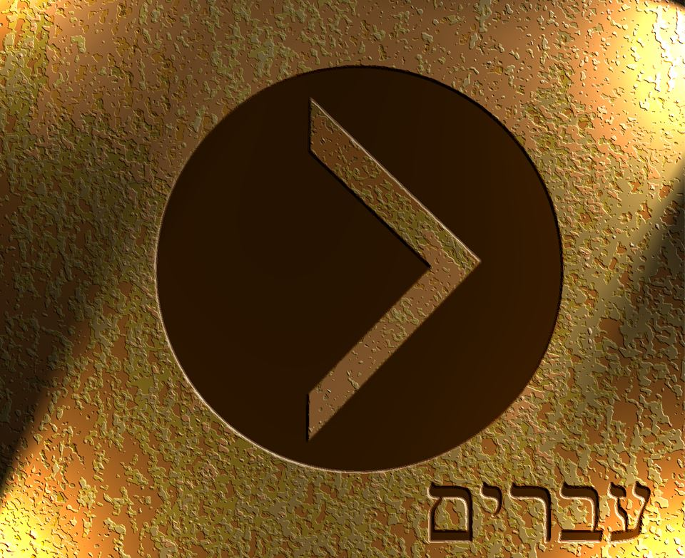

Slide 2
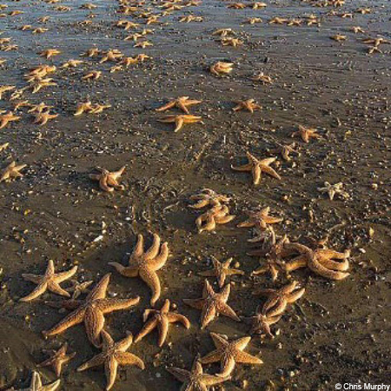

Slide 3
Now the first covenant, in fact, had regulations for worship and its earthly sanctuary. ² For a tent was prepared, the outer one, which contained the lampstand, the table, and the presentation of the loaves; this is called the holy place. ³ And after the second curtain there was a tent called the holy of holies. ⁴ It contained the golden altar of incense and the ark of the covenant covered entirely with gold. In this ark were the golden urn containing the manna, Aaron’s rod that budded, and the stone tablets of the covenant. ⁵ And above the ark were the cherubim of glory overshadowing the mercy seat. Now is not the time to speak of these things in detail. ⁶ So with these things prepared like this, the priests enter continually into the outer tent as they perform their duties. ⁷ But only the high priest enters once a year into the inner tent, and not without blood that he offers for himself and for the sins of the people committed in ignorance. ⁸ The Holy Spirit is making clear that the way into the holy place had not yet appeared as long as the old tabernacle was standing. ⁹ This was a symbol for the time then present, when gifts and sacrifices were offered that could not perfect the conscience of the worshiper. ¹⁰ They served only for matters of food and drink and various washings; they are external regulations imposed until the new order came.
Hebrews 9:1-11 NET

Slide 4
¹¹ But now Christ has come as the high priest of the good things to come. He passed through the greater and more perfect tent not made with hands, that is, not of this creation, ¹² and he entered once for all into the most holy place not by the blood of goats and calves but by his own blood, and so he himself secured eternal redemption. ¹³ For if the blood of goats and bulls and the ashes of a young cow sprinkled on those who are defiled consecrated them and provided ritual purity, ¹⁴ how much more will the blood of Christ, who through the eternal Spirit offered himself without blemish to God, purify our consciences from dead works to worship the living God.
Hebrews 9:11-14 NET

Slide 5
  ⁸ The Holy Spirit is making clear that the way into the holy place had not yet appeared as long as the old tabernacle was standing. ⁹ This was a symbol for the time then present, when gifts and sacrifices were offered that could not perfect the conscience of the worshiper. ¹⁰ They served only for matters of food and drink and various washings; they are external regulations imposed until the new order came.
  Hebrews 9:8-10 NET

Slide 6
¹¹ But now Christ has come as the high priest of the good things to come. He passed through the greater and more perfect tent not made with hands, that is, not of this creation, ¹² and he entered once for all into the most holy place not by the blood of goats and calves but by his own blood, and so he himself secured eternal redemption. ¹³ For if the blood of goats and bulls and the ashes of a young cow sprinkled on those who are defiled consecrated them and provided ritual purity, ¹⁴ how much more will the blood of Christ, who through the eternal Spirit offered himself without blemish to God, purify our consciences from dead works to worship the living God.
Hebrews 9:11-14 NET

Slide 7
¹¹ But now Christ has come as the high priest of the good things to come. He passed through the greater and more perfect tent not made with hands, that is, not of this creation, ¹² and he entered once for all into the most holy place not by the blood of goats and calves but by his own blood, and so he himself secured eternal redemption. ¹³ For if the blood of goats and bulls and the ashes of a young cow sprinkled on those who are defiled consecrated them and provided ritual purity, ¹⁴ how much more will the blood of Christ, who through the eternal Spirit offered himself without blemish to God, purify our consciences from dead works to worship the living God.
Hebrews 9:11-14 NET

Slide 8
¹¹ But now Christ has come as the high priest of the good things to come. He passed through the greater and more perfect tent not made with hands, that is, not of this creation, ¹² and he entered once for all into the most holy place not by the blood of goats and calves but by his own blood, and so he himself secured eternal redemption. ¹³ For if the blood of goats and bulls and the ashes of a young cow sprinkled on those who are defiled consecrated them and provided ritual purity, ¹⁴ how much more will the blood of Christ, who through the eternal Spirit offered himself without blemish to God, purify our consciences from dead works to worship the living God.
Hebrews 9:11-14 NET

Slide 9
“For I will be merciful toward their evil deeds, and their sins I will remember no longer.”
Hebrews 8:12 NET

Slide 10
¹¹ But now Christ has come as the high priest of the good things to come. He passed through the greater and more perfect tent not made with hands, that is, not of this creation, ¹² and he entered once for all into the most holy place not by the blood of goats and calves but by his own blood, and so he himself secured eternal redemption. ¹³ For if the blood of goats and bulls and the ashes of a young cow sprinkled on those who are defiled consecrated them and provided ritual purity, ¹⁴ how much more will the blood of Christ, who through the eternal Spirit offered himself without blemish to God, purify our consciences from dead works to worship the living God.
Hebrews 9:11-14 NET

Slide 11
I appeal to you therefore, brothers, by the mercies of God, to present your bodies as a living sacrifice, holy and acceptable to God, which is your spiritual worship.
Romans 12:1 ESV

Slide 12
Clean Conscience
Romans 8:1 – There is therefore now no condemnation for those who are in Christ Jesus.
Romans 8:33 ESV - ³³ Who shall bring any charge against God's elect?
Hebrews 8:12 ESV - For I will be merciful toward their iniquities, and I will remember their sins no more.”
Hebrews 10:19-23 ESV - ¹⁹ Therefore, brothers, since we have confidence to enter the holy places by the blood of Jesus, ²⁰ by the new and living way that he opened for us through the curtain, that is, through his flesh, 21 and since we have a great priest over the house of God, 22 let us draw near with a true heart in full assurance of faith, with our hearts sprinkled clean from an evil conscience and our bodies washed with pure water. 23 Let us hold fast the confession of our hope without wavering, for he who promised is faithful.

Slide 13
¹⁶ In the same way, let your light shine before others, so that they may see your good works and give glory to your Father who is in heaven.
Matthew 5:16 ESV

