Slide 1
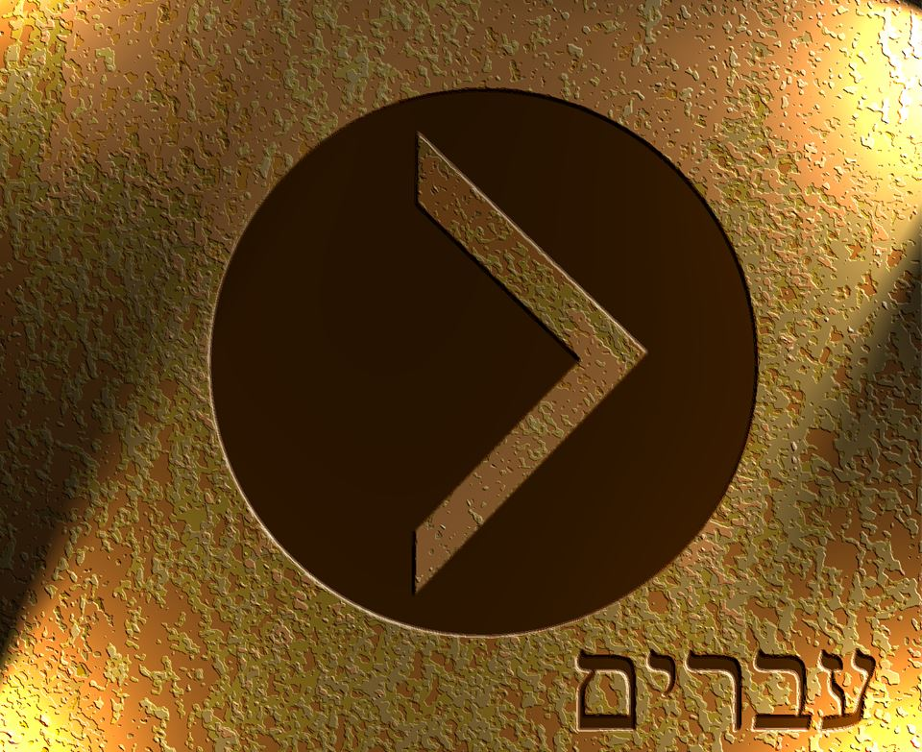

Slide 2
¹ Long ago, at many times and in many ways, God spoke to our fathers by the prophets, ² but in these last days he has spoken to us by his Son, whom he appointed the heir of all things, through whom also he created the world. ³ He is the radiance of the glory of God and the exact imprint of his nature, and he upholds the universe by the word of his power. After making purification for sins, he sat down at the right hand of the Majesty on high, ⁴ having become as much superior to angels as the name he has inherited is more excellent than theirs. ⁵ For to which of the angels did God ever say, “You are my Son, today I have begotten you”? Or again, “I will be to him a father, and he shall be to me a son”? ⁶ And again, when he brings the firstborn into the world, he says, “Let all God's angels worship him.” ⁷ Of the angels he says, “He makes his angels winds, and his ministers a flame of fire.” ⁸ But of the Son he says, “Your throne, O God, is forever and ever, the scepter of uprightness is the scepter of your kingdom.
⁹ You have loved righteousness and hated wickedness; therefore God, your God, has anointed you with the oil of gladness beyond your companions.” ¹⁰ And, “You, Lord, laid the foundation of the earth in the beginning, and the heavens are the work of your hands; ¹¹ they will perish, but you remain; they will all wear out like a garment, ¹² like a robe you will roll them up, like a garment they will be changed. But you are the same, and your years will have no end.” ¹³ And to which of the angels has he ever said, “Sit at my right hand until I make your enemies a footstool for your feet”? ¹⁴ Are they not all ministering spirits sent out to serve for the sake of those who are to inherit salvation?

Slide 3
¹ Long ago, at many times and in many ways, God spoke to our fathers by the prophets, ² but in these last days he has spoken to us by his Son, whom he appointed the heir of all things, through whom also he created the world. ³ He is the radiance of the glory of God and the exact imprint of his nature, and he upholds the universe by the word of his power. After making purification for sins, he sat down at the right hand of the Majesty on high, ⁴ having become as much superior to angels as the name he has inherited is more excellent than theirs. ⁵ For to which of the angels did God ever say, “You are my Son, today I have begotten you”? Or again, “I will be to him a father, and he shall be to me a son”? ⁶ And again, when he brings the firstborn into the world, he says, “Let all God's angels worship him.” ⁷ Of the angels he says, “He makes his angels winds, and his ministers a flame of fire.” ⁸ But of the Son he says, “Your throne, O God, is forever and ever, the scepter of uprightness is the scepter of your kingdom.
⁹ You have loved righteousness and hated wickedness; therefore God, your God, has anointed you with the oil of gladness beyond your companions.” ¹⁰ And, “You, Lord, laid the foundation of the earth in the beginning, and the heavens are the work of your hands; ¹¹ they will perish, but you remain; they will all wear out like a garment, ¹² like a robe you will roll them up, like a garment they will be changed. But you are the same, and your years will have no end.” ¹³ And to which of the angels has he ever said, “Sit at my right hand until I make your enemies a footstool for your feet”? ¹⁴ Are they not all ministering spirits sent out to serve for the sake of those who are to inherit salvation?

Slide 4
¹ Long ago, at many times and in many ways, God spoke to our fathers by the prophets, ² but in these last days he has spoken to us by his Son, whom he appointed the heir of all things, through whom also he created the world. ³ He is the radiance of the glory of God and the exact imprint of his nature, and he upholds the universe by the word of his power. After making purification for sins, he sat down at the right hand of the Majesty on high, ⁴ having become as much superior to angels as the name he has inherited is more excellent than theirs. ⁵ For to which of the angels did God ever say, “You are my Son, today I have begotten you”? Or again, “I will be to him a father, and he shall be to me a son”? ⁶ And again, when he brings the firstborn into the world, he says, “Let all God's angels worship him.” ⁷ Of the angels he says, “He makes his angels winds, and his ministers a flame of fire.” ⁸ But of the Son he says, “Your throne, O God, is forever and ever, the scepter of uprightness is the scepter of your kingdom.
⁹ You have loved righteousness and hated wickedness; therefore God, your God, has anointed you with the oil of gladness beyond your companions.” ¹⁰ And, “You, Lord, laid the foundation of the earth in the beginning, and the heavens are the work of your hands; ¹¹ they will perish, but you remain; they will all wear out like a garment, ¹² like a robe you will roll them up, like a garment they will be changed. But you are the same, and your years will have no end.” ¹³ And to which of the angels has he ever said, “Sit at my right hand until I make your enemies a footstool for your feet”? ¹⁴ Are they not all ministering spirits sent out to serve for the sake of those who are to inherit salvation?

Slide 5
¹ In the beginning was the Word, and the Word was with God, and the Word was God. ² He was in the beginning with God. ³ All things were made through him, and without him was not any thing made that was made.
John 1:1-3 ESV

Slide 6
¹⁶ For by him all things were created, in heaven and on earth, visible and invisible, whether thrones or dominions or rulers or authorities—all things were created through him and for him.
Colossians 1:16 ESV

Slide 7
Heir of All Things
Matthew 3:16-17 ESV - ¹⁶ And when Jesus was baptized, immediately he went up from the water, and behold, the heavens were opened to him, and he saw the Spirit of God descending like a dove and coming to rest on him; ¹⁷ and behold, a voice from heaven said, “This is my beloved Son, with whom I am well pleased.”
Matthew 17:5 ESV - ⁵ He was still speaking when, behold, a bright cloud overshadowed them, and a voice from the cloud said, “This is my beloved Son, with whom I am well pleased; listen to him.”

Slide 8
Heir of All Things
Psalm 24:1 ESV - The earth is the Lord's and the fullness thereof, the world and those who dwell therein
John 3:31-35 ESV - ³¹ He who comes from above is above all. He who is of the earth belongs to the earth and speaks in an earthly way. He who comes from heaven is above all. ³² He bears witness to what he has seen and heard, yet no one receives his testimony. ³³ Whoever receives his testimony sets his seal to this, that God is true. ³⁴ For he whom God has sent utters the words of God, for he gives the Spirit without measure. ³⁵ The Father loves the Son and has given all things into his hand.

Slide 9
¹⁷ And he is before all things, and in him all things hold together.
Colossians 1:17 ESV

Slide 10
¹⁴ And the Word became flesh and dwelt among us, and we have seen his glory, glory as of the only Son from the Father, full of grace and truth.
John 1:14 ESV

Slide 11
¹³ Now when Jesus came into the district of Caesarea Philippi, he asked his disciples, “Who do people say that the Son of Man is?” ¹⁴ And they said, “Some say John the Baptist, others say Elijah, and others Jeremiah or one of the prophets.”
Matthew 16:13-14 ESV

Slide 12
¹⁷ Elijah was a man with a nature like ours, and he prayed fervently that it might not rain, and for three years and six months it did not rain on the earth. ¹⁸ Then he prayed again, and heaven gave rain, and the earth bore its fruit.
James 5:17-18 ESV

Slide 13
¹⁹ and what is the immeasurable greatness of his power toward us who believe, according to the working of his great might ²⁰ that he worked in Christ when he raised him from the dead and seated him at his right hand in the heavenly places, ²¹ far above all rule and authority and power and dominion, and above every name that is named, not only in this age but also in the one to come. ²² And he put all things under his feet and gave him as head over all things to the church, ²³ which is his body, the fullness of him who fills all in all.
Ephesians 1:19-22 ESV

Slide 14
Therefore we must pay much closer attention to what we have heard, lest we drift away from it.
Hebrews 2:1 ESV

