Slide 1


Slide 2
⁵ For it was not to angels that God subjected the world to come, of which we are speaking. ⁶ It has been testified somewhere, “What is man, that you are mindful of him, or the son of man, that you care for him? ⁷ You made him for a little while lower than the angels; you have crowned him with glory and honor, ⁸putting everything in subjection under his feet.” Now in putting everything in subjection to him, he left nothing outside his control. At present, we do not yet see everything in subjection to him. ⁹ But we see him who for a little while was made lower than the angels, namely Jesus, crowned with glory and honor because of the suffering of death, so that by the grace of God he might taste death for everyone.
Hebrews 2:5-9 ESV

Slide 3
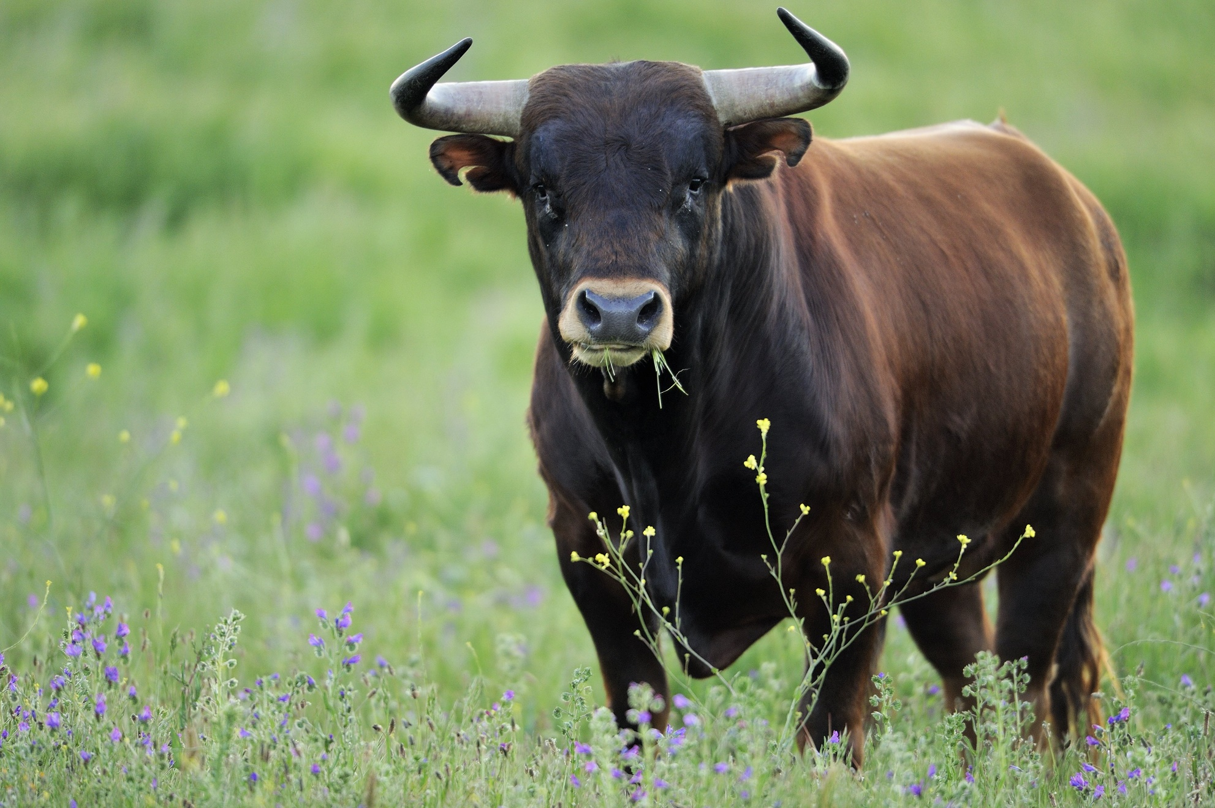

Slide 4
O Lord, our Lord, how majestic is your name in all the earth! You have set your glory above the heavens. ²Out of the mouth of babies and infants, you have established strength because of your foes, to still the enemy and the avenger. ³ When I look at your heavens, the work of your fingers, the moon and the stars, which you have set in place, ⁴ what is man that you are mindful of him, and the son of man that you care for him? ⁵ Yet you have made him a little lower than the heavenly beings and crowned him with glory and honor. ⁶ You have given him dominion over the works of your hands; you have put all things under his feet, ⁷ all sheep and oxen, and also the beasts of the field, ⁸ the birds of the heavens, and the fish of the sea, whatever passes along the paths of the seas. ⁹ O Lord, our Lord, how majestic is your name in all the earth!
Psalm 8 ESV

Slide 5
O Lord, our Lord, how majestic is your name in all the earth! You have set your glory above the heavens. ²Out of the mouth of babies and infants, you have established strength because of your foes, to still the enemy and the avenger. ³ When I look at your heavens, the work of your fingers, the moon and the stars, which you have set in place, ⁴ what is man that you are mindful of him, and the son of man that you care for him? ⁵ Yet you have made him a little lower than the heavenly beings and crowned him with glory and honor. ⁶ You have given him dominion over the works of your hands; you have put all things under his feet, ⁷ all sheep and oxen, and also the beasts of the field, ⁸ the birds of the heavens, and the fish of the sea, whatever passes along the paths of the seas. ⁹ O Lord, our Lord, how majestic is your name in all the earth!
Psalm 8 ESV

Slide 6
²⁶ Then God said, “Let us make man in our image, after our likeness. And let them have dominion over the fish of the sea and over the birds of the heavens and over the livestock and over all the earth and over every creeping thing that creeps on the earth.” ²⁷ So God created man in his own image, in the image of God he created him; male and female he created them. ²⁸ And God blessed them. And God said to them, “Be fruitful and multiply and fill the earth and subdue it, and have dominion over the fish of the sea and over the birds of the heavens and over every living thing that moves on the earth.”
Genesis 1:26-28 ESV

Slide 7
¹⁵ I will put enmity between you and the woman, and between your offspring and her offspring; he shall bruise your head, and you shall bruise his heel.”
Genesis 3:15 ESV

Slide 8
¹⁹ and what is the immeasurable greatness of his power toward us who believe, according to the working of his great might ²⁰ that he worked in Christ when he raised him from the dead and seated him at his right hand in the heavenly places, ²¹ far above all rule and authority and power and dominion, and above every name that is named, not only in this age but also in the one to come. ²² And he put all things under his feet and gave him as head over all things to the church, ²³ which is his body, the fullness of him who fills all in all.
Ephesians 1:19-23 ESV

Slide 9
¹⁸ And Jesus came and said to them, “All authority in heaven and on earth has been given to me.
Matthew 28:18 ESV

Slide 10
Luke 1:33 ESV - ³³ and he will reign over the house of Jacob forever, and of his kingdom there will be no end.”
Hebrews 1:12 ESV - like a robe you will roll them up, like a garment they will be changed. But you are the same, and your years will have no end.”
1 Timothy 6:15b-16 ESV - he who is the blessed and only Sovereign, the King of kings and Lord of lords, ¹⁶ who alone has immortality, who dwells in unapproachable light, whom no one has ever seen or can see. To him be honor and eternal dominion. Amen.
1 Peter 5:11 ESV - To him be the dominion forever and ever. Amen.
Jude 1:25 ESV - to the only God, our Savior, through Jesus Christ our Lord, be glory, majesty, dominion, and authority, before all time and now and forever. Amen.

Slide 11
¹³ He has delivered us from the domain of darkness and transferred us to the kingdom of his beloved Son, ¹⁴ in whom we have redemption, the forgiveness of sins.
Colossians 1:13-14 ESV

Slide 12
⁵ For it was not to angels that God subjected the world to come, of which we are speaking. ⁶ It has been testified somewhere, “What is man, that you are mindful of him, or the son of man, that you care for him? ⁷ You made him for a little while lower than the angels; you have crowned him with glory and honor, ⁸putting everything in subjection under his feet.” Now in putting everything in subjection to him, he left nothing outside his control. At present, we do not yet see everything in subjection to him. ⁹ But we see him who for a little while was made lower than the angels, namely Jesus, crowned with glory and honor because of the suffering of death, so that by the grace of God he might taste death for everyone.
Hebrews 2:5-9 ESV

Slide 13
Therefore, preparing your minds for action, and being sober-minded, set your hope fully on the grace that will be brought to you at the revelation of Jesus Christ.
1 Peter 1:13 ESV

Slide 14
⁵ For it was not to angels that God subjected the world to come, of which we are speaking. ⁶ It has been testified somewhere, “What is man, that you are mindful of him, or the son of man, that you care for him? ⁷ You made him for a little while lower than the angels; you have crowned him with glory and honor, ⁸putting everything in subjection under his feet.” Now in putting everything in subjection to him, he left nothing outside his control. At present, we do not yet see everything in subjection to him. ⁹ But we see him who for a little while was made lower than the angels, namely Jesus, crowned with glory and honor because of the suffering of death, so that by the grace of God he might taste death for everyone.
Hebrews 2:5-9 ESV

Slide 15
¹⁸ And Jesus came and said to them, “All authority in heaven and on earth has been given to me.
¹⁹ Go therefore and make disciples of all nations, baptizing them in the name of the Father and of the Son and of the Holy Spirit, ²⁰ teaching them to observe all that I have commanded you. And behold, I am with you always, to the end of the age.”
Matthew 28:18-20 ESV
? ? ?

Slide 16

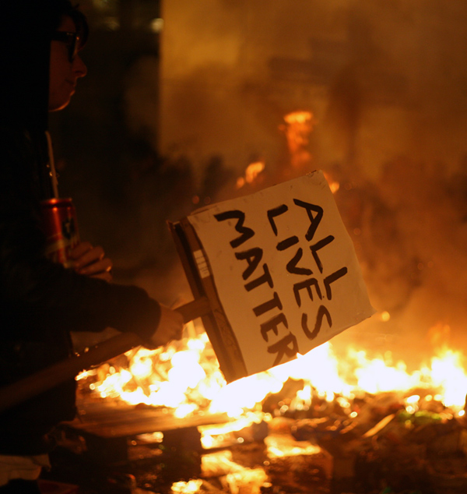


Slide 17


