Slide 1
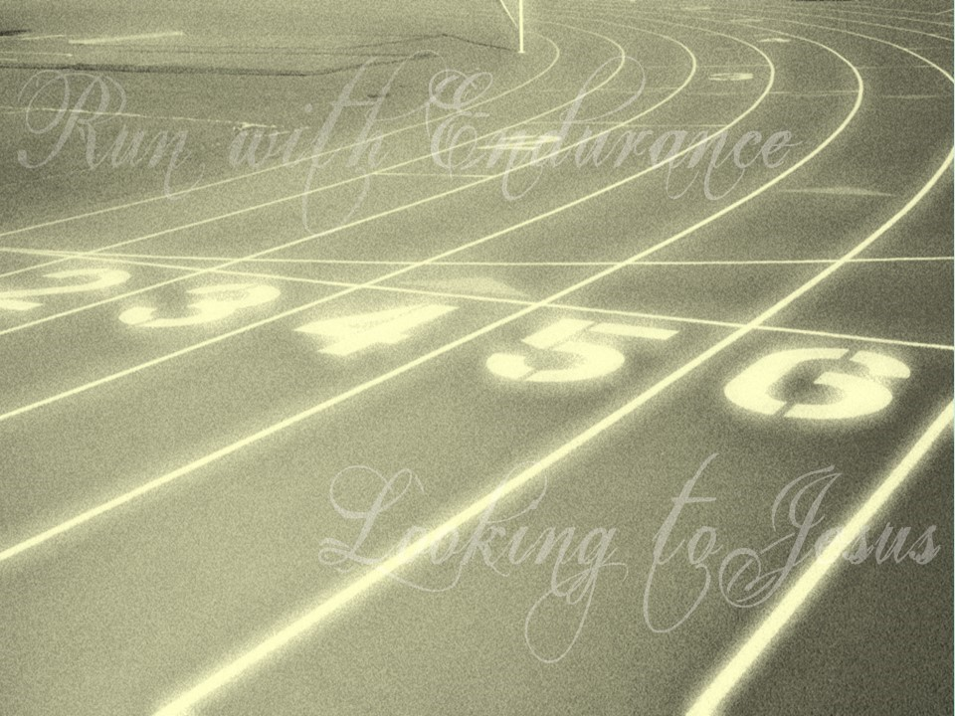

Slide 2
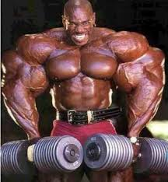


Slide 3
  Therefore, since we are surrounded by so great a cloud of witnesses, let us also lay aside every weight, and sin which clings so closely, and let us run with endurance the race that is set before us, ² looking to Jesus, the founder and perfecter of our faith, who for the joy that was set before him endured the cross, despising the shame, and is seated at the right hand of the throne of God. ³ Consider him who endured from sinners such hostility against himself, so that you may not grow weary or fainthearted. ⁴ In your struggle against sin you have not yet resisted to the point of shedding your blood. ⁵ And have you forgotten the exhortation that addresses you as sons? “My son, do not regard lightly the discipline of the Lord, nor be weary when reproved by him. ⁶ For the Lord disciplines the one he loves, and chastises every son whom he receives.” ⁷ It is for discipline that you have to endure. God is treating you as sons. For what son is there whom his father does not discipline? ⁸ If you are left without discipline, in which all have participated, then you are illegitimate children and not sons. ⁹ Besides this, we have had earthly fathers who disciplined us and we respected them. Shall we not much more be subject to the Father of spirits and live? ¹⁰ For they disciplined us for a short time as it seemed best to them, but he disciplines us for our good, that we may share his holiness. ¹¹ For the moment all discipline seems painful rather than pleasant, but later it yields the peaceful fruit of righteousness to those who have been trained by it.
  Hebrews 12:1-11 ESV

Slide 4
  Therefore, since we are surrounded by so great a cloud of witnesses, let us also lay aside every weight, and sin which clings so closely, and let us run with endurance the race that is set before us, ² looking to Jesus, the founder and perfecter of our faith, who for the joy that was set before him endured the cross, despising the shame, and is seated at the right hand of the throne of God. ³ Consider him who endured from sinners such hostility against himself, so that you may not grow weary or fainthearted. ⁴ In your struggle against sin you have not yet resisted to the point of shedding your blood. ⁵ And have you forgotten the exhortation that addresses you as sons? “My son, do not regard lightly the discipline of the Lord, nor be weary when reproved by him. ⁶ For the Lord disciplines the one he loves, and chastises every son whom he receives.” ⁷ It is for discipline that you have to endure. God is treating you as sons. For what son is there whom his father does not discipline? ⁸ If you are left without discipline, in which all have participated, then you are illegitimate children and not sons. ⁹ Besides this, we have had earthly fathers who disciplined us and we respected them. Shall we not much more be subject to the Father of spirits and live? ¹⁰ For they disciplined us for a short time as it seemed best to them, but he disciplines us for our good, that we may share his holiness. ¹¹ For the moment all discipline seems painful rather than pleasant, but later it yields the peaceful fruit of righteousness to those who have been trained by it.
  Hebrews 12:1-11 ESV

Slide 5
  Therefore, since we are surrounded by so great a cloud of witnesses, let us also lay aside every weight, and sin which clings so closely, and let us run with endurance the race that is set before us, ² looking to Jesus, the founder and perfecter of our faith, who for the joy that was set before him endured the cross, despising the shame, and is seated at the right hand of the throne of God. ³ Consider him who endured from sinners such hostility against himself, so that you may not grow weary or fainthearted. ⁴ In your struggle against sin you have not yet resisted to the point of shedding your blood. ⁵ And have you forgotten the exhortation that addresses you as sons? “My son, do not regard lightly the discipline of the Lord, nor be weary when reproved by him. ⁶ For the Lord disciplines the one he loves, and chastises every son whom he receives.” ⁷ It is for discipline that you have to endure. God is treating you as sons. For what son is there whom his father does not discipline? ⁸ If you are left without discipline, in which all have participated, then you are illegitimate children and not sons. ⁹ Besides this, we have had earthly fathers who disciplined us and we respected them. Shall we not much more be subject to the Father of spirits and live? ¹⁰ For they disciplined us for a short time as it seemed best to them, but he disciplines us for our good, that we may share his holiness. ¹¹ For the moment all discipline seems painful rather than pleasant, but later it yields the peaceful fruit of righteousness to those who have been trained by it.
  Hebrews 12:1-11 ESV

Slide 6
  Therefore, since we are surrounded by so great a cloud of witnesses, let us also lay aside every weight, and sin which clings so closely, and let us run with endurance the race that is set before us, ² looking to Jesus, the founder and perfecter of our faith, who for the joy that was set before him endured the cross, despising the shame, and is seated at the right hand of the throne of God. ³ Consider him who endured from sinners such hostility against himself, so that you may not grow weary or fainthearted. ⁴ In your struggle against sin you have not yet resisted to the point of shedding your blood. ⁵ And have you forgotten the exhortation that addresses you as sons? “My son, do not regard lightly the discipline of the Lord, nor be weary when reproved by him. ⁶ For the Lord disciplines the one he loves, and chastises every son whom he receives.” ⁷ It is for discipline that you have to endure. God is treating you as sons. For what son is there whom his father does not discipline? ⁸ If you are left without discipline, in which all have participated, then you are illegitimate children and not sons. ⁹ Besides this, we have had earthly fathers who disciplined us and we respected them. Shall we not much more be subject to the Father of spirits and live? ¹⁰ For they disciplined us for a short time as it seemed best to them, but he disciplines us for our good, that we may share his holiness. ¹¹ For the moment all discipline seems painful rather than pleasant, but later it yields the peaceful fruit of righteousness to those who have been trained by it.
  Hebrews 12:1-11 ESV

Slide 7
  Therefore, since we are surrounded by so great a cloud of witnesses, let us also lay aside every weight, and sin which clings so closely, and let us run with endurance the race that is set before us, ² looking to Jesus, the founder and perfecter of our faith, who for the joy that was set before him endured the cross, despising the shame, and is seated at the right hand of the throne of God. ³ Consider him who endured from sinners such hostility against himself, so that you may not grow weary or fainthearted. ⁴ In your struggle against sin you have not yet resisted to the point of shedding your blood. ⁵ And have you forgotten the exhortation that addresses you as sons? “My son, do not regard lightly the discipline of the Lord, nor be weary when reproved by him. ⁶ For the Lord disciplines the one he loves, and chastises every son whom he receives.” ⁷ It is for discipline that you have to endure. God is treating you as sons. For what son is there whom his father does not discipline? ⁸ If you are left without discipline, in which all have participated, then you are illegitimate children and not sons. ⁹ Besides this, we have had earthly fathers who disciplined us and we respected them. Shall we not much more be subject to the Father of spirits and live? ¹⁰ For they disciplined us for a short time as it seemed best to them, but he disciplines us for our good, that we may share his holiness. ¹¹ For the moment all discipline seems painful rather than pleasant, but later it yields the peaceful fruit of righteousness to those who have been trained by it.
  Hebrews 12:1-11 ESV

Slide 8
  ⁶ In this you rejoice, though now for a little while, if necessary, you have been grieved by various trials, ⁷ so that the tested genuineness of your faith—more precious than gold that perishes though it is tested by fire—may be found to result in praise and glory and honor at the revelation of Jesus Christ.
  1 Peter 1:6-7 ESV

