Slide 1
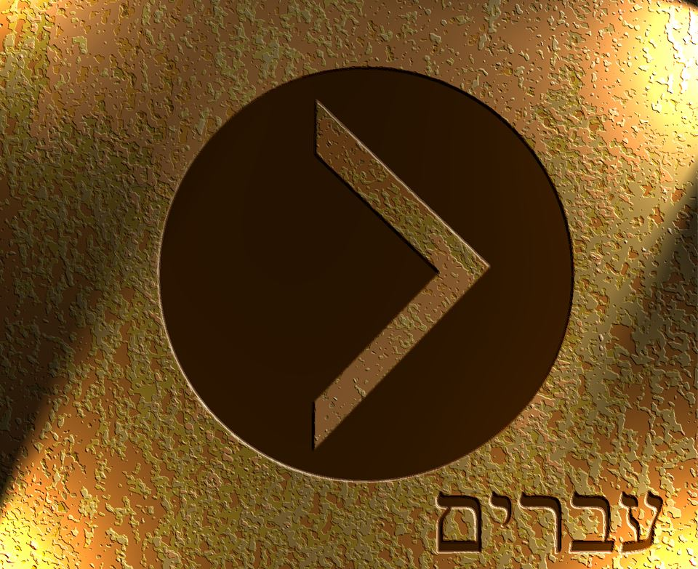

Slide 2
Therefore, holy brothers, you who share in a heavenly calling, consider Jesus, the apostle and high priest of our confession, ² who was faithful to him who appointed him, just as Moses also was faithful in all God's house. ³ For Jesus has been counted worthy of more glory than Moses—as much more glory as the builder of a house has more honor than the house itself. ⁴ (For every house is built by someone, but the builder of all things is God.) ⁵ Now Moses was faithful in all God's house as a servant, to testify to the things that were to be spoken later, ⁶ but Christ is faithful over God's house as a son. And we are his house if indeed we hold fast our confidence and our boasting in our hope.
Hebrews 3:1-6 ESV

Slide 3
⁶ And he said, “Hear my words: If there is a prophet among you, I the Lord make myself known to him in a vision; I speak with him in a dream. ⁷ Not so with my servant Moses. He is faithful in all my house. ⁸ With him I speak mouth to mouth, clearly, and not in riddles, and he beholds the form of the Lord. Why then were you not afraid to speak against my servant Moses?”
Numbers 12:6-7 ESV

Slide 4
Therefore, holy brothers, you who share in a heavenly calling, consider Jesus, the apostle and high priest of our confession, ² who was faithful to him who appointed him, just as Moses also was faithful in all God's house. ³ For Jesus has been counted worthy of more glory than Moses—as much more glory as the builder of a house has more honor than the house itself. ⁴ (For every house is built by someone, but the builder of all things is God.) ⁵ Now Moses was faithful in all God's house as a servant, to testify to the things that were to be spoken later, ⁶ but Christ is faithful over God's house as a son. And we are his house if indeed we hold fast our confidence and our boasting in our hope.
Hebrews 3:1-6 ESV

Slide 5
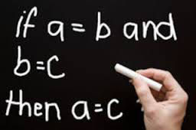

Slide 6
Every house has a builder
The builder of all things is God
Jesus is the builder
JESUS IS GOD
THEREFORE…

Slide 7
²⁰ Our fathers worshiped on this mountain, but you say that in Jerusalem is the place where people ought to worship.” ²¹ Jesus said to her, “Woman, believe me, the hour is coming when neither on this mountain nor in Jerusalem will you worship the Father. ²² You worship what you do not know; we worship what we know, for salvation is from the Jews.²³ But the hour is coming, and is now here, when the true worshipers will worship the Father in spirit and truth, for the Father is seeking such people to worship him. ²⁴ God is spirit, and those who worship him must worship in spirit and truth.”
John 4:20-24 ESV

Slide 8
⁴ As you come to him, a living stone rejected by men but in the sight of God chosen and precious, ⁵ you yourselves like living stones are being built up as a spiritual house, to be a holy priesthood, to offer spiritual sacrifices acceptable to God through Jesus Christ.
1 Peter 2:4-5 ESV

Slide 9
Therefore, holy brothers, you who share in a heavenly calling, consider Jesus, the apostle and high priest of our confession, ² who was faithful to him who appointed him, just as Moses also was faithful in all God's house. ³ For Jesus has been counted worthy of more glory than Moses—as much more glory as the builder of a house has more honor than the house itself. ⁴ (For every house is built by someone, but the builder of all things is God.) ⁵ Now Moses was faithful in all God's house as a servant, to testify to the things that were to be spoken later, ⁶ but Christ is faithful over God's house as a son. And we are his house if indeed we hold fast our confidence and our boasting in our hope.
Hebrews 3:1-6 ESV

Slide 10
