Slide 1

Be Good and
Do Good Stuff
Hebrews 13

Slide 2
  ¹⁶ Do not neglect to do good and to share what you have, for such sacrifices are pleasing to God.
  Hebrews 13:16 ESV

Slide 3
  ²⁸ Therefore let us be grateful for receiving a kingdom that cannot be shaken, and thus let us offer to God acceptable worship, with reverence and awe, ²⁹ for our God is a consuming fire.
  Hebrews 12:28-29 ESV

Slide 4
  ⁷ Remember your leaders, those who spoke to you the word of God. Consider the outcome of their way of life, and imitate their faith. ⁸ Jesus Christ is the same yesterday and today and forever. ⁹ Do not be led away by diverse and strange teachings, for it is good for the heart to be strengthened by grace, not by foods, which have not benefited those devoted to them. ¹⁰ We have an altar from which those who serve the tent have no right to eat. ¹¹ For the bodies of those animals whose blood is brought into the holy places by the high priest as a sacrifice for sin are burned outside the camp. ¹² So Jesus also suffered outside the gate in order to sanctify the people through his own blood. ¹³ Therefore let us go to him outside the camp and bear the reproach he endured.¹⁴ For here we have no lasting city, but we seek the city that is to come.¹⁵ Through him then let us continually offer up a sacrifice of praise to God, that is, the fruit of lips that acknowledge his name. ¹⁶ Do not neglect to do good and to share what you have, for such sacrifices are pleasing to God. ¹⁷ Obey your leaders and submit to them, for they are keeping watch over your souls, as those who will have to give an account. Let them do this with joy and not with groaning, for that would be of no advantage to you. ¹⁸ Pray for us, for we are sure that we have a clear conscience, desiring to act honorably in all things. ¹⁹ I urge you the more earnestly to do this in order that I may be restored to you the sooner.
  Hebrews 13:7-19 ESV

Slide 5
  ⁷ Remember your leaders, those who spoke to you the word of God. Consider the outcome of their way of life, and imitate their faith. ⁸ Jesus Christ is the same yesterday and today and forever. ⁹ Do not be led away by diverse and strange teachings, for it is good for the heart to be strengthened by grace, not by foods, which have not benefited those devoted to them. ¹⁰ We have an altar from which those who serve the tent have no right to eat. ¹¹ For the bodies of those animals whose blood is brought into the holy places by the high priest as a sacrifice for sin are burned outside the camp. ¹² So Jesus also suffered outside the gate in order to sanctify the people through his own blood. ¹³ Therefore let us go to him outside the camp and bear the reproach he endured.¹⁴ For here we have no lasting city, but we seek the city that is to come.¹⁵ Through him then let us continually offer up a sacrifice of praise to God, that is, the fruit of lips that acknowledge his name. ¹⁶ Do not neglect to do good and to share what you have, for such sacrifices are pleasing to God. ¹⁷ Obey your leaders and submit to them, for they are keeping watch over your souls, as those who will have to give an account. Let them do this with joy and not with groaning, for that would be of no advantage to you. ¹⁸ Pray for us, for we are sure that we have a clear conscience, desiring to act honorably in all things. ¹⁹ I urge you the more earnestly to do this in order that I may be restored to you the sooner.
  Hebrews 13:7-19 ESV

Slide 6
  ⁷ Remember your leaders, those who spoke to you the word of God. Consider the outcome of their way of life, and imitate their faith. ⁸ Jesus Christ is the same yesterday and today and forever. ⁹ Do not be led away by diverse and strange teachings, for it is good for the heart to be strengthened by grace, not by foods, which have not benefited those devoted to them. ¹⁰ We have an altar from which those who serve the tent have no right to eat. ¹¹ For the bodies of those animals whose blood is brought into the holy places by the high priest as a sacrifice for sin are burned outside the camp. ¹² So Jesus also suffered outside the gate in order to sanctify the people through his own blood. ¹³ Therefore let us go to him outside the camp and bear the reproach he endured.¹⁴ For here we have no lasting city, but we seek the city that is to come.¹⁵ Through him then let us continually offer up a sacrifice of praise to God, that is, the fruit of lips that acknowledge his name. ¹⁶ Do not neglect to do good and to share what you have, for such sacrifices are pleasing to God. ¹⁷ Obey your leaders and submit to them, for they are keeping watch over your souls, as those who will have to give an account. Let them do this with joy and not with groaning, for that would be of no advantage to you. ¹⁸ Pray for us, for we are sure that we have a clear conscience, desiring to act honorably in all things. ¹⁹ I urge you the more earnestly to do this in order that I may be restored to you the sooner.
  Hebrews 13:7-19 ESV

Slide 7
  ⁷ Remember your leaders, those who spoke to you the word of God. Consider the outcome of their way of life, and imitate their faith. ⁸ Jesus Christ is the same yesterday and today and forever. ⁹ Do not be led away by diverse and strange teachings, for it is good for the heart to be strengthened by grace, not by foods, which have not benefited those devoted to them. ¹⁰ We have an altar from which those who serve the tent have no right to eat. ¹¹ For the bodies of those animals whose blood is brought into the holy places by the high priest as a sacrifice for sin are burned outside the camp. ¹² So Jesus also suffered outside the gate in order to sanctify the people through his own blood. ¹³ Therefore let us go to him outside the camp and bear the reproach he endured.¹⁴ For here we have no lasting city, but we seek the city that is to come.¹⁵ Through him then let us continually offer up a sacrifice of praise to God, that is, the fruit of lips that acknowledge his name. ¹⁶ Do not neglect to do good and to share what you have, for such sacrifices are pleasing to God. ¹⁷ Obey your leaders and submit to them, for they are keeping watch over your souls, as those who will have to give an account. Let them do this with joy and not with groaning, for that would be of no advantage to you. ¹⁸ Pray for us, for we are sure that we have a clear conscience, desiring to act honorably in all things. ¹⁹ I urge you the more earnestly to do this in order that I may be restored to you the sooner.
  Hebrews 13:7-19 ESV

Slide 8
  ⁷ Remember your leaders, those who spoke to you the word of God. Consider the outcome of their way of life, and imitate their faith. ⁸ Jesus Christ is the same yesterday and today and forever. ⁹ Do not be led away by diverse and strange teachings, for it is good for the heart to be strengthened by grace, not by foods, which have not benefited those devoted to them. ¹⁰ We have an altar from which those who serve the tent have no right to eat. ¹¹ For the bodies of those animals whose blood is brought into the holy places by the high priest as a sacrifice for sin are burned outside the camp. ¹² So Jesus also suffered outside the gate in order to sanctify the people through his own blood. ¹³ Therefore let us go to him outside the camp and bear the reproach he endured.¹⁴ For here we have no lasting city, but we seek the city that is to come.¹⁵ Through him then let us continually offer up a sacrifice of praise to God, that is, the fruit of lips that acknowledge his name. ¹⁶ Do not neglect to do good and to share what you have, for such sacrifices are pleasing to God. ¹⁷ Obey your leaders and submit to them, for they are keeping watch over your souls, as those who will have to give an account. Let them do this with joy and not with groaning, for that would be of no advantage to you. ¹⁸ Pray for us, for we are sure that we have a clear conscience, desiring to act honorably in all things. ¹⁹ I urge you the more earnestly to do this in order that I may be restored to you the sooner.
  Hebrews 13:7-19 ESV

Slide 9
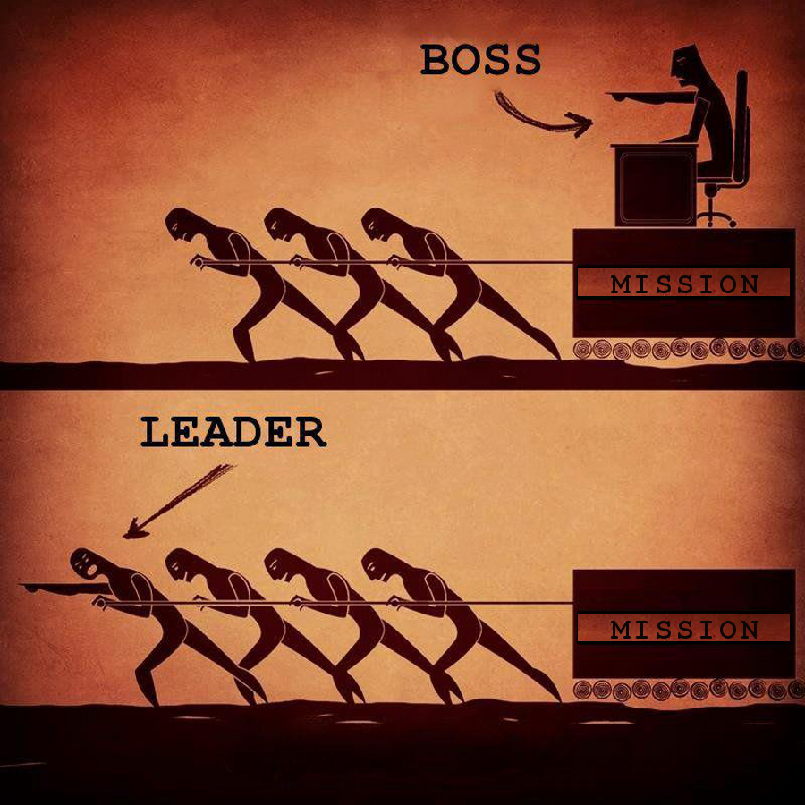

Slide 10
  …strike the shepherd, and the sheep of the flock will be scattered.
  Matthew 26:31b ESV

