Slide 1

When God Speaks…
Hebrews 13

Slide 2
  Long ago, at many times and in many ways, God spoke to our fathers by the prophets, ² but in these last days he has spoken to us by his Son, whom he appointed the heir of all things, through whom also he created the world. ³ He is the radiance of the glory of God and the exact imprint of his nature, and he upholds the universe by the word of his power. After making purification for sins, he sat down at the right hand of the Majesty on high
  Hebrews 1:1-2 ESV

Slide 3
  ²⁰ Now may the God of peace who brought again from the dead our Lord Jesus, the great shepherd of the sheep, by the blood of the eternal covenant, ²¹ equip you with everything good that you may do his will, working in us that which is pleasing in his sight, through Jesus Christ, to whom be glory forever and ever. Amen.
  Hebrews 13:20-21 ESV

Slide 4
  I will put enmity between you and the woman, and between your offspring and her offspring; he shall bruise your head, and you shall bruise his heel.”
  Genesis 3:15 ESV

Slide 5
  ³¹ “Behold, the days are coming, declares the Lord, when I will make a new covenant with the house of Israel and the house of Judah, ³² not like the covenant that I made with their fathers on the day when I took them by the hand to bring them out of the land of Egypt, my covenant that they broke, though I was their husband, declares the Lord. ³³ For this is the covenant that I will make with the house of Israel after those days, declares the Lord: I will put my law within them, and I will write it on their hearts. And I will be their God, and they shall be my people. ³⁴ And no longer shall each one teach his neighbor and each his brother, saying, ‘Know the Lord,’ for they shall all know me, from the least of them to the greatest, declares the Lord. For I will forgive their iniquity, and I will remember their sin no more.”
  Jeremiah 31:31-34 ESV

Slide 6
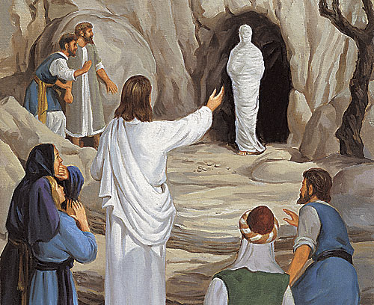

Slide 7
  ²⁰ Now may the God of peace who brought again from the dead our Lord Jesus, the great shepherd of the sheep, by the blood of the eternal covenant, ²¹ equip you with everything good that you may do his will, working in us that which is pleasing in his sight, through Jesus Christ, to whom be glory forever and ever. Amen.
  Hebrews 13:20-21 ESV

Slide 8
  ⁶ And I am sure of this, that he who began a good work in you will bring it to completion at the day of Jesus Christ.
  Philippians 1:6 ESV

Slide 9
  In him you also, when you heard the word of truth, the gospel of your salvation, and believed in him, were sealed with the promised Holy Spirit
  Ephesians 1:13 ESV

Slide 10
  ²⁰ Now may the God of peace who brought again from the dead our Lord Jesus, the great shepherd of the sheep, by the blood of the eternal covenant, ²¹ equip you with everything good that you may do his will, working in us that which is pleasing in his sight, through Jesus Christ, to whom be glory forever and ever. Amen.
  Hebrews 13:20-21 ESV

Slide 11
  ¹³ for it is God who works in you, both to will and to work for his good pleasure.
  Philippians 2:13 ESV

Slide 12
  ²⁰ Now may the God of peace who brought again from the dead our Lord Jesus, the great shepherd of the sheep, by the blood of the eternal covenant, ²¹ equip you with everything good that you may do his will, working in us that which is pleasing in his sight, through Jesus Christ, to whom be glory forever and ever. Amen.
  Hebrews 13:20-21 ESV

Slide 13
Jeremiah 10:6-7 ESV - ⁶ There is none like you, O Lord; you are great, and your name is great in might. ⁷ Who would not fear you, O King of the nations? For this is your due; for among all the wise ones of the nations and in all their kingdoms there is none like you.
Exodus 15:11 ESV - ¹¹ “Who is like you, O Lord, among the gods? Who is like you, majestic in holiness, awesome in glorious deeds, doing wonders?
Psalm 113:1-6 ESV - Praise the Lord! Praise, O servants of the Lord, praise the name of the Lord! ² Blessed be the name of the Lord from this time forth and forevermore! ³ From the rising of the sun to its setting, the name of the Lord is to be praised! ⁴ The Lord is high above all nations, and his glory above the heavens! ⁵ Who is like the Lord our God, who is seated on high, ⁶ who looks far down on the heavens and the earth?

Slide 14
Romans 10:9 ESV - if you confess with your mouth that Jesus is Lord and believe in your heart that God raised him from the dead, you will be saved.
Romans 10:13 ESV - ¹³ For “everyone who calls on the name of the Lord will be saved.”
1 John 1:9 ESV - ⁹ If we confess our sins, he is faithful and just to forgive us our sins and to cleanse us from all unrighteousness.
Ezekiel 36:26-27 ESV - ²⁶ And I will give you a new heart, and a new spirit I will put within you. And I will remove the heart of stone from your flesh and give you a heart of flesh. ²⁷ And I will put my Spirit within you, and cause you to walk in my statutes and be careful to obey my rules.

Slide 15
Matthew 25:23 ESV - ‘Well done, good and faithful servant. You have been faithful over a little; I will set you over much. Enter into the joy of your master.’
Matthew 10:32 NASB - "Therefore everyone who confesses Me before men, I will also confess him before My Father who is in heaven.

Slide 16
  ²⁰ Now may the God of peace who brought again from the dead our Lord Jesus, the great shepherd of the sheep, by the blood of the eternal covenant, ²¹ equip you with everything good that you may do his will, working in us that which is pleasing in his sight, through Jesus Christ, to whom be glory forever and ever. Amen.
  Hebrews 13:20-21 ESV

