Slide 1
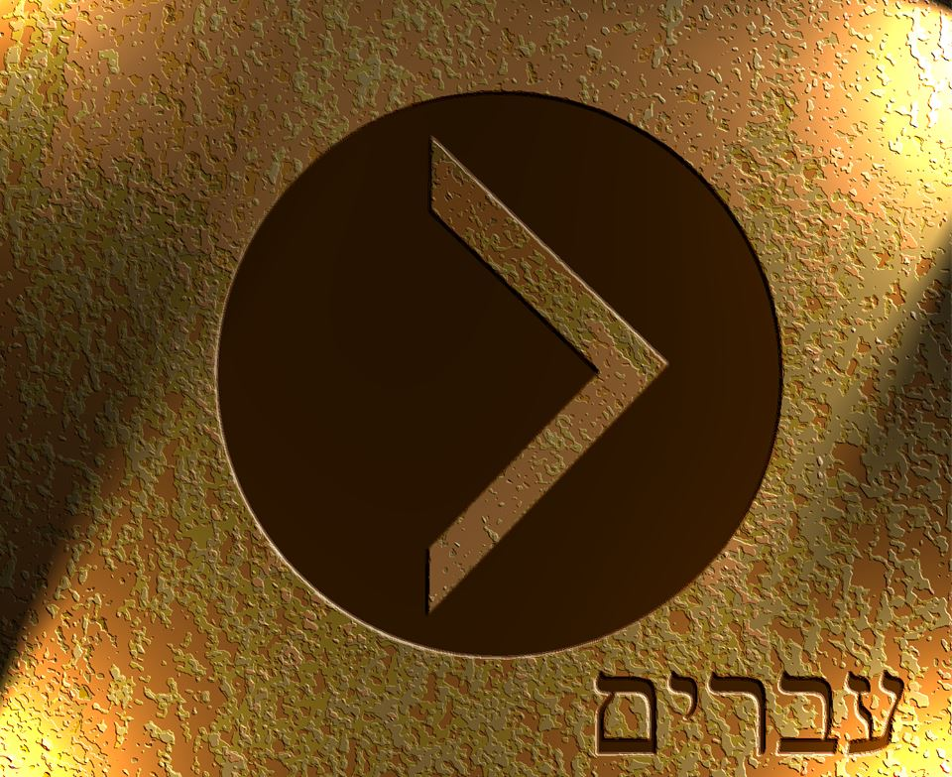

Slide 2
For every high priest chosen from among men is appointed to act on behalf of men in relation to God, to offer gifts and sacrifices for sins. ² He can deal gently with the ignorant and wayward, since he himself is beset with weakness. ³ Because of this he is obligated to offer sacrifice for his own sins just as he does for those of the people. ⁴ And no one takes this honor for himself, but only when called by God, just as Aaron was. ⁵ So also Christ did not exalt himself to be made a high priest, but was appointed by him who said to him, “You are my Son, today I have begotten you”; ⁶ as he says also in another place, “You are a priest forever, after the order of Melchizedek.” ⁷ In the days of his flesh, Jesus offered up prayers and supplications, with loud cries and tears, to him who was able to save him from death, and he was heard because of his reverence. ⁸ Although he was a son, he learned obedience through what he suffered. ⁹ And being made perfect, he became the source of eternal salvation to all who obey him, ¹⁰ being designated by God a high priest after the order of Melchizedek.
Hebrews 5:1-10 ESV

Slide 3
For every high priest chosen from among men is appointed to act on behalf of men in relation to God, to offer gifts and sacrifices for sins. ² He can deal gently with the ignorant and wayward, since he himself is beset with weakness. ³ Because of this he is obligated to offer sacrifice for his own sins just as he does for those of the people. ⁴ And no one takes this honor for himself, but only when called by God, just as Aaron was. ⁵ So also Christ did not exalt himself to be made a high priest, but was appointed by him who said to him, “You are my Son, today I have begotten you”; ⁶ as he says also in another place, “You are a priest forever, after the order of Melchizedek.” ⁷ In the days of his flesh, Jesus offered up prayers and supplications, with loud cries and tears, to him who was able to save him from death, and he was heard because of his reverence. ⁸ Although he was a son, he learned obedience through what he suffered. ⁹ And being made perfect, he became the source of eternal salvation to all who obey him, ¹⁰ being designated by God a high priest after the order of Melchizedek.
Hebrews 5:1-10 ESV

Slide 4
⁵ He set himself to seek God in the days of Zechariah, who instructed him in the fear of God, and as long as he sought the Lord, God made him prosper.
2 Chronicles 26:5 ESV

Slide 5
¹⁷ Therefore he had to be made like his brothers in every respect, so that he might become a merciful and faithful high priest in the service of God, to make propitiation for the sins of the people.
Hebrews 2:17 ESV

Slide 6
For every high priest chosen from among men is appointed to act on behalf of men in relation to God, to offer gifts and sacrifices for sins. ² He can deal gently with the ignorant and wayward, since he himself is beset with weakness. ³ Because of this he is obligated to offer sacrifice for his own sins just as he does for those of the people. ⁴ And no one takes this honor for himself, but only when called by God, just as Aaron was. ⁵ So also Christ did not exalt himself to be made a high priest, but was appointed by him who said to him, “You are my Son, today I have begotten you”; ⁶ as he says also in another place, “You are a priest forever, after the order of Melchizedek.” ⁷ In the days of his flesh, Jesus offered up prayers and supplications, with loud cries and tears, to him who was able to save him from death, and he was heard because of his reverence. ⁸ Although he was a son, he learned obedience through what he suffered. ⁹ And being made perfect, he became the source of eternal salvation to all who obey him, ¹⁰ being designated by God a high priest after the order of Melchizedek.
Hebrews 5:1-10 ESV

Slide 7
For every high priest chosen from among men is appointed to act on behalf of men in relation to God, to offer gifts and sacrifices for sins. ² He can deal gently with the ignorant and wayward, since he himself is beset with weakness. ³ Because of this he is obligated to offer sacrifice for his own sins just as he does for those of the people. ⁴ And no one takes this honor for himself, but only when called by God, just as Aaron was. ⁵ So also Christ did not exalt himself to be made a high priest, but was appointed by him who said to him, “You are my Son, today I have begotten you”; ⁶ as he says also in another place, “You are a priest forever, after the order of Melchizedek.” ⁷ In the days of his flesh, Jesus offered up prayers and supplications, with loud cries and tears, to him who was able to save him from death, and he was heard because of his reverence. ⁸ Although he was a son, he learned obedience through what he suffered. ⁹ And being made perfect, he became the source of eternal salvation to all who obey him, ¹⁰ being designated by God a high priest after the order of Melchizedek.
Hebrews 5:1-10 ESV

Slide 8
For every high priest chosen from among men is appointed to act on behalf of men in relation to God, to offer gifts and sacrifices for sins. ² He can deal gently with the ignorant and wayward, since he himself is beset with weakness. ³ Because of this he is obligated to offer sacrifice for his own sins just as he does for those of the people. ⁴ And no one takes this honor for himself, but only when called by God, just as Aaron was. ⁵ So also Christ did not exalt himself to be made a high priest, but was appointed by him who said to him, “You are my Son, today I have begotten you”; ⁶ as he says also in another place, “You are a priest forever, after the order of Melchizedek.” ⁷ In the days of his flesh, Jesus offered up prayers and supplications, with loud cries and tears, to him who was able to save him from death, and he was heard because of his reverence. ⁸ Although he was a son, he learned obedience through what he suffered. ⁹ And being made perfect, he became the source of eternal salvation to all who obey him, ¹⁰ being designated by God a high priest after the order of Melchizedek.
Hebrews 5:1-10 ESV

Slide 9
¹⁵ For we do not have a high priest who is unable to sympathize with our weaknesses, but one who in every respect has been tempted as we are, yet without sin.
Hebrews 4:15 ESV

Slide 10
¹⁸ And Melchizedek king of Salem brought out bread and wine. (He was priest of God Most High.) ¹⁹ And he blessed him and said, “Blessed be Abram by God Most High, Possessor of heaven and earth; ²⁰ and blessed be God Most High, who has delivered your enemies into your hand!” And Abram gave him a tenth of everything.
Genesis 14:18-20 ESV

Slide 11
For every high priest chosen from among men is appointed to act on behalf of men in relation to God, to offer gifts and sacrifices for sins. ² He can deal gently with the ignorant and wayward, since he himself is beset with weakness. ³ Because of this he is obligated to offer sacrifice for his own sins just as he does for those of the people. ⁴ And no one takes this honor for himself, but only when called by God, just as Aaron was. ⁵ So also Christ did not exalt himself to be made a high priest, but was appointed by him who said to him, “You are my Son, today I have begotten you”; ⁶ as he says also in another place, “You are a priest forever, after the order of Melchizedek.” ⁷ In the days of his flesh, Jesus offered up prayers and supplications, with loud cries and tears, to him who was able to save him from death, and he was heard because of his reverence. ⁸ Although he was a son, he learned obedience through what he suffered. ⁹ And being made perfect, he became the source of eternal salvation to all who obey him, ¹⁰ being designated by God a high priest after the order of Melchizedek.
Hebrews 5:1-10 ESV

Slide 12
¹⁶ who has become a priest, not on the basis of a legal requirement concerning bodily descent, but by the power of an indestructible life. ¹⁷ For it is witnessed of him, “You are a priest forever, after the order of Melchizedek.”
Hebrews 7:16-17 ESV

Slide 13
²³ The former priests were many in number, because they were prevented by death from continuing in office, ²⁴ but he holds his priesthood permanently, because he continues forever. ²⁵ Consequently, he is able to save to the uttermost those who draw near to God through him, since he always lives to make intercession for them.
Hebrews 7:23-25 ESV

Slide 14
For every high priest chosen from among men is appointed to act on behalf of men in relation to God, to offer gifts and sacrifices for sins. ² He can deal gently with the ignorant and wayward, since he himself is beset with weakness. ³ Because of this he is obligated to offer sacrifice for his own sins just as he does for those of the people. ⁴ And no one takes this honor for himself, but only when called by God, just as Aaron was. ⁵ So also Christ did not exalt himself to be made a high priest, but was appointed by him who said to him, “You are my Son, today I have begotten you”; ⁶ as he says also in another place, “You are a priest forever, after the order of Melchizedek.” ⁷ In the days of his flesh, Jesus offered up prayers and supplications, with loud cries and tears, to him who was able to save him from death, and he was heard because of his reverence. ⁸ Although he was a son, he learned obedience through what he suffered. ⁹ And being made perfect, he became the source of eternal salvation to all who obey him, ¹⁰ being designated by God a high priest after the order of Melchizedek.
Hebrews 5:1-10 ESV

