Slide 1


Slide 2
⁴ For it is impossible in the case of those who have once been enlightened, tasted the heavenly gift, become partakers of the Holy Spirit, ⁵ tasted the good word of God and the miracles of the coming age, ⁶ and then have committed apostasy, to renew them again to repentance, since they are crucifying the Son of God for themselves all over again and holding him up to contempt. ⁷ For the ground that has soaked up the rain that frequently falls on it and yields useful vegetation for those who tend it receives a blessing from God. ⁸ But if it produces thorns and thistles, it is useless and about to be cursed; its fate is to be burned. ⁹ But in your case, dear friends, even though we speak like this, we are convinced of better things relating to salvation. ¹⁰ For God is not unjust so as to forget your work and the love you have demonstrated for his name, in having served and continuing to serve the saints. ¹¹ But we passionately want each of you to demonstrate the same eagerness for the fulfillment of your hope until the end, ¹² so that you may not be sluggish, but imitators of those who through faith and perseverance inherit the promises.
Hebrews 6:4-12 NET

Slide 3
⁴ For it is impossible in the case of those who have once been enlightened, tasted the heavenly gift, become partakers of the Holy Spirit, ⁵ tasted the good word of God and the miracles of the coming age, ⁶ and then have committed apostasy, to renew them again to repentance, since they are crucifying the Son of God for themselves all over again and holding him up to contempt. ⁷ For the ground that has soaked up the rain that frequently falls on it and yields useful vegetation for those who tend it receives a blessing from God. ⁸ But if it produces thorns and thistles, it is useless and about to be cursed; its fate is to be burned. ⁹ But in your case, dear friends, even though we speak like this, we are convinced of better things relating to salvation. ¹⁰ For God is not unjust so as to forget your work and the love you have demonstrated for his name, in having served and continuing to serve the saints. ¹¹ But we passionately want each of you to demonstrate the same eagerness for the fulfillment of your hope until the end, ¹² so that you may not be sluggish, but imitators of those who through faith and perseverance inherit the promises.
Hebrews 6:4-12 NET

Slide 4
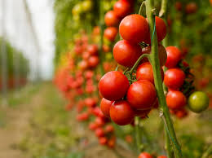
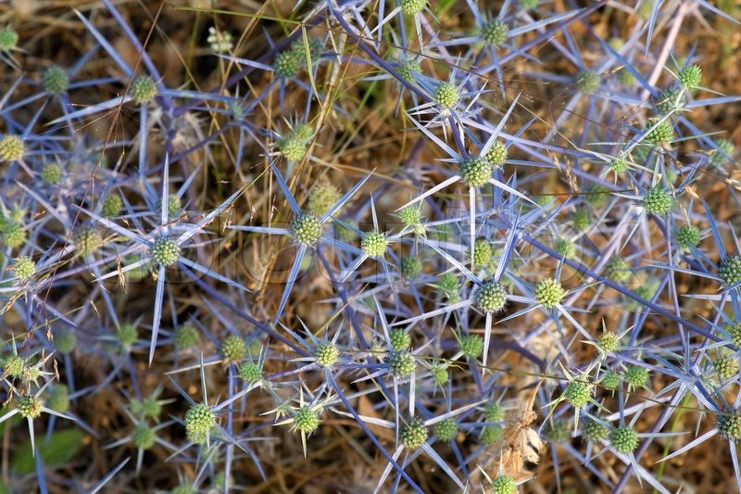
A Tale of Two Fields

Slide 5
¹⁵ “Beware of false prophets, who come to you in sheep's clothing but inwardly are ravenous wolves. ¹⁶ You will recognize them by their fruits. Are grapes gathered from thornbushes, or figs from thistles? ¹⁷ So, every healthy tree bears good fruit, but the diseased tree bears bad fruit. ¹⁸ A healthy tree cannot bear bad fruit, nor can a diseased tree bear good fruit. ¹⁹ Every tree that does not bear good fruit is cut down and thrown into the fire. ²⁰ Thus you will recognize them by their fruits. ²¹ “Not everyone who says to me, ‘Lord, Lord,’ will enter the kingdom of heaven, but the one who does the will of my Father who is in heaven.²² On that day many will say to me, ‘Lord, Lord, did we not prophesy in your name, and cast out demons in your name, and do many mighty works in your name?’ ²³ And then will I declare to them, ‘I never knew you; depart from me, you workers of lawlessness.’
Matthew 7:15-23 ESV

Slide 6
⁴ For it is impossible in the case of those who have once been enlightened, tasted the heavenly gift, become partakers of the Holy Spirit, ⁵ tasted the good word of God and the miracles of the coming age, ⁶ and then have committed apostasy, to renew them again to repentance, since they are crucifying the Son of God for themselves all over again and holding him up to contempt. ⁷ For the ground that has soaked up the rain that frequently falls on it and yields useful vegetation for those who tend it receives a blessing from God. ⁸ But if it produces thorns and thistles, it is useless and about to be cursed; its fate is to be burned. ⁹ But in your case, dear friends, even though we speak like this, we are convinced of better things relating to salvation. ¹⁰ For God is not unjust so as to forget your work and the love you have demonstrated for his name, in having served and continuing to serve the saints. ¹¹ But we passionately want each of you to demonstrate the same eagerness for the fulfillment of your hope until the end, ¹² so that you may not be sluggish, but imitators of those who through faith and perseverance inherit the promises.
Hebrews 6:4-12 NET

Slide 7
⁴ For it is impossible in the case of those who have once been enlightened, tasted the heavenly gift, become partakers of the Holy Spirit, ⁵ tasted the good word of God and the miracles of the coming age, ⁶ and then have committed apostasy, to renew them again to repentance, since they are crucifying the Son of God for themselves all over again and holding him up to contempt. ⁷ For the ground that has soaked up the rain that frequently falls on it and yields useful vegetation for those who tend it receives a blessing from God. ⁸ But if it produces thorns and thistles, it is useless and about to be cursed; its fate is to be burned. ⁹ But in your case, dear friends, even though we speak like this, we are convinced of better things relating to salvation. ¹⁰ For God is not unjust so as to forget your work and the love you have demonstrated for his name, in having served and continuing to serve the saints. ¹¹ But we passionately want each of you to demonstrate the same eagerness for the fulfillment of your hope until the end, ¹² so that you may not be sluggish, but imitators of those who through faith and perseverance inherit the promises.
Hebrews 6:4-12 NET

Slide 8
⁶ And I am sure of this, that he who began a good work in you will bring it to completion at the day of Jesus Christ.
Philippians 1:6 ESV

Slide 9
Faith
Ephesians 2:8-9 ESV - ⁸ For by grace you have been saved through faith. And this is not your own doing; it is the gift of God, ⁹ not a result of works, so that no one may boast.
Hebrews 11:6a ESV - ⁶ And without faith it is impossible to please him

Slide 10
¹² For the word of God is living and active, sharper than any two-edged sword, piercing to the division of soul and of spirit, of joints and of marrow, and discerning the thoughts and intentions of the heart. ¹³ And no creature is hidden from his sight, but all are naked and exposed to the eyes of him to whom we must give account.
Hebrews 4:12-13 ESV

