Slide 1


Slide 2
¹¹ About this we have much to say, and it is hard to explain, since you have become dull of hearing. ¹² For though by this time you ought to be teachers, you need someone to teach you again the basic principles of the oracles of God. You need milk, not solid food, ¹³ for everyone who lives on milk is unskilled in the word of righteousness, since he is a child. ¹⁴ But solid food is for the mature, for those who have their powers of discernment trained by constant practice to distinguish good from evil.
Hebrews 5:11-14 ESV

Slide 3
¹¹ About this we have much to say, and it is hard to explain, since you have become dull of hearing. ¹² For though by this time you ought to be teachers, you need someone to teach you again the basic principles of the oracles of God. You need milk, not solid food, ¹³ for everyone who lives on milk is unskilled in the word of righteousness, since he is a child. ¹⁴ But solid food is for the mature, for those who have their powers of discernment trained by constant practice to distinguish good from evil.
Hebrews 5:11-14 ESV

Slide 4


Slide 5
¹² For when there is a change in the priesthood, there is necessarily a change in the law as well.
Hebrews 7:12 ESV

Slide 6
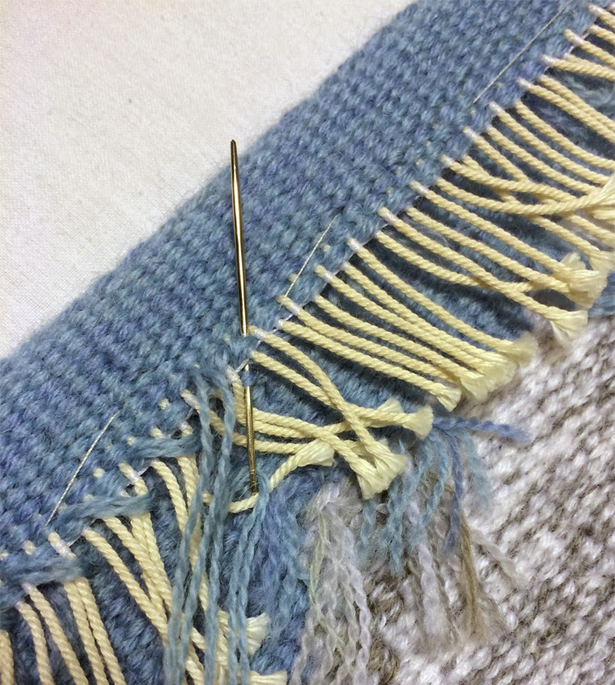

Slide 7


Slide 8
  It all depends on whether your man is of the desponding type who can be tempted to despair, or of the wishful-thinking type who can be assured that all is well. The former type is getting rare among the humans. If your patient should happen to belong to it, everything is easy. You have only got to keep him out of the way of experienced Christians (an easy task now-a-days), to direct his attention to the appropriate passages in scripture, and then to set him to work on the desperate design of recovering his old feelings by sheer will-power, and the game is ours. If he is of the more hopeful type, your job is to make him acquiesce in the present low temperature of his spirit and gradually become content with it, persuading himself that it is not so low after all. In a week or two you will be making him doubt whether the first days of his Christianity were not, perhaps, a little excessive. Talk to him about “moderation in all things”. If you can once get him to the point of thinking that “religion is all very well up to a point”, you can feel quite happy about his soul. A moderated religion is as good for us as no religion at all—and more amusing.

Slide 9
Wisdom is supreme—so acquire wisdom, and whatever you acquire, acquire understanding!
Proverbs 4:7 NET

Slide 10
Follow the Threads
Hebrews 7:18-19 ESV - ¹⁸ For on the one hand, a former commandment is set aside because of its weakness and uselessness ¹⁹ (for the law made nothing perfect); but on the other hand, a better hope is introduced, through which we draw near to God.
Hebrews 7:22 ESV - ²² This makes Jesus the guarantor of a better covenant.
Hebrews 9:28 ESV - ²⁸ so Christ, having been offered once to bear the sins of many, will appear a second time, not to deal with sin but to save those who are eagerly waiting for him.
Hebrews 10:10 ESV - ¹⁰ And by that will we have been sanctified through the offering of the body of Jesus Christ once for all.
Hebrews 10:14 ESV - ¹⁴ For by a single offering he has perfected for all time those who are being sanctified.

