Slide 1
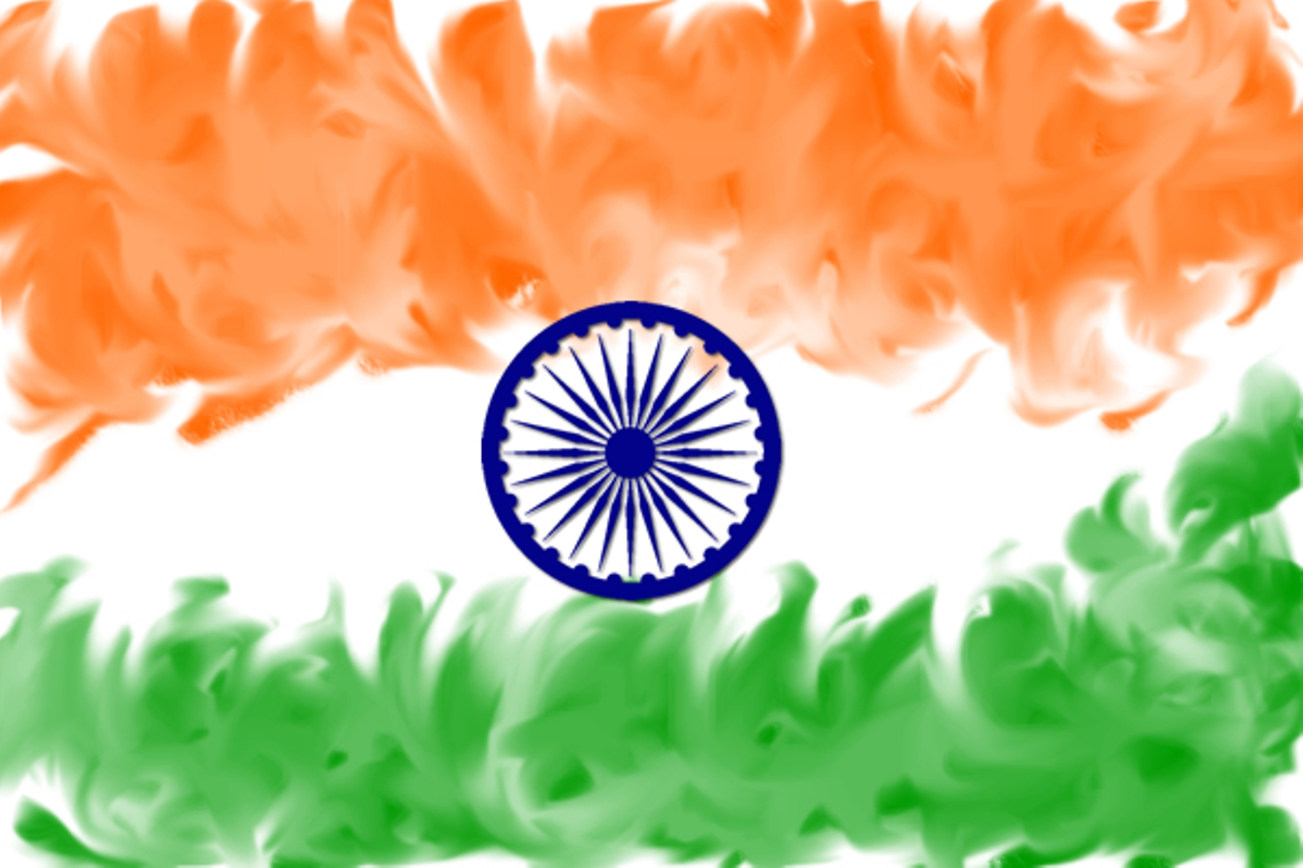
Making the Gospel Known Ministries

Slide 2
³¹ Then Jesus said to those Jews who believed Him, “If you abide in My word, you are My disciples indeed. ³² And you shall know the truth, and the truth shall make you free.”
John 8:31-32 NKJV

Slide 3
⁷ I say to you that likewise there will be more joy in heaven over one sinner who repents than over ninety-nine just persons who need no repentance.
¹⁰ Likewise, I say to you, there is joy in the presence of the angels of God over one sinner who repents.”
Luke 15:7,10 NKJV

Slide 4
⁹ After these things I looked, and behold, a great multitude which no one could number, of all nations, tribes, peoples, and tongues, standing before the throne and before the Lamb, clothed with white robes, with palm branches in their hands, ¹⁰ and crying out with a loud voice, saying, “Salvation belongs to our God who sits on the throne, and to the Lamb!”
Revelation 7:9-10 NKJV

Slide 5
¹ God be merciful to us and bless us,
And cause His face to shine upon us, Selah
² That Your way may be known on earth,
Your salvation among all nations.
³ Let the peoples praise You, O God;
Let all the peoples praise You.
⁴ Oh, let the nations be glad and sing for joy!
For You shall judge the people righteously,
And govern the nations on earth. Selah
⁵ Let the peoples praise You, O God;
Let all the peoples praise You.
⁶ Then the earth shall yield her increase;
God, our own God, shall bless us.
⁷ God shall bless us,
And all the ends of the earth shall fear Him.
Psalm 67 NKJV

