Slide 1
KID’S CHURCH
Thanksgiving Coloring Contest

Slide 2
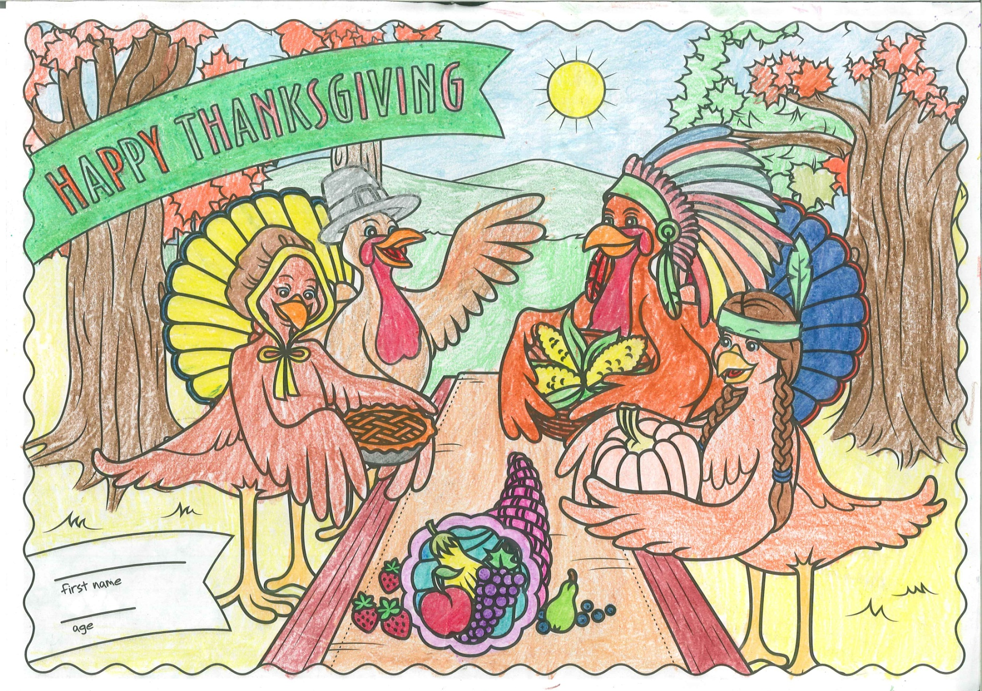
Entry 1

Slide 3
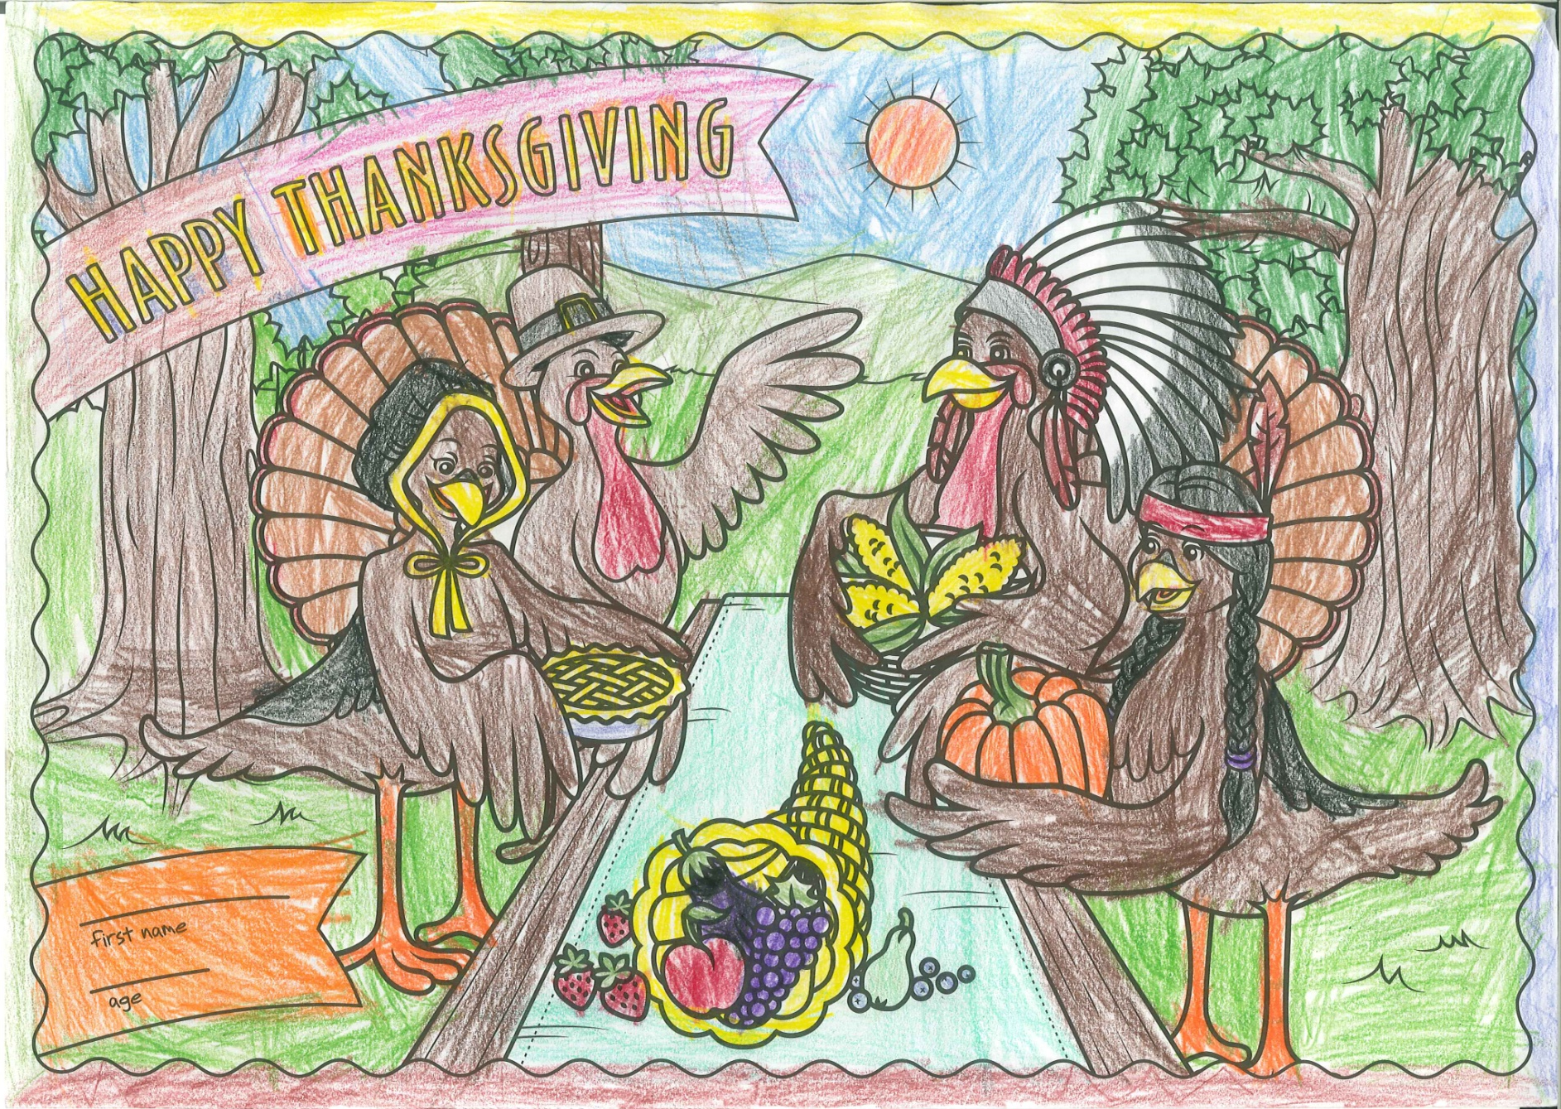
Entry 2

Slide 4
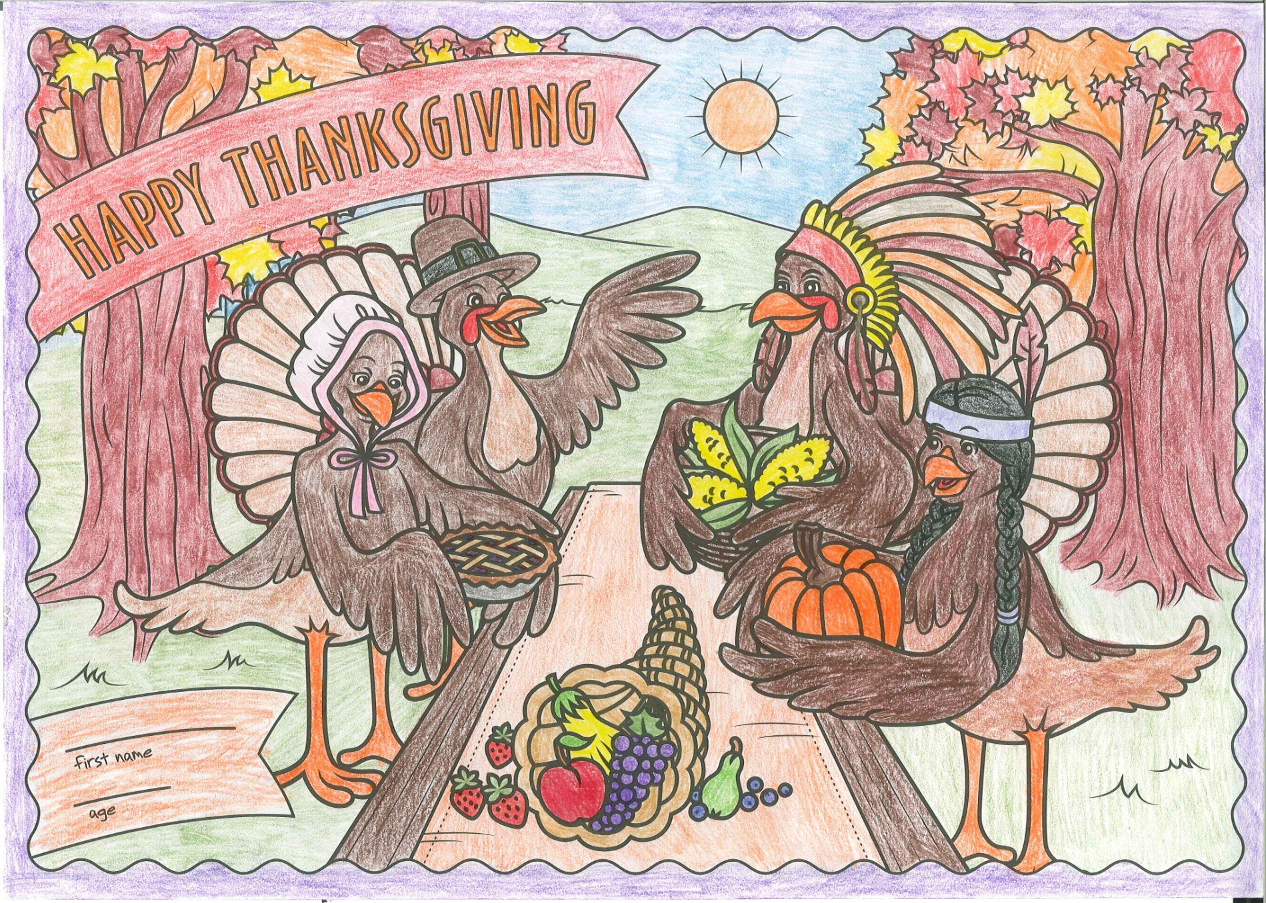
Entry 3

Slide 5
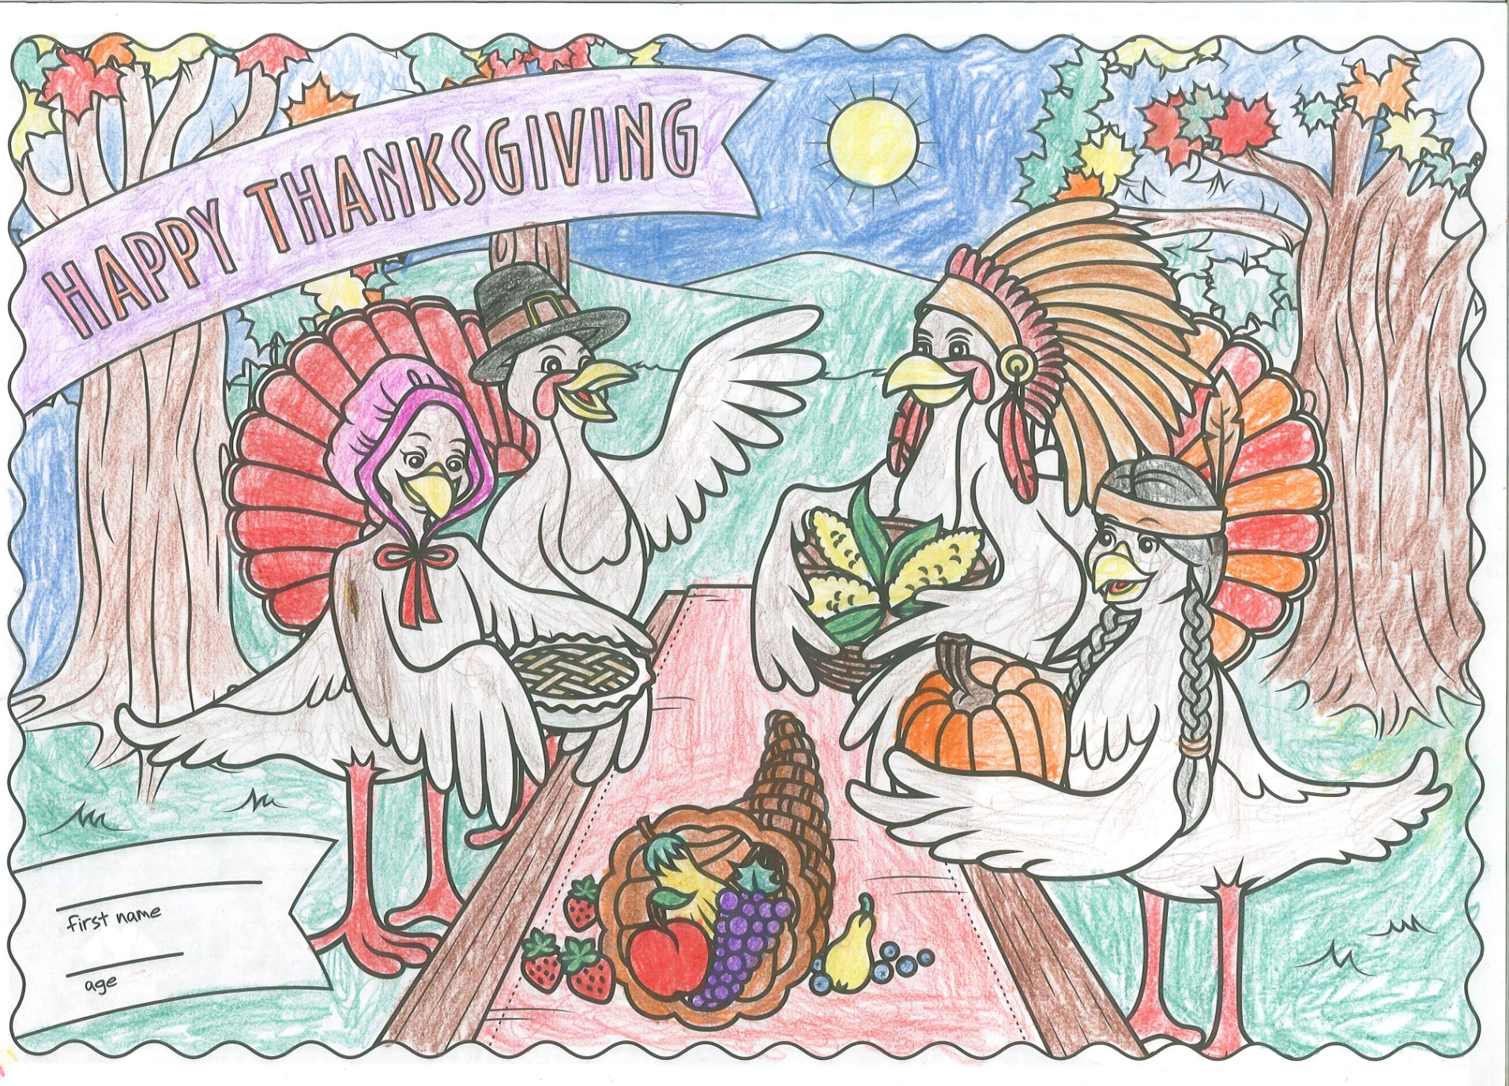
Entry 4

Slide 6
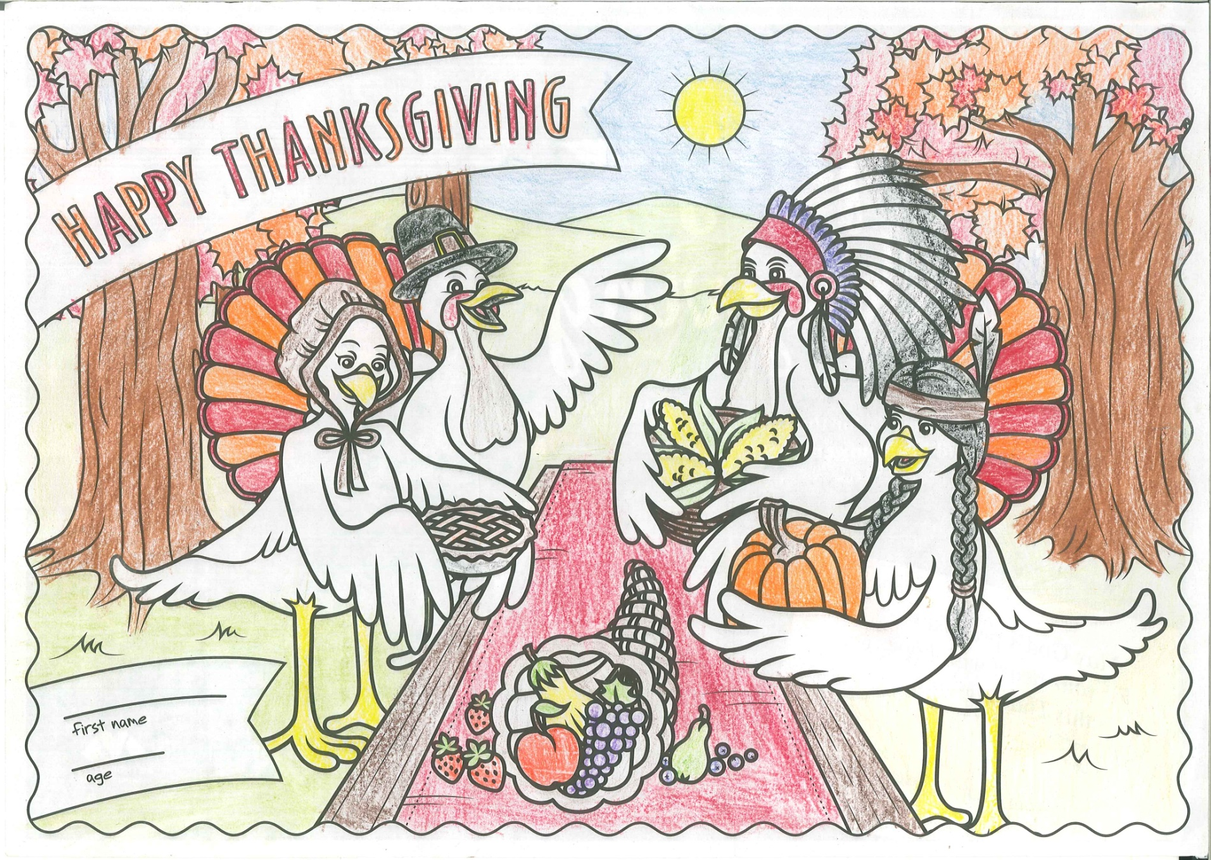
Entry 5

Slide 7
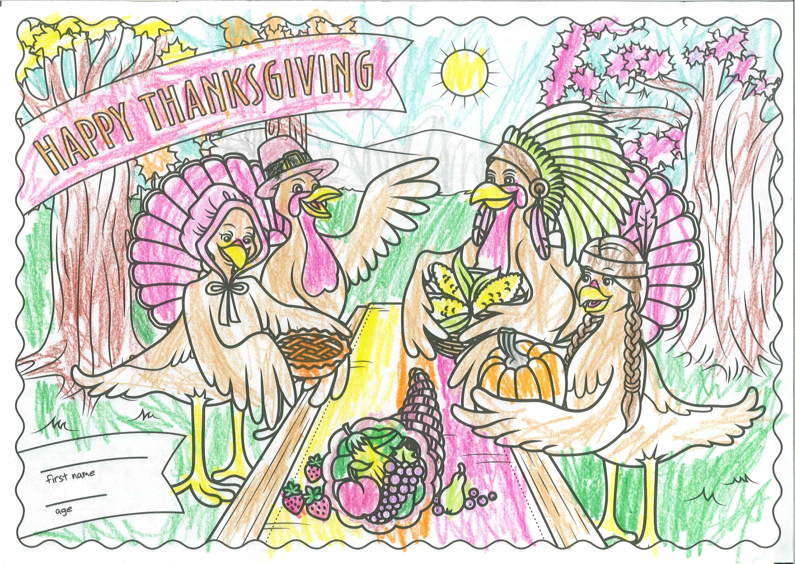
Entry 6

Slide 8
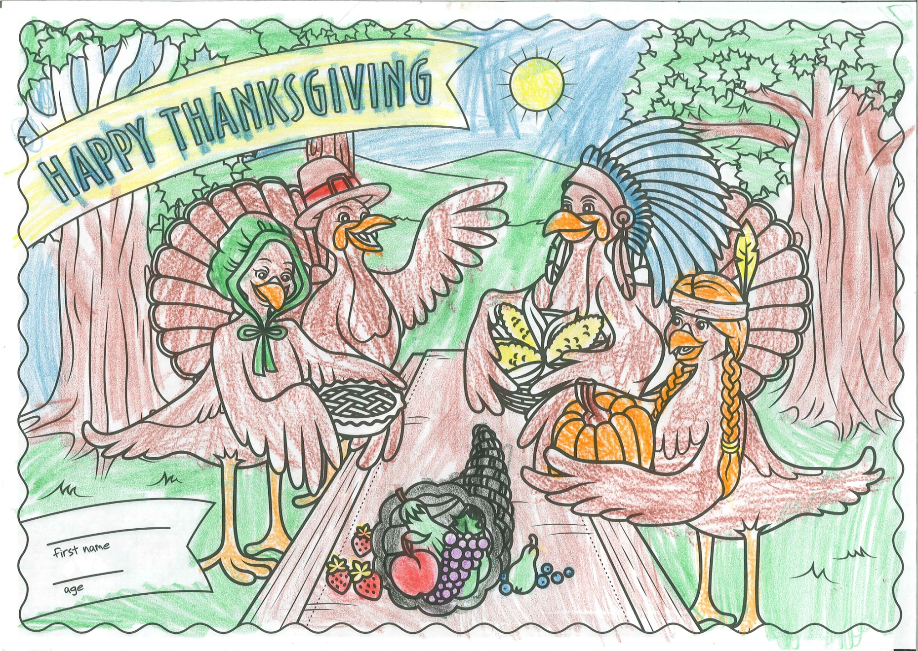
Entry 7

Slide 9
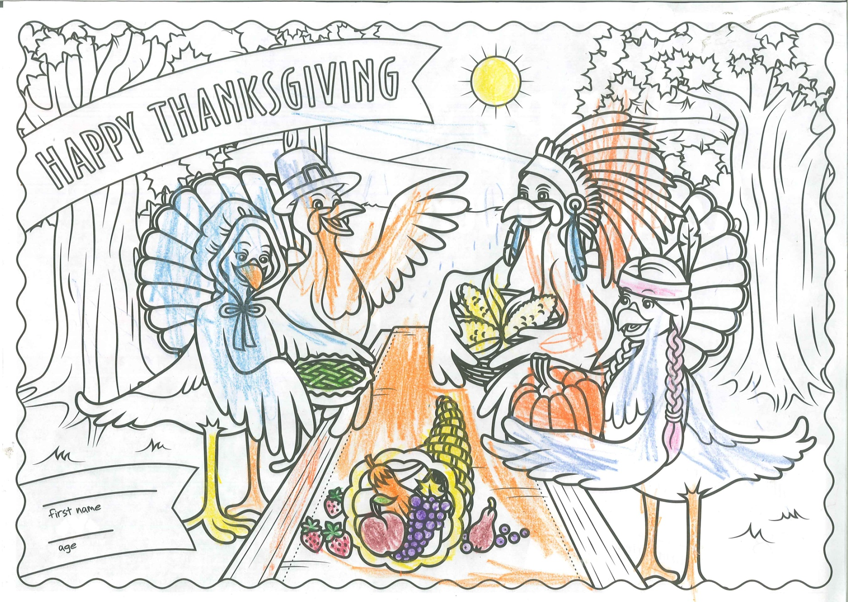
Entry 8

Slide 10
2nd Place!!!

Slide 11
1st Place!!!

