Slide 1


Slide 2
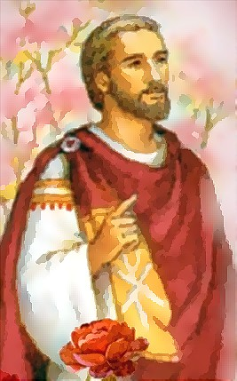

Slide 3
Anyone who does not love does not know God, because God is love.
1 John 4:18 ESV

Slide 4
John 3:16a ESV - ¹⁶ “For God so loved the world…
Galatians 2:20b - And the life I now live in the flesh I live by faith in the Son of God. Who loved me…
Ephesians 2:4 ESV - ⁴ But God, being rich in mercy, because of the great love with which he loved us
1 John 3:1a ESV - See what kind of love the Father has given to us…
1 John 4:9 ESV - ⁹ In this the love of God was made manifest among us

Slide 5
John 3:16 ESV - ¹⁶ “For God so loved the world, that he gave his only Son, that whoever believes in him should not perish but have eternal life.
Galatians 2:20b ESV - And the life I now live in the flesh I live by faith in the Son of God, who loved me and gave himself for me.
Ephesians 2:4-5 ESV - ⁴ But God, being rich in mercy, because of the great love with which he loved us, ⁵ even when we were dead in our trespasses, made us alive together with Christ—by grace you have been saved
1 John 4:9-10 ESV - ⁹ In this the love of God was made manifest among us, that God sent his only Son into the world, so that we might live through him. ¹⁰ In this is love, not that we have loved God but that he loved us and sent his Son to be the propitiation for our sins.
Romans 5:8 ESV - ⁸ but God shows his love for us in that while we were still sinners, Christ died for us.
1 John 3:1a ESV - See what kind of love the Father has given to us, that we should be called children of God; and so we are.

Slide 6
Give thanks to the Lord, for he is good, for his steadfast love endures forever.
² Give thanks to the God of gods, for his steadfast love endures forever.
³ Give thanks to the Lord of lords, for his steadfast love endures forever;
⁴ to him who alone does great wonders, for his steadfast love endures forever;
⁵ to him who by understanding made the heavens, for his steadfast love endures forever;
⁶ to him who spread out the earth above the waters, for his steadfast love endures forever;
⁷ to him who made the great lights, for his steadfast love endures forever;
⁸ the sun to rule over the day, for his steadfast love endures forever;
⁹ the moon and stars to rule over the night, for his steadfast love endures forever;

Slide 7
¹⁰ to him who struck down the firstborn of Egypt, for his steadfast love endures forever;
¹¹ and brought Israel out from among them, for his steadfast love endures forever;
¹² with a strong hand and an outstretched arm, for his steadfast love endures forever;
¹³ to him who divided the Red Sea in two, for his steadfast love endures forever;
¹⁴ and made Israel pass through the midst of it, for his steadfast love endures forever;
¹⁵ but overthrew Pharaoh and his host in the Red Sea, for his steadfast love endures forever;
¹⁶ to him who led his people through the wilderness, for his steadfast love endures forever;
¹⁷ to him who struck down great kings, for his steadfast love endures forever;
¹⁸ and killed mighty kings, for his steadfast love endures forever;

Slide 8
¹⁹ Sihon, king of the Amorites, for his steadfast love endures forever;
²⁰ and Og, king of Bashan, for his steadfast love endures forever;
²¹ and gave their land as a heritage, for his steadfast love endures forever;
²² a heritage to Israel his servant, for his steadfast love endures forever.
²³ It is he who remembered us in our low estate, for his steadfast love endures forever;
²⁴ and rescued us from our foes, for his steadfast love endures forever;
²⁵ he who gives food to all flesh, for his steadfast love endures forever.
²⁶ Give thanks to the God of heaven, for his steadfast love endures forever.

Slide 9
- ³⁵ Who shall separate us from the love of Christ? Shall tribulation, or distress, or persecution, or famine, or nakedness, or danger, or sword? ³⁶ As it is written, “For your sake we are being killed all the day long; we are regarded as sheep to be slaughtered.” ³⁷ No, in all these things we are more than conquerors through him who loved us. ³⁸ For I am sure that neither death nor life, nor angels nor rulers, nor things present nor things to come, nor powers, ³⁹ nor height nor depth, nor anything else in all creation, will be able to separate us from the love of God in Christ Jesus our Lord.
Romans 8:35-39 ESV

Slide 10
⁴ Love is patient, love is kind, it is not envious. Love does not brag, it is not puffed up. ⁵ It is not rude, it is not self-serving, it is not easily angered or resentful. ⁶ It is not glad about injustice, but rejoices in the truth. ⁷ It bears all things, believes all things, hopes all things, endures all things. ⁸ Love never ends.
1 Corinthians 13:4-8a NET

Slide 11
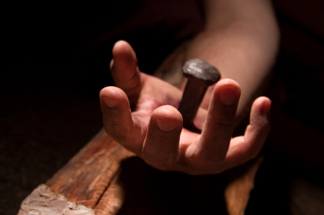
Greater love has no one than this, that someone lay down his life for his friends.
John 15:13 ESV

