Slide 1


Slide 2
²⁸ And when he had said these things, he went on ahead, going up to Jerusalem. ²⁹ When he drew near to Bethphage and Bethany, at the mount that is called Olivet, he sent two of the disciples, ³⁰ saying, “Go into the village in front of you, where on entering you will find a colt tied, on which no one has ever yet sat. Untie it and bring it here. ³¹ If anyone asks you, ‘Why are you untying it?’ you shall say this: ‘The Lord has need of it.’” ³² So those who were sent went away and found it just as he had told them. ³³ And as they were untying the colt, its owners said to them, “Why are you untying the colt?” ³⁴ And they said, “The Lord has need of it.” ³⁵ And they brought it to Jesus, and throwing their cloaks on the colt, they set Jesus on it. ³⁶ And as he rode along, they spread their cloaks on the road. ³⁷ As he was drawing near—already on the way down the Mount of Olives—the whole multitude of his disciples began to rejoice and praise God with a loud voice for all the mighty works that they had seen, ³⁸ saying, “Blessed is the King who comes in the name of the Lord! Peace in heaven and glory in the highest!” ³⁹ And some of the Pharisees in the crowd said to him, “Teacher, rebuke your disciples.” ⁴⁰ He answered, “I tell you, if these were silent, the very stones would cry out.”
Luke 19:28-40 ESV

Slide 3
²⁸ And when he had said these things, he went on ahead, going up to Jerusalem. ²⁹ When he drew near to Bethphage and Bethany, at the mount that is called Olivet, he sent two of the disciples, ³⁰ saying, “Go into the village in front of you, where on entering you will find a colt tied, on which no one has ever yet sat. Untie it and bring it here. ³¹ If anyone asks you, ‘Why are you untying it?’ you shall say this: ‘The Lord has need of it.’” ³² So those who were sent went away and found it just as he had told them. ³³ And as they were untying the colt, its owners said to them, “Why are you untying the colt?” ³⁴ And they said, “The Lord has need of it.” ³⁵ And they brought it to Jesus, and throwing their cloaks on the colt, they set Jesus on it. ³⁶ And as he rode along, they spread their cloaks on the road. ³⁷ As he was drawing near—already on the way down the Mount of Olives—the whole multitude of his disciples began to rejoice and praise God with a loud voice for all the mighty works that they had seen, ³⁸ saying, “Blessed is the King who comes in the name of the Lord! Peace in heaven and glory in the highest!” ³⁹ And some of the Pharisees in the crowd said to him, “Teacher, rebuke your disciples.” ⁴⁰ He answered, “I tell you, if these were silent, the very stones would cry out.”
Luke 19:28-40 ESV

Slide 4
²² The stone that the builders rejected has become the cornerstone. ²³ This is the Lord's doing; it is marvelous in our eyes. ²⁴ This is the day that the Lord has made; let us rejoice and be glad in it. ²⁵ Save us, we pray, O Lord! O Lord, we pray, give us success! ²⁶ Blessed is he who comes in the name of the Lord! We bless you from the house of the Lord.
Psalm 118:22-26 ESV

Slide 5
²⁸ And when he had said these things, he went on ahead, going up to Jerusalem. ²⁹ When he drew near to Bethphage and Bethany, at the mount that is called Olivet, he sent two of the disciples, ³⁰ saying, “Go into the village in front of you, where on entering you will find a colt tied, on which no one has ever yet sat. Untie it and bring it here. ³¹ If anyone asks you, ‘Why are you untying it?’ you shall say this: ‘The Lord has need of it.’” ³² So those who were sent went away and found it just as he had told them. ³³ And as they were untying the colt, its owners said to them, “Why are you untying the colt?” ³⁴ And they said, “The Lord has need of it.” ³⁵ And they brought it to Jesus, and throwing their cloaks on the colt, they set Jesus on it. ³⁶ And as he rode along, they spread their cloaks on the road. ³⁷ As he was drawing near—already on the way down the Mount of Olives—the whole multitude of his disciples began to rejoice and praise God with a loud voice for all the mighty works that they had seen, ³⁸ saying, “Blessed is the King who comes in the name of the Lord! Peace in heaven and glory in the highest!” ³⁹ And some of the Pharisees in the crowd said to him, “Teacher, rebuke your disciples.” ⁴⁰ He answered, “I tell you, if these were silent, the very stones would cry out.”
Luke 19:28-40 ESV

Slide 6
“Come, everyone who thirsts, come to the waters; and he who has no money, come, buy and eat! Come, buy wine and milk without money and without price. ² Why do you spend your money for that which is not bread, and your labor for that which does not satisfy? Listen diligently to me, and eat what is good, and delight yourselves in rich food. ³ Incline your ear, and come to me; hear, that your soul may live; and I will make with you an everlasting covenant, my steadfast, sure love for David. ⁴ Behold, I made him a witness to the peoples, a leader and commander for the peoples. ⁵ Behold, you shall call a nation that you do not know, and a nation that did not know you shall run to you, because of the Lord your God, and of the Holy One of Israel, for he has glorified you. ⁶ “Seek the Lord while he may be found; call upon him while he is near; ⁷ let the wicked forsake his way, and the unrighteous man his thoughts; let him return to the Lord, that he may have compassion on him, and to our God, for he will abundantly pardon. ⁸ For my thoughts are not your thoughts, neither are your ways my ways, declares the Lord. ⁹ For as the heavens are higher than the earth, so are my ways higher than your ways and my thoughts than your thoughts. ¹⁰ “For as the rain and the snow come down from heaven and do not return there but water the earth, making it bring forth and sprout, giving seed to the sower and bread to the eater, ¹¹ so shall my word be that goes out from my mouth; it shall not return to me empty, but it shall accomplish that which I purpose, and shall succeed in the thing for which I sent it. ¹² “For you shall go out in joy and be led forth in peace; the mountains and the hills before you shall break forth into singing, and all the trees of the field shall clap their hands. ¹³ Instead of the thorn shall come up the cypress; instead of the brier shall come up the myrtle; and it shall make a name for the Lord, an everlasting sign that shall not be cut off.”

Slide 7
And to Adam he said, “Because you have listened to the voice of your wife and have eaten of the tree of which I commanded you, ‘You shall not eat of it,’ cursed is the ground because of you; in pain you shall eat of it all the days of your life;
Genesis 3:17 ESV

Slide 8
¹⁹ For the creation waits with eager longing for the revealing of the sons of God. ²⁰ For the creation was subjected to futility, not willingly, but because of him who subjected it, in hope ²¹ that the creation itself will be set free from its bondage to corruption and obtain the freedom of the glory of the children of God. ²² For we know that the whole creation has been groaning together in the pains of childbirth until now. ²³ And not only the creation, but we ourselves, who have the firstfruits of the Spirit, groan inwardly as we wait eagerly for adoption as sons, the redemption of our bodies.
Romans 8:19-23 ESV

Slide 9
¹³ Instead of the thorn shall come up the cypress; instead of the brier shall come up the myrtle; and it shall make a name for the Lord, an everlasting sign that shall not be cut off.”
Isaiah 55:13 ESV

Slide 10
Worthy!
Psalms 19:1-3 ESV - The heavens declare the glory of God, and the sky above proclaims his handiwork. ² Day to day pours out speech, and night to night reveals knowledge. ³ There is no speech, nor are there words, whose voice is not heard.
Psalm 145:3,10 ESV - ³ Great is the Lord, and greatly to be praised, and his greatness is unsearchable. ¹⁰ All your works shall give thanks to you, O Lord, and all your saints shall bless you!
Revelation 4:9-11 ESV - ⁹ And whenever the living creatures give glory and honor and thanks to him who is seated on the throne, who lives forever and ever, ¹⁰ the twenty-four elders fall down before him who is seated on the throne and worship him who lives forever and ever. They cast their crowns before the throne, saying, ¹¹ “Worthy are you, our Lord and God, to receive glory and honor and power, for you created all things, and by your will they existed and were created.”

Slide 11

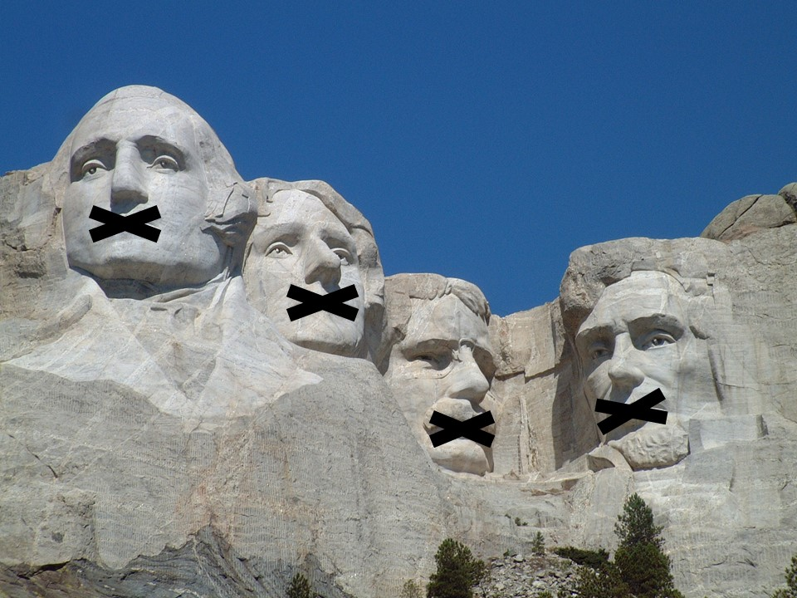
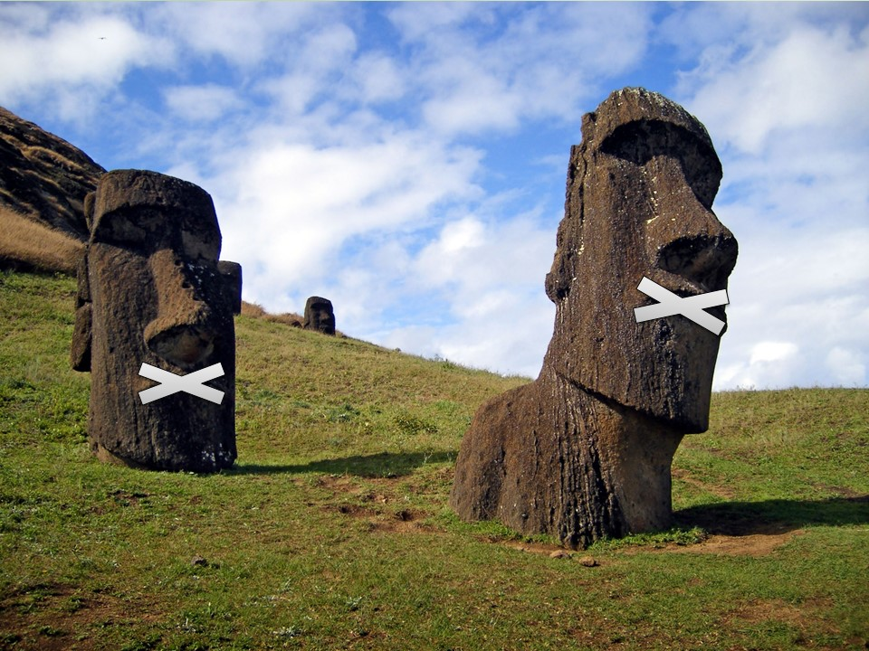
⁵ you yourselves like living stones are being built up as a spiritual house, to be a holy priesthood, to offer spiritual sacrifices acceptable to God through Jesus Christ.
1 Peter 2:5 ESV

Slide 12
Come!
Isaiah 55:1 ESV - “Come, everyone who thirsts, come to the waters; and he who has no money, come, buy and eat! Come, buy wine and milk without money and without price.
John 7:37-38 ESV - ³⁷ On the last day of the feast, the great day, Jesus stood up and cried out, “If anyone thirsts, let him come to me and drink. ³⁸ Whoever believes in me, as the Scripture has said, ‘Out of his heart will flow rivers of living water.’”
Revelation 22:17 ESV - ¹⁷ The Spirit and the Bride say, “Come.” And let the one who hears say, “Come.” And let the one who is thirsty come; let the one who desires take the water of life without price.

Slide 13
⁴¹ And when he drew near and saw the city, he wept over it, ⁴² saying, “Would that you, even you, had known on this day the things that make for peace! But now they are hidden from your eyes.
Luke 19:41-42 ESV

