Slide 1
Retreat Recap 2016

Slide 2
To grow to be a godly, Christ-centered body of believers; equipped with and grounded in truth; walking in faith by the Spirit; working powerfully in the gifts the Father has bestowed upon us; exemplifying the Gospel to the communities in which we are planted; motivated to sow the seeds of salvation.

Slide 3
To grow to be a godly, Christ-centered body of believers; equipped with and grounded in truth; walking in faith by the Spirit; working powerfully in the gifts the Father has bestowed upon us; exemplifying the Gospel to the communities in which we are planted; motivated to sow the seeds of salvation.

Slide 4
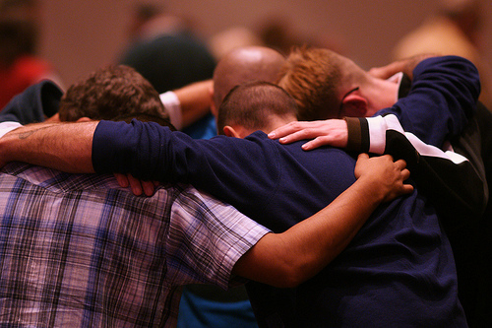
Discipleship

Slide 5

3/18 & 3/19

Slide 6
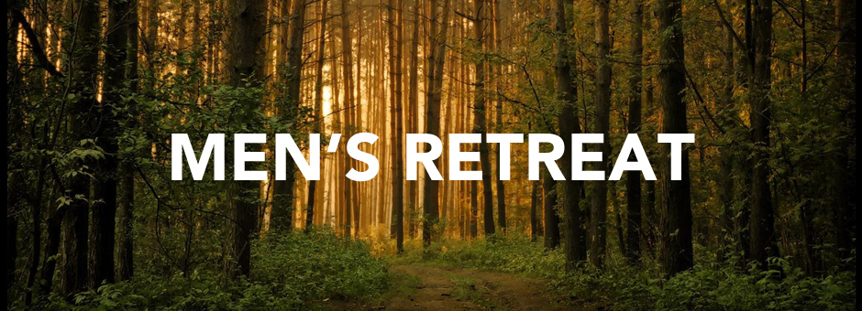
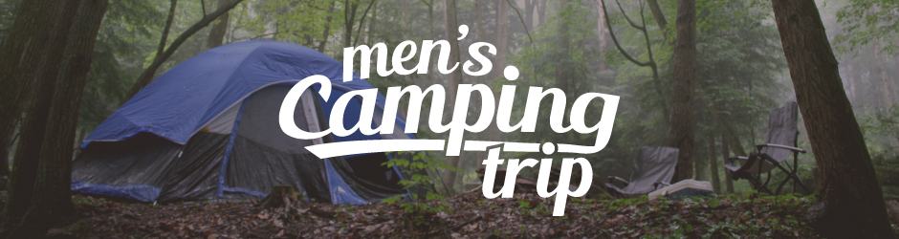
9/9 & 9/10
4/1 & 4/2

