Slide 1

The Aim of Our Charge

Slide 2


Slide 3

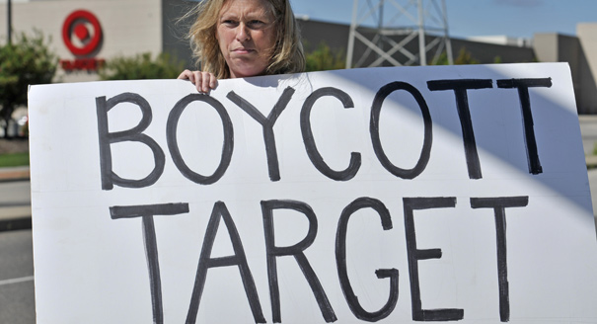



Slide 4
So God created man in his own image, in the image of God he created him; male and female he created them.
Genesis 1:27 ESV

Slide 5
²¹ For although they knew God, they did not honor him as God or give thanks to him, but they became futile in their thinking, and their foolish hearts were darkened. ²² Claiming to be wise, they became fools, ²³ and exchanged the glory of the immortal God for images resembling mortal man and birds and animals and creeping things. ²⁴ Therefore God gave them up in the lusts of their hearts to impurity, to the dishonoring of their bodies among themselves, ²⁵ because they exchanged the truth about God for a lie and worshiped and served the creature rather than the Creator, who is blessed forever! Amen. ²⁶ For this reason God gave them up to dishonorable passions. For their women exchanged natural relations for those that are contrary to nature; ²⁷ and the men likewise gave up natural relations with women and were consumed with passion for one another, men committing shameless acts with men and receiving in themselves the due penalty for their error. ²⁸ And since they did not see fit to acknowledge God, God gave them up to a debased mind to do what ought not to be done. ²⁹ They were filled with all manner of unrighteousness, evil, covetousness, malice. They are full of envy, murder, strife, deceit, maliciousness. They are gossips,³⁰ slanderers, haters of God, insolent, haughty, boastful, inventors of evil, disobedient to parents, ³¹ foolish, faithless, heartless, ruthless. ³² Though they know God's righteous decree that those who practice such things deserve to die, they not only do them but give approval to those who practice them.
Romans 1:21-32 ESV

Slide 6
⁵ The aim of our charge is love that issues from a pure heart and a good conscience and a sincere faith.
1 Timothy 1:5 ESV

Slide 7


Slide 8
¹³ Be watchful, stand firm in the faith, act like men, be strong. ¹⁴ Let all that you do be done in love.
1 Corinthians 16:13-14 ESV

Slide 9
¹⁴ For the love of Christ controls us, because we have concluded this: that one has died for all, therefore all have died; ¹⁵ and he died for all, that those who live might no longer live for themselves but for him who for their sake died and was raised.¹⁶ From now on, therefore, we regard no one according to the flesh. Even though we once regarded Christ according to the flesh, we regard him thus no longer. ¹⁷ Therefore, if anyone is in Christ, he is a new creation. The old has passed away; behold, the new has come. ¹⁸ All this is from God, who through Christ reconciled us to himself and gave us the ministry of reconciliation; ¹⁹ that is, in Christ God was reconciling the world to himself, not counting their trespasses against them, and entrusting to us the message of reconciliation. ²⁰ Therefore, we are ambassadors for Christ, God making his appeal through us. We implore you on behalf of Christ, be reconciled to God. ²¹ For our sake he made him to be sin who knew no sin, so that in him we might become the righteousness of God.
2 Corinthians 5:14-21 ESV

Slide 10
⁹ Or do you not know that the unrighteous will not inherit the kingdom of God? Do not be deceived: neither the sexually immoral, nor idolaters, nor adulterers, nor men who practice homosexuality, ¹⁰ nor thieves, nor the greedy, nor drunkards, nor revilers, nor swindlers will inherit the kingdom of God. ¹¹ And such were some of you. But you were washed, you were sanctified, you were justified in the name of the Lord Jesus Christ and by the Spirit of our God
1 Corinthians 6:9-11 ESV

Slide 11
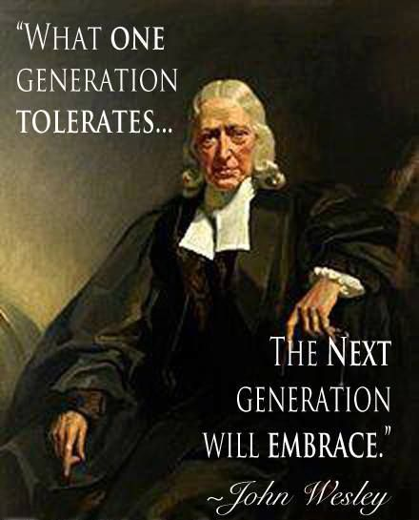

Slide 12
²⁶ So I do not run aimlessly; I do not box as one beating the air. ²⁷ But I discipline my body and keep it under control, lest after preaching to others I myself should be disqualified.
1 Corinthians 9:26-27 ESV

Slide 13
³² Though they know God's righteous decree that those who practice such things deserve to die, they not only do them but give approval to those who practice them.
Romans 1:32 ESV

