Slide 1


Slide 2

¹⁶ But I say, walk by the Spirit, and you will not gratify the desires of the flesh. ¹⁷ For the desires of the flesh are against the Spirit, and the desires of the Spirit are against the flesh, for these are opposed to each other, to keep you from doing the things you want to do. ¹⁸ But if you are led by the Spirit, you are not under the law. ¹⁹ Now the works of the flesh are evident: sexual immorality, impurity, sensuality, ²⁰ idolatry, sorcery, enmity, strife, jealousy, fits of anger, rivalries, dissensions, divisions, ²¹ envy, drunkenness, orgies, and things like these. I warn you, as I warned you before, that those who do such things will not inherit the kingdom of God.
Galatians 5:16-22 ESV

Slide 3
¹⁶ But I say, walk by the Spirit, and you will not gratify the desires of the flesh. ¹⁷ For the desires of the flesh are against the Spirit, and the desires of the Spirit are against the flesh, for these are opposed to each other, to keep you from doing the things you want to do. ¹⁸ But if you are led by the Spirit, you are not under the law. ¹⁹ Now the works of the flesh are evident: sexual immorality, impurity, sensuality, ²⁰ idolatry, sorcery, enmity, strife, jealousy, fits of anger, rivalries, dissensions, divisions, ²¹ envy, drunkenness, orgies, and things like these. I warn you, as I warned you before, that those who do such things will not inherit the kingdom of God.
Galatians 5:16-22 ESV

Slide 4
¹⁶ But I say, walk by the Spirit, and you will not gratify the desires of the flesh. ¹⁷ For the desires of the flesh are against the Spirit, and the desires of the Spirit are against the flesh, for these are opposed to each other, to keep you from doing the things you want to do. ¹⁸ But if you are led by the Spirit, you are not under the law. ¹⁹ Now the works of the flesh are evident: sexual immorality, impurity, sensuality, ²⁰ idolatry, sorcery, enmity, strife, jealousy, fits of anger, rivalries, dissensions, divisions, ²¹ envy, drunkenness, orgies, and things like these. I warn you, as I warned you before, that those who do such things will not inherit the kingdom of God.
Galatians 5:16-22 ESV

Slide 5
¹⁶ But I say, walk by the Spirit, and you will not gratify the desires of the flesh. ¹⁷ For the desires of the flesh are against the Spirit, and the desires of the Spirit are against the flesh, for these are opposed to each other, to keep you from doing the things you want to do. ¹⁸ But if you are led by the Spirit, you are not under the law. ¹⁹ Now the works of the flesh are evident: sexual immorality, impurity, sensuality, ²⁰ idolatry, sorcery, enmity, strife, jealousy, fits of anger, rivalries, dissensions, divisions, ²¹ envy, drunkenness, orgies, and things like these. I warn you, as I warned you before, that those who do such things will not inherit the kingdom of God.
Galatians 5:16-22 ESV

Slide 6
²⁴ And those who belong to Christ Jesus have crucified the flesh with its passions and desires.
Galatians 5:24 ESV

Slide 7
⁵ Put to death therefore what is earthly in you: sexual immorality, impurity, passion, evil desire, and covetousness, which is idolatry. ⁶ On account of these the wrath of God is coming. ⁷ In these you too once walked, when you were living in them. ⁸ But now you must put them all away: anger, wrath, malice, slander, and obscene talk from your mouth. ⁹ Do not lie to one another, seeing that you have put off the old self with its practices ¹⁰ and have put on the new self, which is being renewed in knowledge after the image of its creator.
Colossians 3:5-10 ESV

Slide 8
⁴ For the weapons of our warfare are not of the flesh but have divine power to destroy strongholds. ⁵ We destroy arguments and every lofty opinion raised against the knowledge of God, and take every thought captive to obey Christ, ⁶ being ready to punish every disobedience, when your obedience is complete.
2 Corinthians 10:4-6 ESV

Slide 9
¹⁶ But I say, walk by the Spirit, and you will not gratify the desires of the flesh. ¹⁷ For the desires of the flesh are against the Spirit, and the desires of the Spirit are against the flesh, for these are opposed to each other, to keep you from doing the things you want to do. ¹⁸ But if you are led by the Spirit, you are not under the law. ¹⁹ Now the works of the flesh are evident: sexual immorality, impurity, sensuality, ²⁰ idolatry, sorcery, enmity, strife, jealousy, fits of anger, rivalries, dissensions, divisions, ²¹ envy, drunkenness, orgies, and things like these. I warn you, as I warned you before, that those who do such things will not inherit the kingdom of God.
Galatians 5:16-22 ESV

Slide 10
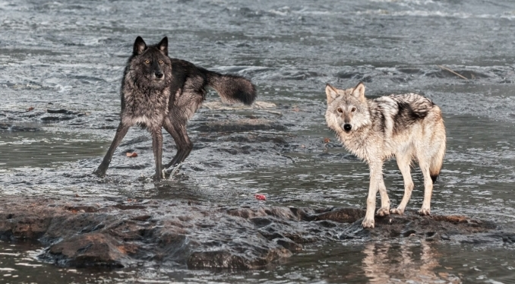

Slide 11
¹³ For if you live according to the flesh you will die, but if by the Spirit you put to death the deeds of the body, you will live.
Romans 8:13 ESV

Slide 12
¹⁶ But I say, walk by the Spirit, and you will not gratify the desires of the flesh. ¹⁷ For the desires of the flesh are against the Spirit, and the desires of the Spirit are against the flesh, for these are opposed to each other, to keep you from doing the things you want to do. ¹⁸ But if you are led by the Spirit, you are not under the law. ¹⁹ Now the works of the flesh are evident: sexual immorality, impurity, sensuality, ²⁰ idolatry, sorcery, enmity, strife, jealousy, fits of anger, rivalries, dissensions, divisions, ²¹ envy, drunkenness, orgies, and things like these. I warn you, as I warned you before, that those who do such things will not inherit the kingdom of God.
Galatians 5:16-22 ESV

Slide 13
¹¹ For the grace of God has appeared, bringing salvation for all people, ¹² training us to renounce ungodliness and worldly passions, and to live self-controlled, upright, and godly lives in the present age, ¹³ waiting for our blessed hope, the appearing of the glory of our great God and Savior Jesus Christ, ¹⁴ who gave himself for us to redeem us from all lawlessness and to purify for himself a people for his own possession who are zealous for good works.
Titus 2:11-14 ESV

