Slide 1


Slide 2
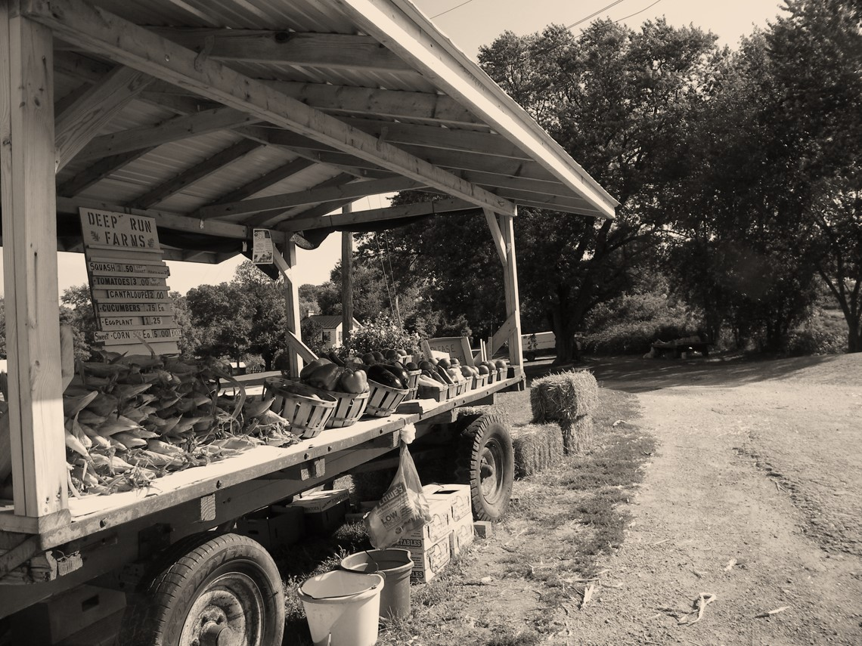


²² But the fruit of the Spirit is love, joy, peace, patience, kindness, goodness, faithfulness, ²³ gentleness, self-control; against such things there is no law.
Galatians 5:22-23 ESV

Slide 3
¹⁹ We love because he first loved us.
1 John 4:19 ESV

Slide 4

1 John 4:7-8 ESV - ⁷ Beloved, let us love one another, for love is from God, and whoever loves has been born of God and knows God. ⁸ Anyone who does not love does not know God, because God is love.
John 13:35 ESV - ³⁵ By this all people will know that you are my disciples, if you have love for one another.”

Slide 5
⁹ In this the love of God was made manifest among us, that God sent his only Son into the world, so that we might live through him. ¹⁰ In this is love, not that we have loved God but that he loved us and sent his Son to be the propitiation for our sins.
1 John 4:9-10 ESV

Slide 6
⁸ but God shows his love for us in that while we were still sinners, Christ died for us.
Romans 5:8 ESV

Slide 7
When we were utterly helpless, Christ came at just the right time and died for us sinners.
Romans 5:6 NLT

Slide 8
¹¹ Beloved, if God so loved us, we also ought to love one another. ¹² No one has ever seen God; if we love one another, God abides in us and his love is perfected in us. ¹³ By this we know that we abide in him and he in us, because he has given us of his Spirit. ¹⁴ And we have seen and testify that the Father has sent his Son to be the Savior of the world. ¹⁵ Whoever confesses that Jesus is the Son of God, God abides in him, and he in God.
1 John 4:11-15 ESV

Slide 9
¹⁶ By this we know love, that he laid down his life for us, and we ought to lay down our lives for the brothers. ¹⁷ But if anyone has the world's goods and sees his brother in need, yet closes his heart against him, how does God's love abide in him? ¹⁸ Little children, let us not love in word or talk but in deed and in truth.
1 John 3:16-17 ESV

Slide 10
If I speak in the tongues of men and of angels, but have not love, I am a noisy gong or a clanging cymbal. ² And if I have prophetic powers, and understand all mysteries and all knowledge, and if I have all faith, so as to remove mountains, but have not love, I am nothing. ³ If I give away all I have, and if I deliver up my body to be burned, but have not love, I gain nothing.
1 Corinthians 13:1-3 ESV

Slide 11

Confidence
Talent
Faith
Ability
Charity
Gifts
Sacrifice
Knowledge

Slide 12
⁹ Let love be genuine.
Romans 12:9a ESV

Slide 13
¹⁴ For this reason I bow my knees before the Father, ¹⁵ from whom every family in heaven and on earth is named, ¹⁶ that according to the riches of his glory he may grant you to be strengthened with power through his Spirit in your inner being, ¹⁷ so that Christ may dwell in your hearts through faith—that you, being rooted and grounded in love, ¹⁸ may have strength to comprehend with all the saints what is the breadth and length and height and depth, ¹⁹ and to know the love of Christ that surpasses knowledge, that you may be filled with all the fullness of God.
Ephesians 3:14-19 ESV

Slide 14
⁶ For in Christ Jesus neither circumcision nor uncircumcision counts for anything, but only faith working through love.
Galatians 5:6 ESV

Slide 15
¹⁶ In the same way, let your light shine before others, so that they may see your good works and give glory to your Father who is in heaven.
Matthew 5:16 ESV

