Slide 1
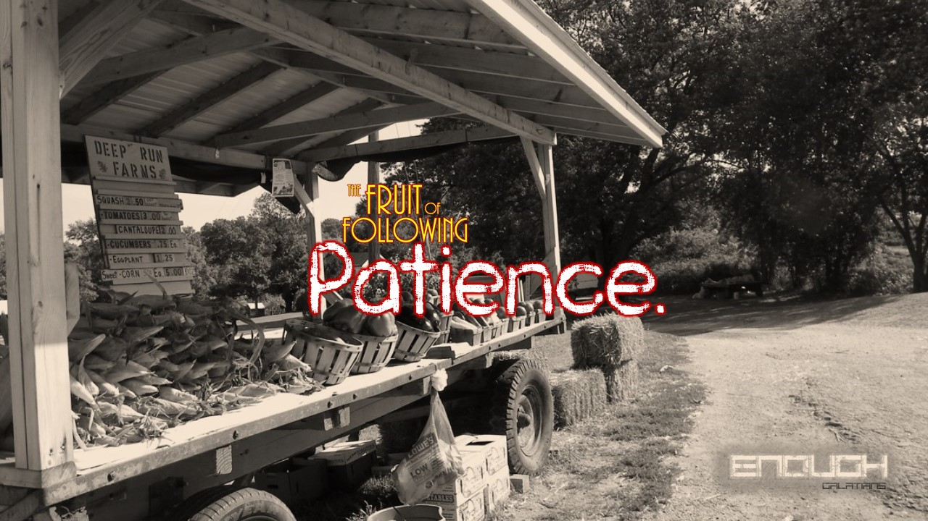

Slide 2
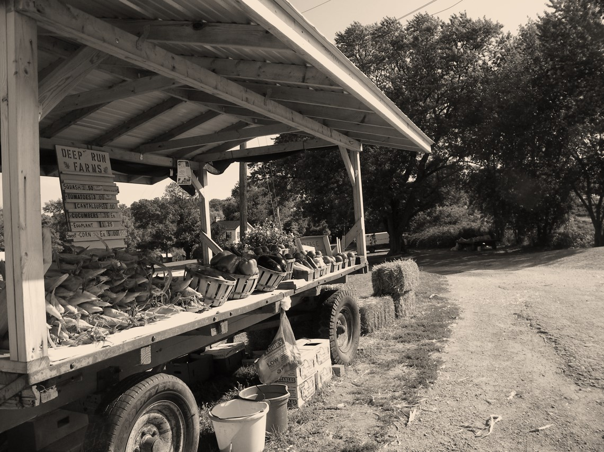


²² But the fruit of the Spirit is love, joy, peace, patience, kindness, goodness, faithfulness, ²³ gentleness, self-control; against such things there is no law.
Galatians 5:22-23 ESV

Slide 3
“The rebellious children are as good as dead,” says the Lord, “those who make plans without consulting me, who form alliances without consulting my Spirit, and thereby compound their sin. ² They travel down to Egypt without seeking my will, seeking Pharaoh’s protection, and looking for safety in Egypt’s protective shade. ³ But Pharaoh’s protection will bring you nothing but shame, and the safety of Egypt’s protective shade nothing but humiliation. ⁴ Though his officials are in Zoan and his messengers arrive at Hanes, ⁵ all will be put to shame because of a nation that cannot help them, who cannot give them aid or help, but only shame and disgrace.”
Isaiah 30:1-4 NET

Slide 4
⁸ Now go, write it down on a tablet in their presence, inscribe it on a scroll, so that it might be preserved for a future time as an enduring witness. ⁹ For these are rebellious people— they are lying children, children unwilling to obey the Lord’s law. ¹⁰ They say to the visionaries, “See no more visions!” and to the seers, “Don’t relate messages to us about what is right! Tell us nice things, relate deceptive messages. ¹¹ Turn aside from the way, stray off the path. Remove from our presence the Holy One of Israel.”
Isaiah 30:8-11 NET

Slide 5
³ For the time is coming when people will not endure sound teaching, but having itching ears they will accumulate for themselves teachers to suit their own passions, ⁴ and will turn away from listening to the truth and wander off into myths.
2 Timothy 4:3-4 ESV

Slide 6
For this reason this is what the Holy One of Israel says: “You have rejected this message; you trust instead in your ability to oppress and trick, and rely on that kind of behavior. ¹³ So this sin will become your downfall. You will be like a high wall that bulges and cracks and is ready to collapse; it crumbles suddenly, in a flash. ¹⁴ It shatters in pieces like a clay jar, so shattered to bits that none of it can be salvaged.
Among its fragments one cannot find a shard large enough to scoop a hot coal from a fire or to skim off water from a cistern.”
Isaiah 30:12-14 NET

Slide 7
For this is what the master, the Lord, the Holy One of Israel says: “If you repented and patiently waited for me, you would be delivered; if you calmly trusted in me you would find strength, but you are unwilling.
Isaiah 30:15 NET

Slide 8
³³ I have said these things to you, that in me you may have peace. In the world you will have tribulation. But take heart; I have overcome the world.”
John 16:33 ESV

Slide 9
¹⁸ For this reason the Lord is ready to show you mercy; he sits on his throne, ready to have compassion on you. Indeed, the Lord is a just God; all who wait for him in faith will be blessed.
Isaiah 30:18 NET

Slide 10
²⁷ Look, the name of the Lord comes from a distant place in raging anger and awesome splendor. He speaks angrily and his word is like destructive fire. ²⁸ His battle cry overwhelms like a flooding river that reaches one’s neck. He shakes the nations in a sieve that isolates the chaff; he puts a bit into the mouth of the nations and leads them to destruction.
³⁰ The Lord will give a mighty shout and intervene in power, with furious anger and flaming, destructive fire, with a driving rainstorm and hailstones. ³¹ Indeed, the Lord’s shout will shatter Assyria; he will beat them with a club. ³² Every blow from his punishing cudgel, with which the Lord will beat them, will be accompanied by music from the tambourine and harp, and he will attack them with his weapons. ³³ For the burial place is already prepared; it has been made deep and wide for the king. The firewood is piled high on it. The Lord’s breath, like a stream flowing with brimstone, will ignite it.
Isaiah 30:27-28, 30-33 NET

Slide 11
²⁹ You will sing as you do in the evening when you are celebrating a festival. You will be happy like one who plays a flute as he goes to the mountain of the Lord, the Rock who shelters Israel.
Isaiah 30:29 NET

Slide 12
⁹ The Lord is not slow to fulfill his promise as some count slowness, but is patient toward you, not wishing that any should perish, but that all should reach repentance.
2 Peter 3:9 ESV

Slide 13
“Certain of God’s people are in trouble and distress, and they are eager for immediate rescue. They cannot wait God’s time, nor exercise submission to his will. He will surely deliver them in due season; but they cannot tarry till the hour cometh; like children, they snatch at unripe fruit. ‘To everything there is a season, and a time to every purpose under the heaven’; but their one season is the present; they cannot, they will not wait. They must have their desire instantaneously fulfilled, or else they are ready to take wrong means of attaining it. If in poverty, they are in haste to be rich; and they shall not long be innocent. If under reproach, their heart ferments towards revenge. They would sooner rush under the guidance of Satan into some questionable policy, than in childlike simplicity trust in the Lord and do good. It must not be so with you, my brethren, you must learn a better way.”
Charles Spurgeon

