Slide 1


Slide 2
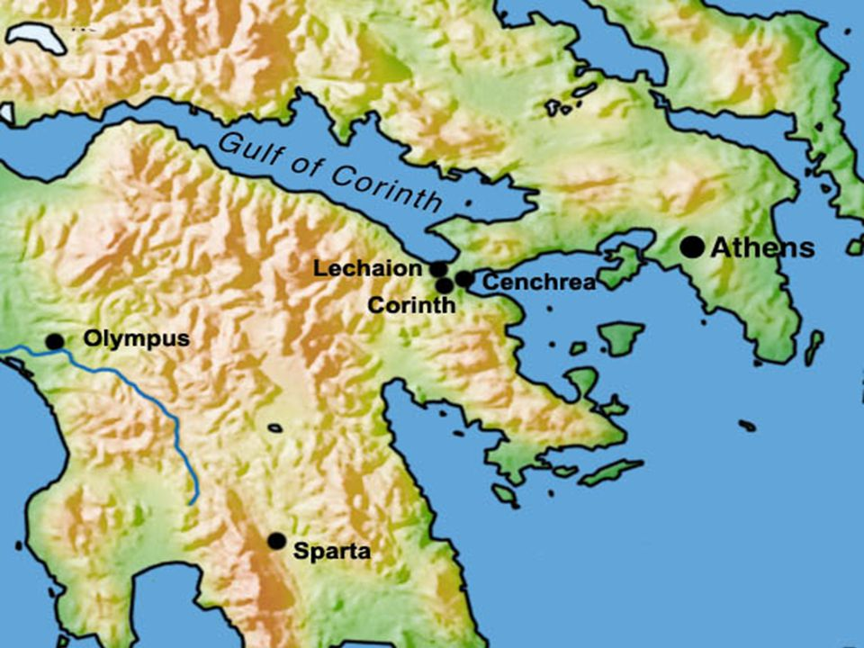

Slide 3

Paul, called by the will of God to be an apostle of Christ Jesus, and our brother Sosthenes, ² To the church of God that is in Corinth, to those sanctified in Christ Jesus, called to be saints together with all those who in every place call upon the name of our Lord Jesus Christ, both their Lord and ours: ³ Grace to you and peace from God our Father and the Lord Jesus Christ. ⁴ I give thanks to my God always for you because of the grace of God that was given you in Christ Jesus, ⁵ that in every way you were enriched in him in all speech and all knowledge— ⁶ even as the testimony about Christ was confirmed among you— ⁷ so that you are not lacking in any gift, as you wait for the revealing of our Lord Jesus Christ, ⁸ who will sustain you to the end, guiltless in the day of our Lord Jesus Christ. ⁹ God is faithful, by whom you were called into the fellowship of his Son, Jesus Christ our Lord.
1 Corinthians 1:1-9 ESV

Slide 4
Paul, called by the will of God to be an apostle of Christ Jesus, and our brother Sosthenes, ² To the church of God that is in Corinth, to those sanctified in Christ Jesus, called to be saints together with all those who in every place call upon the name of our Lord Jesus Christ, both their Lord and ours: ³ Grace to you and peace from God our Father and the Lord Jesus Christ. ⁴ I give thanks to my God always for you because of the grace of God that was given you in Christ Jesus, ⁵ that in every way you were enriched in him in all speech and all knowledge— ⁶ even as the testimony about Christ was confirmed among you— ⁷ so that you are not lacking in any gift, as you wait for the revealing of our Lord Jesus Christ, ⁸ who will sustain you to the end, guiltless in the day of our Lord Jesus Christ. ⁹ God is faithful, by whom you were called into the fellowship of his Son, Jesus Christ our Lord.
1 Corinthians 1:1-9 ESV

Slide 5
⁴ There is one body and one Spirit—just as you were called to the one hope that belongs to your call— ⁵ one Lord, one faith, one baptism, ⁶ one God and Father of all, who is over all and through all and in all.
Ephesians 4:4-6 ESV

Slide 6
Paul, called by the will of God to be an apostle of Christ Jesus, and our brother Sosthenes, ² To the church of God that is in Corinth, to those sanctified in Christ Jesus, called to be saints together with all those who in every place call upon the name of our Lord Jesus Christ, both their Lord and ours: ³ Grace to you and peace from God our Father and the Lord Jesus Christ. ⁴ I give thanks to my God always for you because of the grace of God that was given you in Christ Jesus, ⁵ that in every way you were enriched in him in all speech and all knowledge— ⁶ even as the testimony about Christ was confirmed among you— ⁷ so that you are not lacking in any gift, as you wait for the revealing of our Lord Jesus Christ, ⁸ who will sustain you to the end, guiltless in the day of our Lord Jesus Christ. ⁹ God is faithful, by whom you were called into the fellowship of his Son, Jesus Christ our Lord.
1 Corinthians 1:1-9 ESV

Slide 7
Paul, called by the will of God to be an apostle of Christ Jesus, and our brother Sosthenes, ² To the church of God that is in Corinth, to those sanctified in Christ Jesus, called to be saints together with all those who in every place call upon the name of our Lord Jesus Christ, both their Lord and ours: ³ Grace to you and peace from God our Father and the Lord Jesus Christ. ⁴ I give thanks to my God always for you because of the grace of God that was given you in Christ Jesus, ⁵ that in every way you were enriched in him in all speech and all knowledge— ⁶ even as the testimony about Christ was confirmed among you— ⁷ so that you are not lacking in any gift, as you wait for the revealing of our Lord Jesus Christ, ⁸ who will sustain you to the end, guiltless in the day of our Lord Jesus Christ. ⁹ God is faithful, by whom you were called into the fellowship of his Son, Jesus Christ our Lord.
1 Corinthians 1:1-9 ESV

Slide 8
Paul, called by the will of God to be an apostle of Christ Jesus, and our brother Sosthenes, ² To the church of God that is in Corinth, to those sanctified in Christ Jesus, called to be saints together with all those who in every place call upon the name of our Lord Jesus Christ, both their Lord and ours: ³ Grace to you and peace from God our Father and the Lord Jesus Christ. ⁴ I give thanks to my God always for you because of the grace of God that was given you in Christ Jesus, ⁵ that in every way you were enriched in him in all speech and all knowledge— ⁶ even as the testimony about Christ was confirmed among you— ⁷ so that you are not lacking in any gift, as you wait for the revealing of our Lord Jesus Christ, ⁸ who will sustain you to the end, guiltless in the day of our Lord Jesus Christ. ⁹ God is faithful, by whom you were called into the fellowship of his Son, Jesus Christ our Lord.
1 Corinthians 1:1-9 ESV

Slide 9

Dear Sir:
Thank you for submitting the resumes of the twelve men you have picked for management positions in your new organization. All of them have now taken our battery of tests; we have not only run the results through our computer, but also arranged personal interviews for each of them with our psychologist and vocational aptitude consultant.
It is the staff opinion that most of your nominees are lacking in background, education and vocational aptitude for the type of enterprise you are undertaking. They do not have the team concept. We would recommend that you continue your search for persons of experience in managerial ability and proven capability.
Simon Peter is emotionally unstable and given to fits of temper. Andrew has absolutely no qualities of leadership. The two brothers, James and John, the sons of Zebedee, place personal interest above company loyalty. Thomas demonstrates a questioning attitude that would tend to undermine morale.
We feel that it is our duty to tell you that Matthew has been blacklisted by the Greater Jerusalem Better Business Bureau. James, the son of Alphaeus, and Thaddaeus definitely have radical leanings, and they both registered a high score on the manic depressive scale.
One of the candidates, however, shows great potential. He is a man of ability and resourcefulness, meets people well, has a keen business mind and has contacts in high places. He is highly motivated, ambitious and responsible. We recommend Judas Iscariot as your controller and right-hand man. All of the other profiles are self-explanatory.
We wish you every success in your new venture.
Sincerely yours,
Jordan Management Consultants

Slide 10

⁸ Open your mouth on behalf of those unable to speak, for the legal rights of all the dying. ⁹ Open your mouth, judge in righteousness, and plead the cause of the poor and needy.
Proverbs 31:8-9 NET

